Slide 1










FOOTBALL
Army Football Association
Plan 21-22 Review

Slide 2









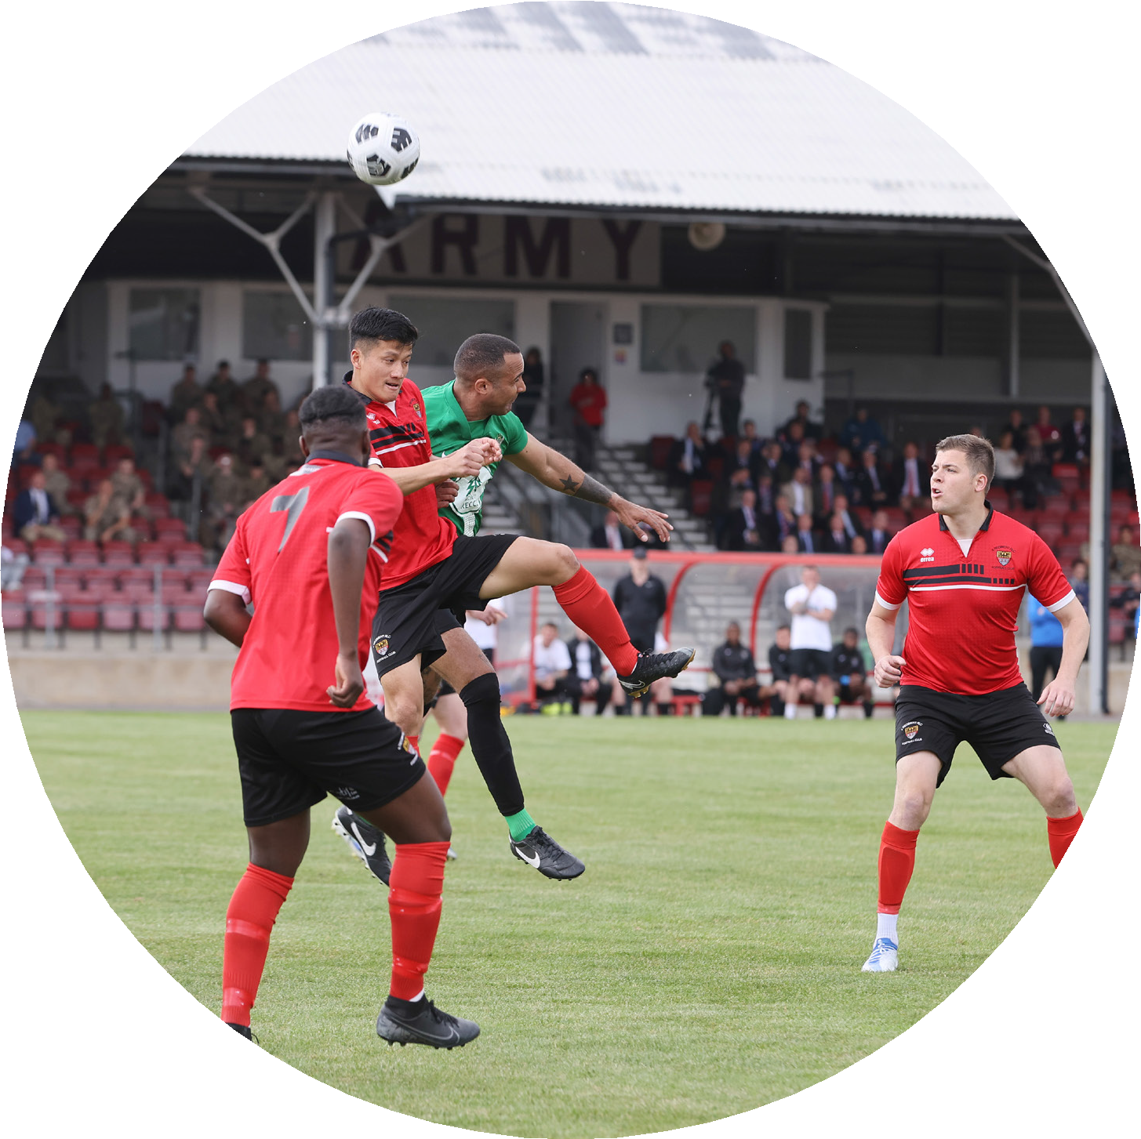
FOOTBALL
Vision & Long-Term Goals 22/23
The proposals set out in this vision reflect the experience gained from season 21-22 and the strategies and tactics that may be utilised to overcome the various challenges presented and the changing demographics and increased commitments of the British Army.
In Season 2022/23 we will continue to ensure maximum participation and registration at Unit and Corps level across all areas of the game.
Building upon the success of the Army 6s and Edwards Cup finals we will seek opportunities to play our finals at local civilian football grounds, tying such events where we can to Army sport outreach.
We will, in conjunction with our Single Service partners, expand the reach of The Soldiers’ Game to our retired community, creating the conditions for Veteran’s football at both a local and Inter Service level.
We will continue to mature our commitment to Safeguarding, Diversity and Inclusion construct in line with FA guidelines.
Through good governance and sound management will retain our position as one of the pre-eminent counties in the FA.
We will continue to expand our sponsorship base.
/ Vision & Long-Term Goals 22/23 02

Slide 3
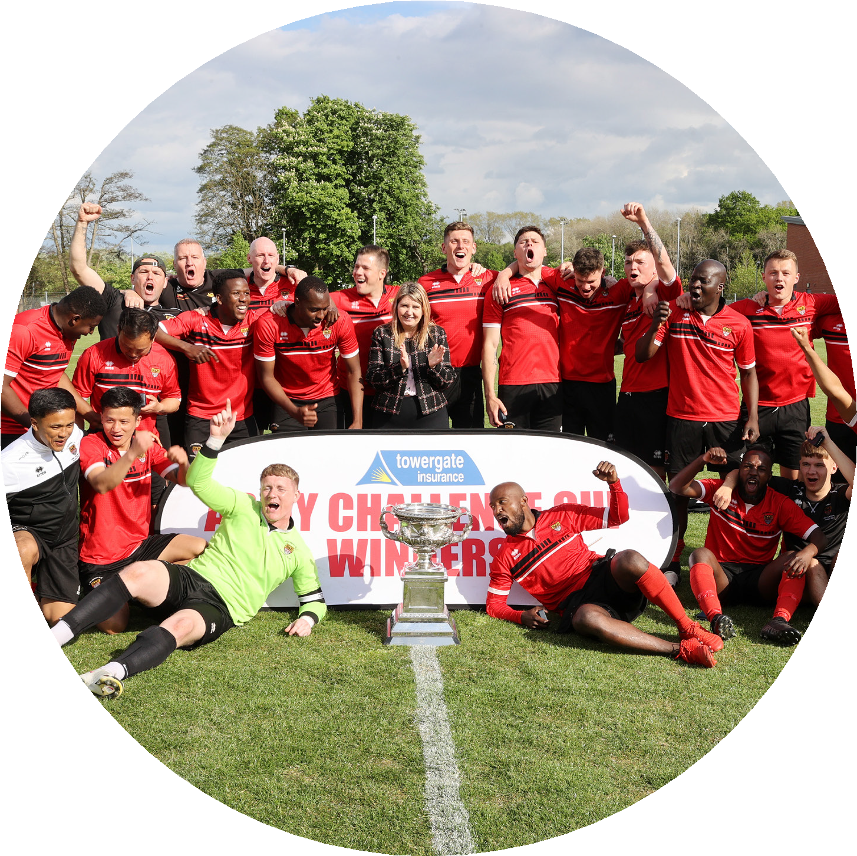
21/22 Achievements
FOOTBALL
Registered Male Players | Target: 7808 | Achieved: 11,577
Registered Female Players | Target: 918 | Achieved: 869
Referee Recruitment | Target: 49 | Achieved: 53
Referee Retention | Target: 137 | Achieved: 141
Referee Conversion | Target: 26 | Achieved: 28
Referee Progression | Target: 12 | Achieved: 31
12 Referees successfully promoted from level 7-6
10 Referees successfully promoted from level 6-5
5 Referees nominated to the Football Association for promotion to level 4, all 5 were successful
2 Officials promoted to the Step One Assistant Referee List (Vanarama National League Premier)
2 Referees successfully promoted from level 3-2B
Clubs: 202
Teams: 858 Major and Minor Units Cup Entries: 124
Reserve Cup Entries: 32
Equality Standard Foundation Stage achieved
/ 21/22 Achievements 03

Slide 4
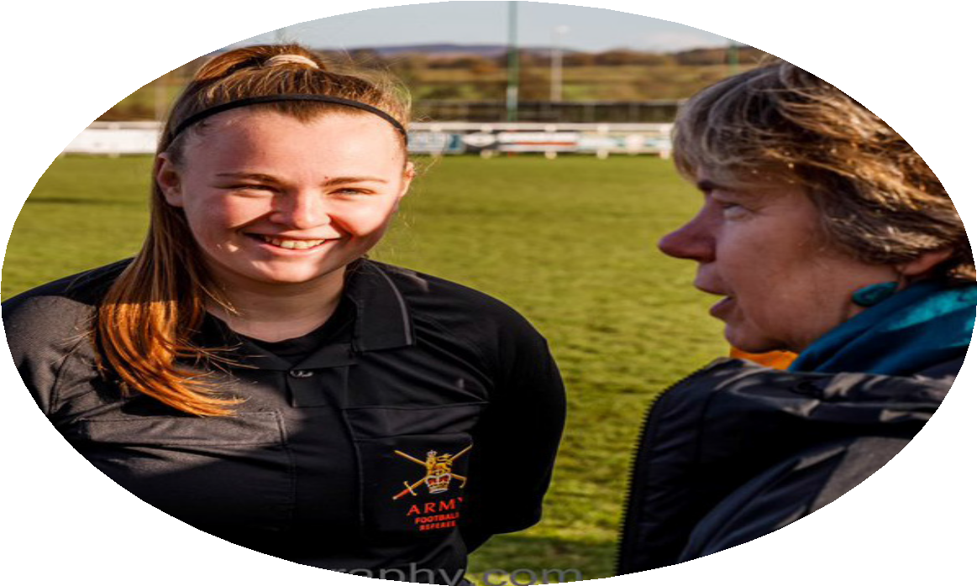
FOOTBALL
Business Plan/Long Term Goals
Develop Veteran’s Football.
Support all Trustees in the undertaking of their duties, ensure necessary MS recognition is provided.
Continue to work towards achieving the Code of Governance Compliance.
Seek further sponsorship opportunities in, as yet untapped areas of the game.
In conjunction with Army FA Secretary, ensure good governance of the Army FA office, with particular reference to finance and assurance.
Lead the development of an Engagement and Media plan for Army FA, to include social media presence and Trustee accounts.
/ Business Plan/Long Term Goals 04

Slide 5
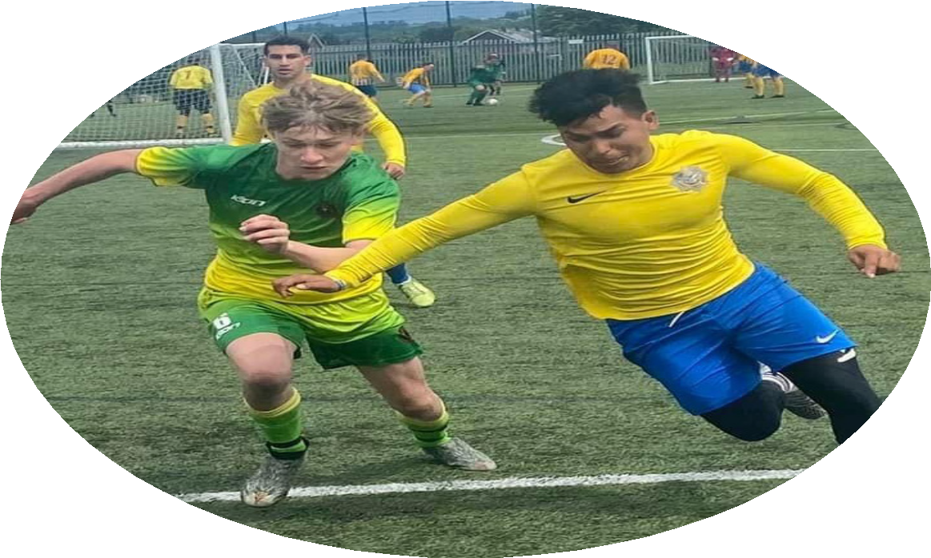
Diversity and Inclusion
Ensure awareness of FA Governing Body initiatives and events wrt D&I, setting conditions for Army FA involvement where possible.
Continue to progress Army FA’s D&I maturity commensurate with FA expectations.
Conduct benchmarking within the Sports Equality Standard Scheme with the aim of achieving the Preliminary Sports Equality Standard Award (we currently have the Foundation Level Award).
Safeguarding
Army Football is committed to safeguarding and protecting children, young people and adults at risk.
Individually and collectively, we are signed up to Affiliated Football’s Policies and Procedures and we are committed to achieving The FA’s Safeguarding Operating Standard for County FAs.
We recognise our collective and individual safeguarding responsibilities and accountabilities.
Unit (Grassroots) Football
To deliver Flexible playing opportunities for all in order to increase participation in Unit Football.
To deliver Inclusive playing opportunities for all in order to increase participation in Unit Football.
To deliver Accessible playing opportunities for all in order to increase participation in Unit Football.
Provide the support to the regional secretaries in order to fulfil the above and ensure they receive the necessary recognition.
FOOTBALL
/ Diversity and Inclusion, Safeguarding, Unit (Grassroots) Football 05

Slide 6
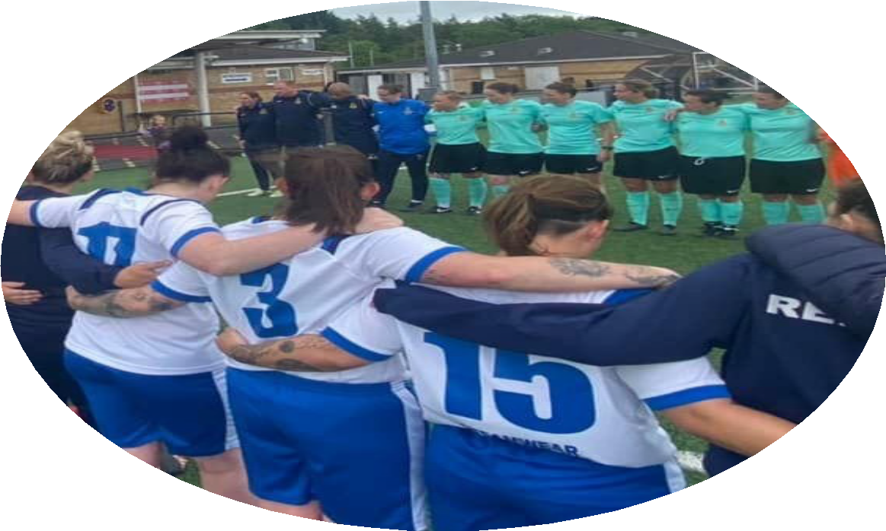
Women’s Football
FOOTBALL
Develop women’s grassroots football at Unit level whilst continuing to enhance our successes within the Inter-Corps Leagues and Cup Competitions.
Widen the reach of Army representative football across all parts of the UK through carefully selected fixtures and locations.
Representative Football
Widen the reach of Army representative football across all parts of the UK through carefully selected fixtures and locations.
Further professionalise the representative set-up and player experience
to facilitate development as players, as a team and most importantly,
as people.
Develop closer relationships across all representative sides to facilitate mentoring, learning and development opportunities and share ideas and best practice.
Army Reserves
Army Reserve football to be selected as the organisation to participate in a funded OS Defence Engagement - possibly the Balkans.
Staff succession strategy - looking at the future especially in terms of senior leadership team.
Formal recognition of the Army Reserve Men’s Master’s Team.
/ Women’s Football, Representative Football, Army Reserves 06

Slide 7
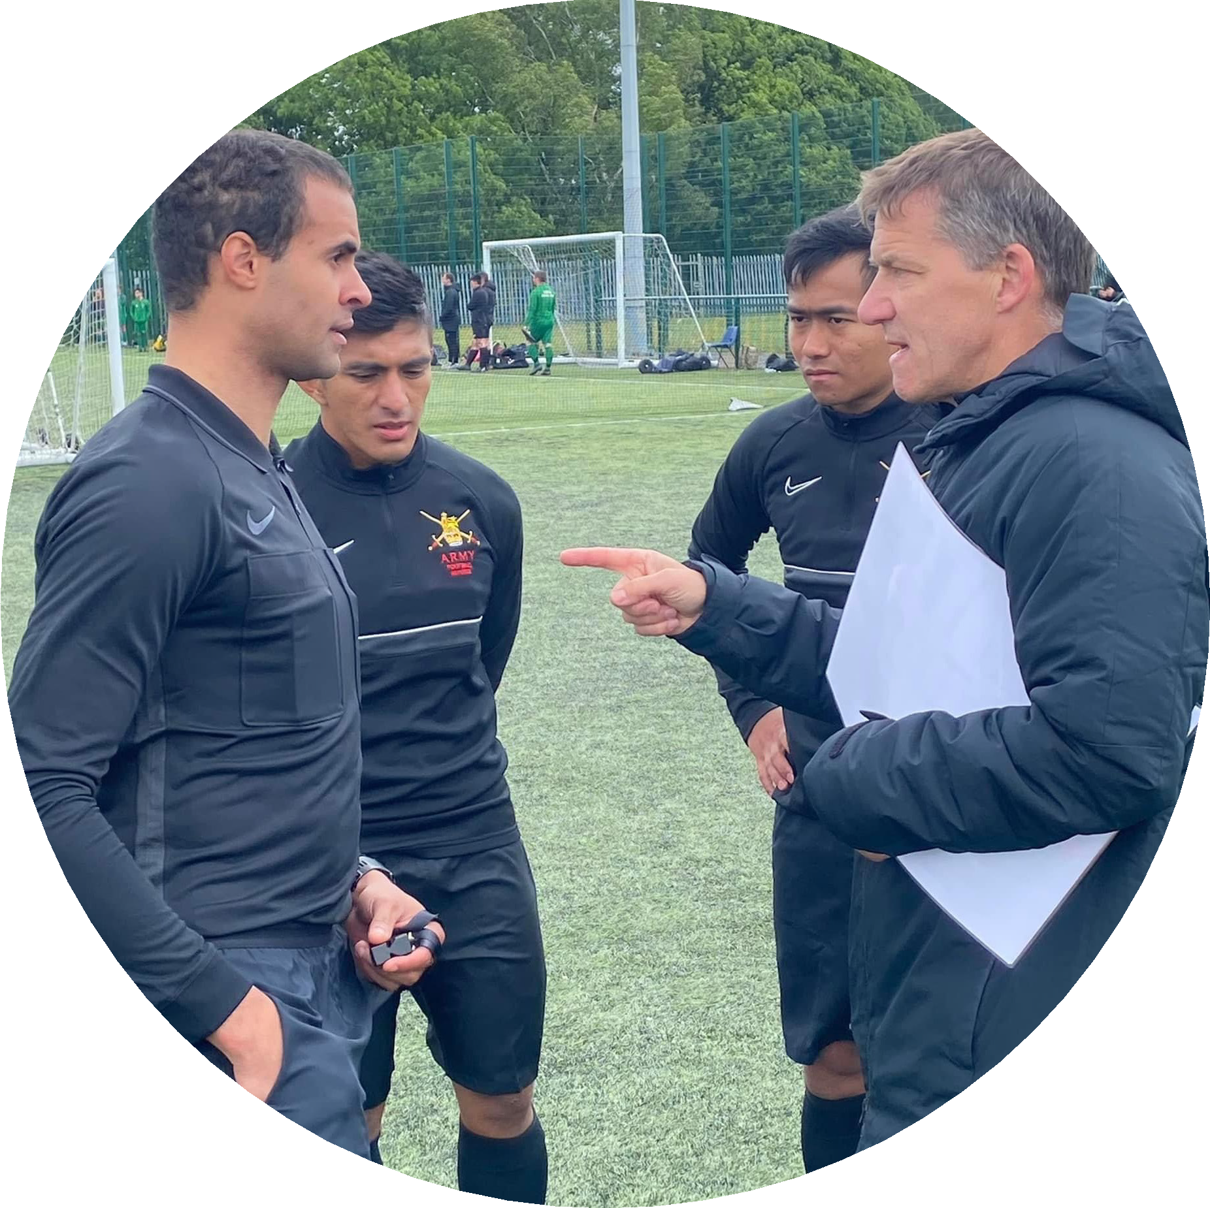
FOOTBALL
Football Development
Increased participation via more formats of the game including Futsal, 7 v 7’s, Walking Football and Master’s Football.
Coach education relevant to the requirements of the adult 11 v 11 game at Unit, Corps and Representative level.
Support and mentoring for new coaches (incorporating 11 v 11 and wider formats), with positive action to enhance diversity and the Women’s game.
Achieve the target for 70% of Adult teams to be within an England Football Accredited Club by June 2024.
/ Football Development 07

Slide 8
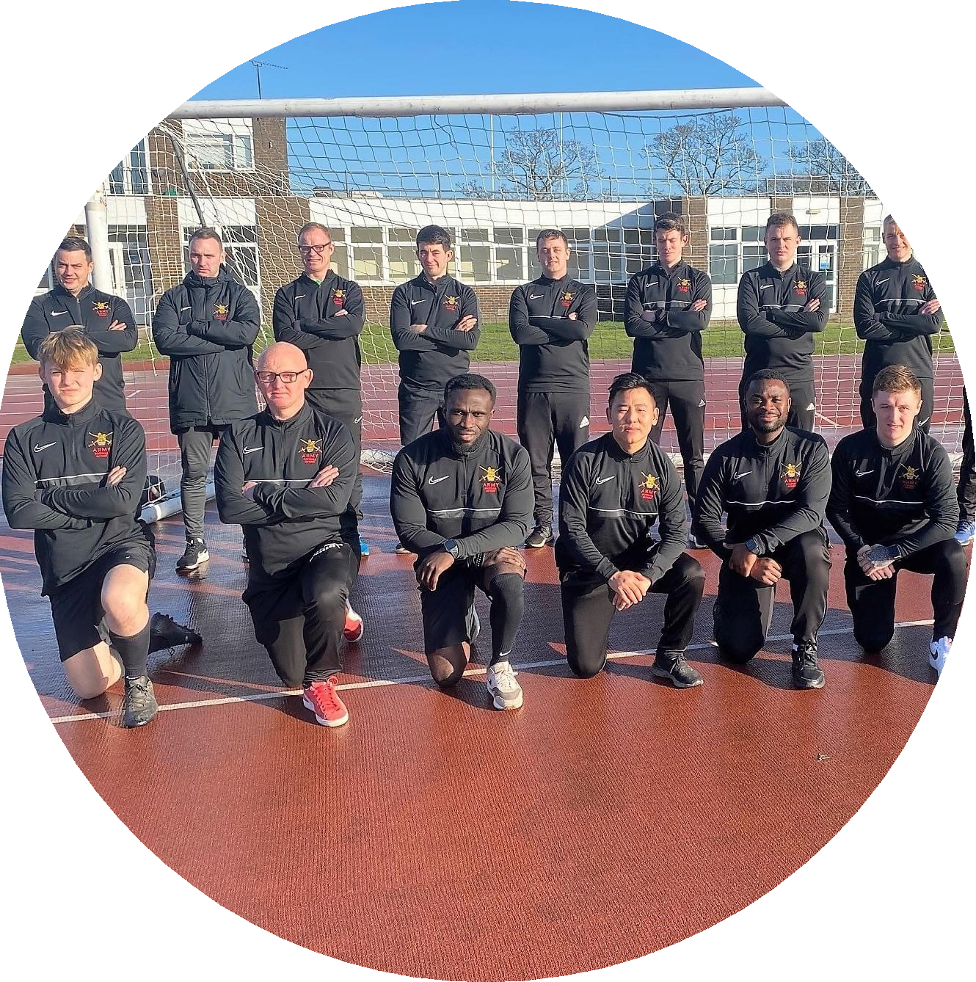
Officials
FOOTBALL
The forecasting of four referee courses for 2022/23 are confirmed and are to be organised in parallel with small sided competitions or festivals throughout the United Kingdom to enable best practice and early participation for newly qualified officials.
The continued requirement for tutors and mentors will be continuously addressed to ensure we remain at the head of delivery and mentorship.
The FA is implementing a new process for referee’s promotion with the criteria for early promotion possible for identified talented officials up to level 5(5ABC). We will continue to train our own referees to level 4.
Regional Training Development seminars will be held within regions
applicable to all officials.
With COVID hopefully behind us we will be looking to cover a very busy schedule of returning football at all levels. We will be aiming to supply 3 officials to every game at Corps and above level and are looking to appoint an all-female team for the first female Corps fixture 22/23.
/ Football Development 07

Slide 9









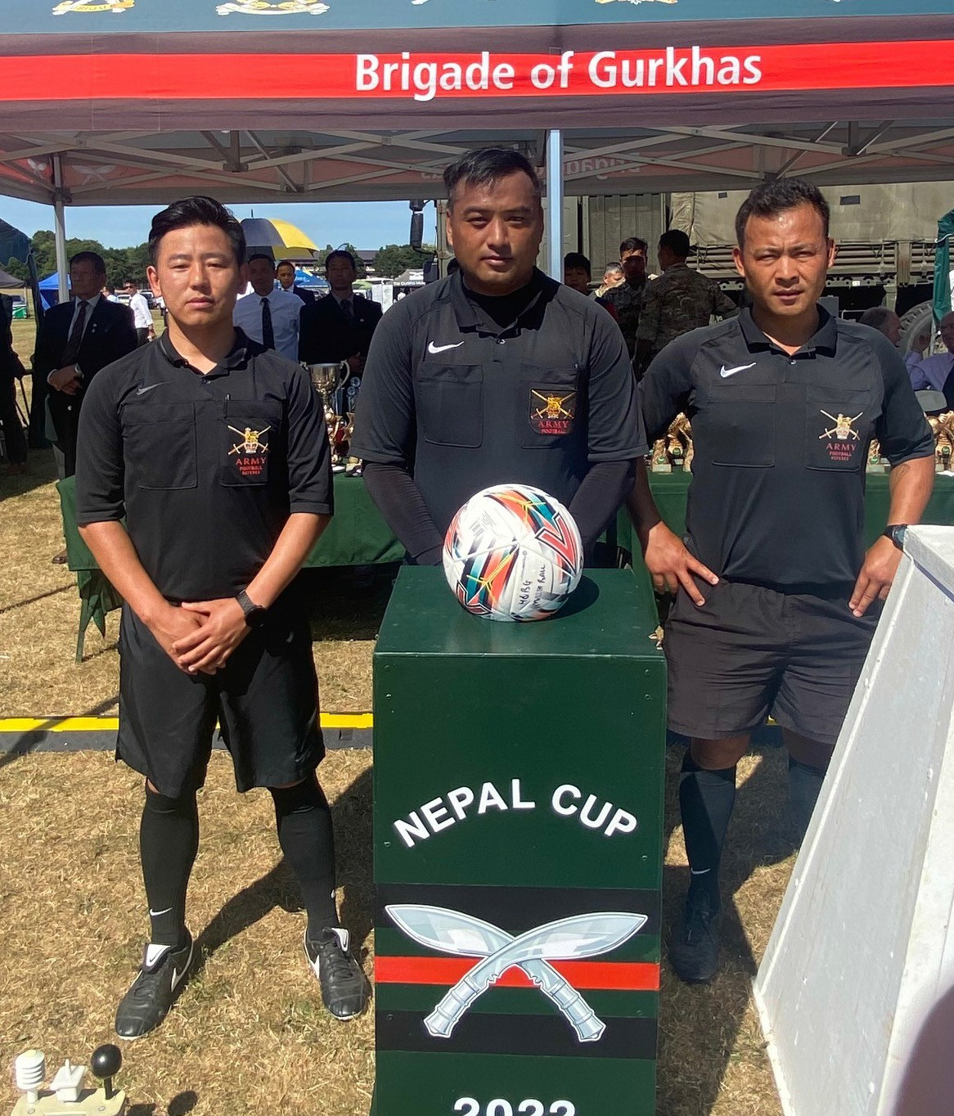
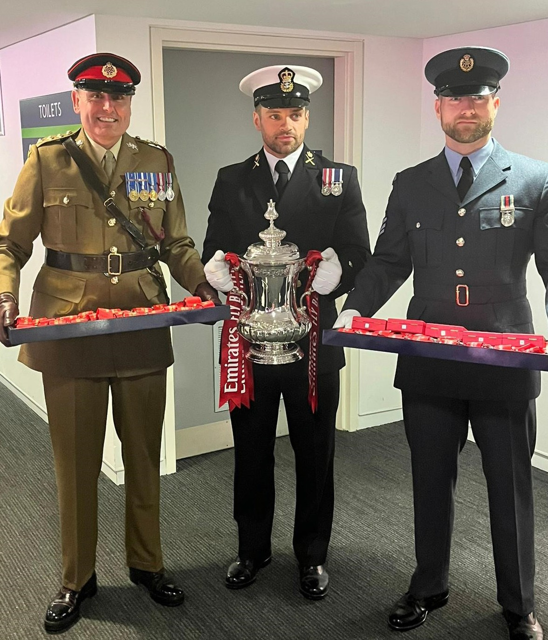
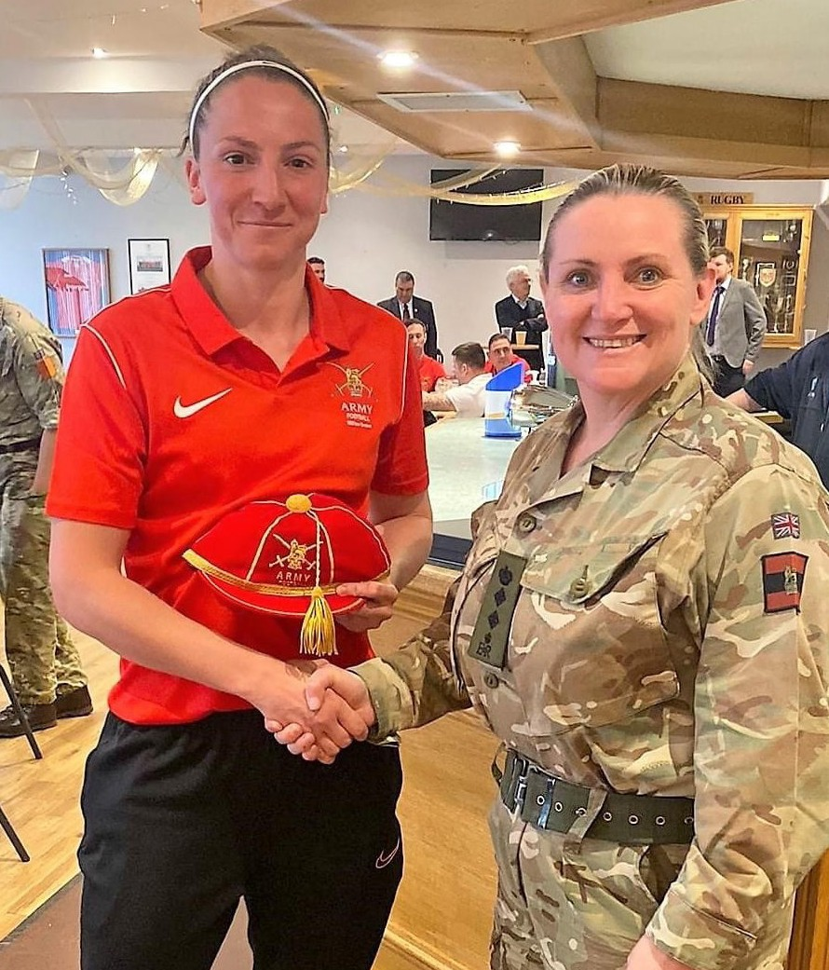
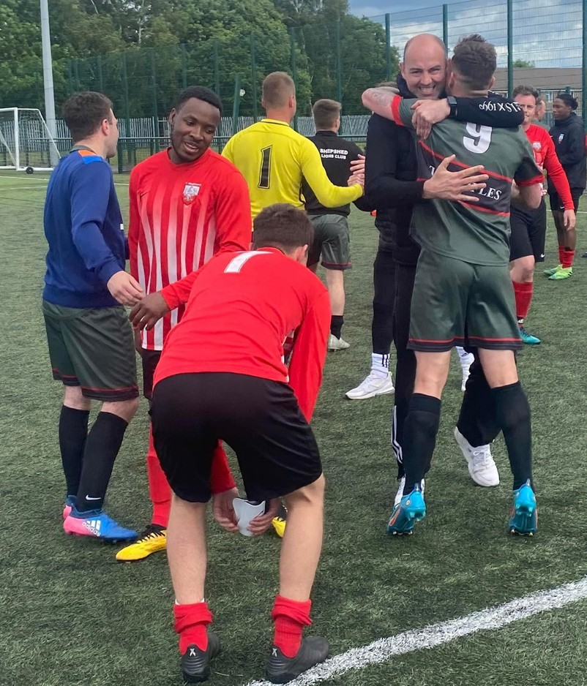
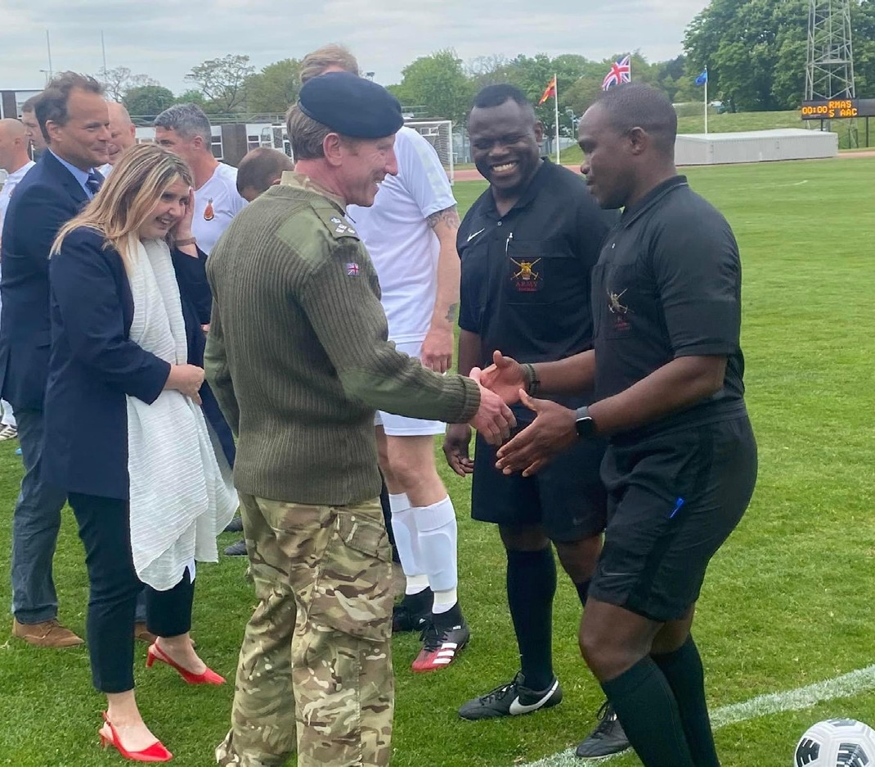
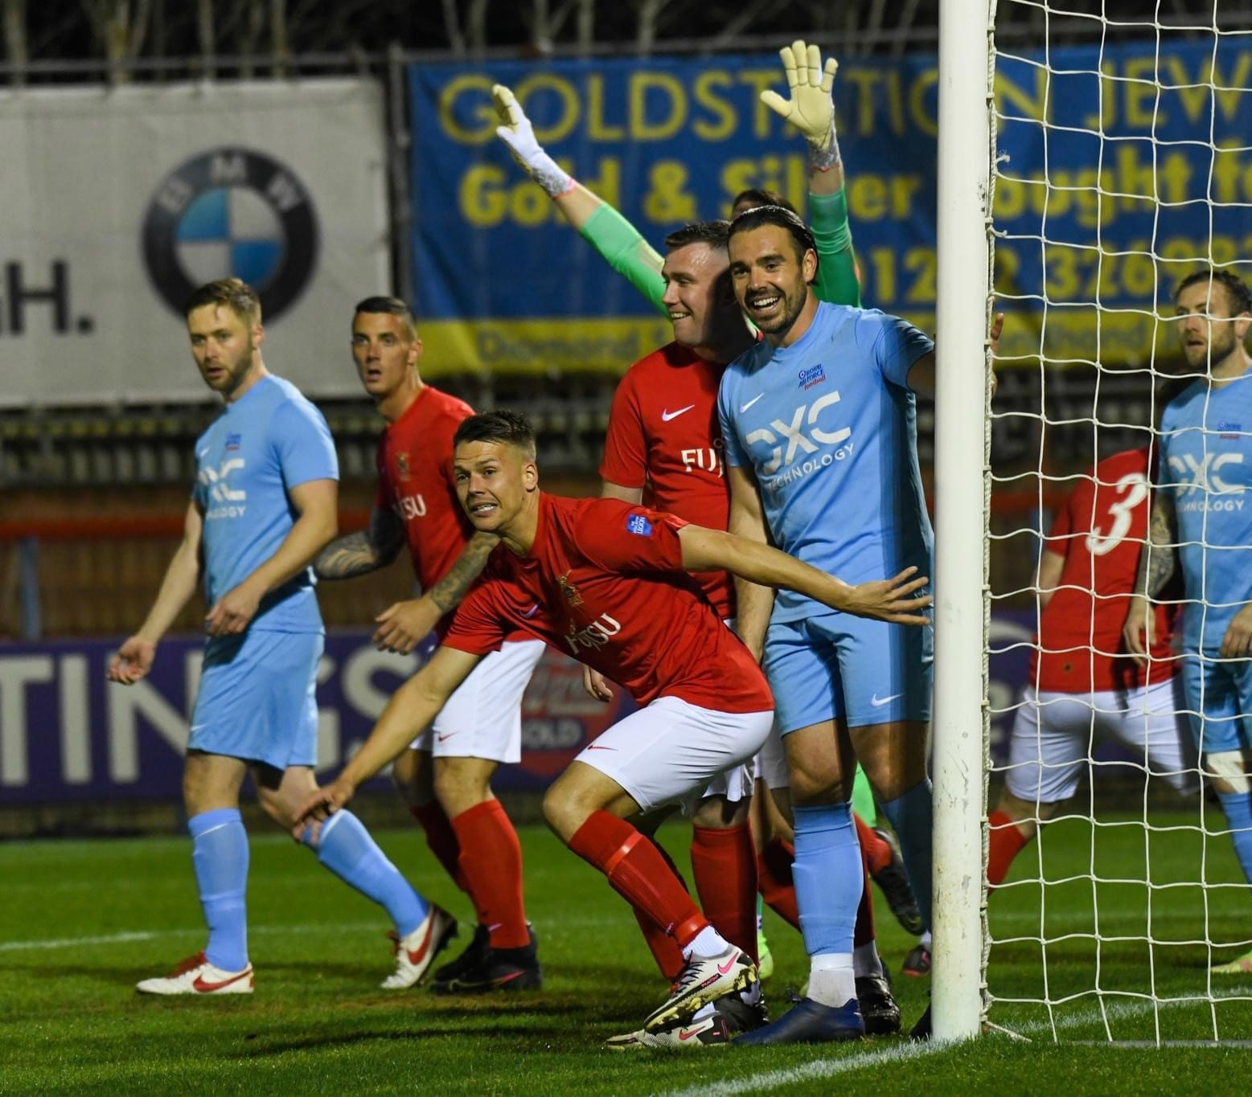
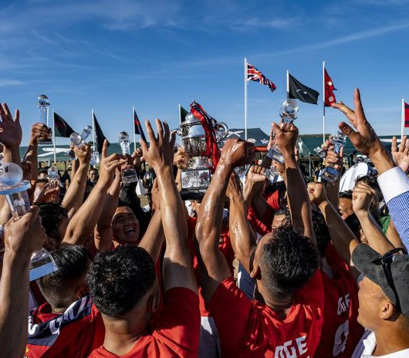
ARMY FOOTBALL IN 2021/22
Army Football in 2021/22
FOOTBALL
Army Football Association Plan – Season 2022/23
/ Army Football in 2021/22 08

Slide 10
