Slide 1
CLUB’S NAME GOES HERE
YYYY - YYYY

Slide 2
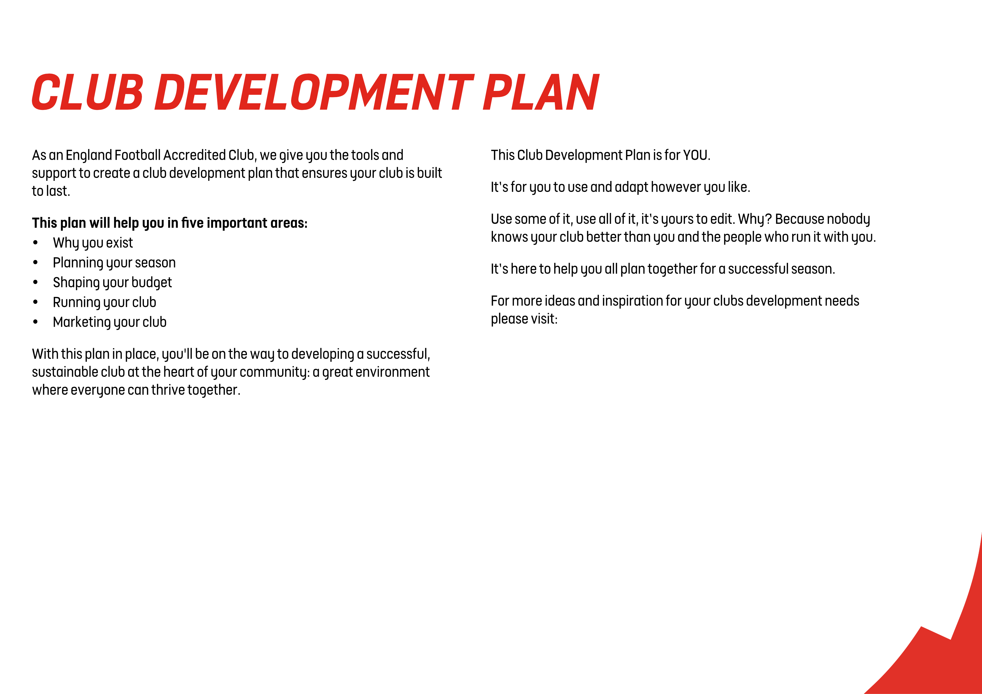
ADD CLUB’S NAME HERE
The Leagues and Clubs YouTube Hub.

Slide 3
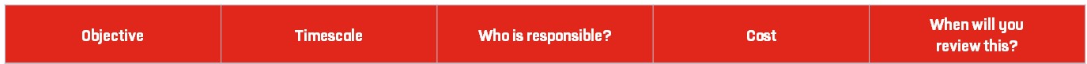
Use this planner to set goals and create tasks to complete which will
help you understand your clubs vision, and what its purpose is.
Tip: Visit our England Football League and Club Hub on YouTube
for ideas and insights to help you develop a vision and mission for your club.

Slide 4
Use this planner to set the goals and tasks you need to complete for a positive season on and off the pitch. Think about what needs to happen both monthly and weekly.
Tip: Visit our England Football League and Club Hub on YouTube for ideas and insights to help you plan ahead for a successful season.

Slide 5
Use this planner to set the goals and tasks you need to complete for a clear plan for your club budget and finances.
Tip: Visit our England Football League and Club Hub on YouTube for ideas and insights to help you with your club finances.

Slide 6
Total Projected Income
Total Projected Expenditure
Annual Balance

Slide 7
Use this planner to set goals and the tasks you need to complete to build your volunteer team. It can also be used to identify key responsibilities for those who are already playing their part in your club.
Tip: Visit our England Football League and Club Hub on YouTube for ideas and insights to help you make the most of the people at your club.

Slide 9
Use this planner to set goals and the tasks you need to complete to understand your market, and the methods you will use to listen to and communicate with them.
Tip: Visit our England Football League and Club Hub for ideas and insights into how to market your club and communicate effectively. Think about placement opportunities with local education providers, or give players within your club the opportunity to manage your online presence and social media content.

Slide 10
England Football Resources
England Football – Leagues & Clubs
England Football Accreditation
Club Learning Opportunities
YouTube - The League and Club Hub
England Football Learning
Club Resources
Club Structures Guide
Contact details for County FAs
Other Grassroots Support
Football Foundation
Football Foundation – Local Plans
Sport England
Sport England – Funding

