Slide 1

Hampshire FA FC
2024 - 2025

Slide 2
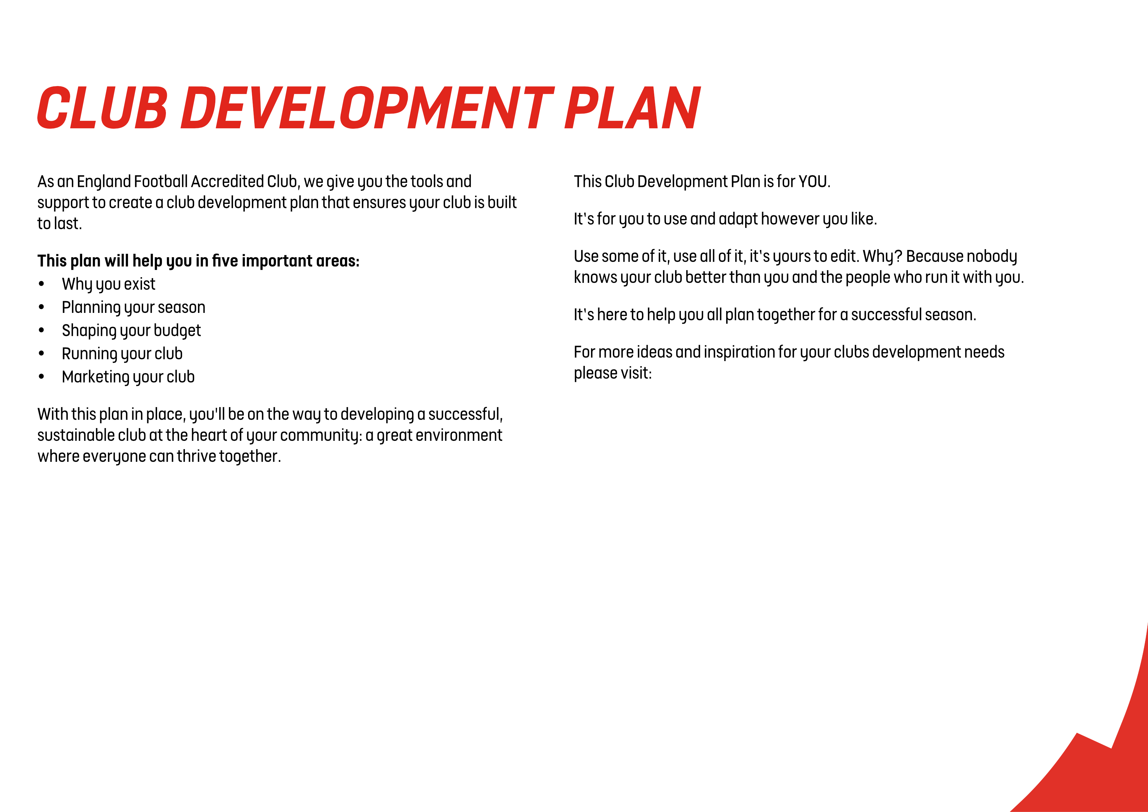
Hampshire FA FC
The Leagues and Clubs YouTube Hub.

Slide 3
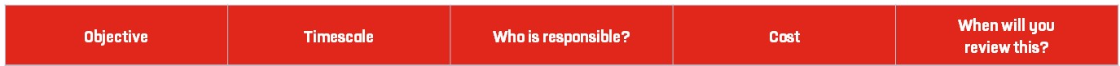
Use this planner to set goals and create tasks to complete which will
help you understand your clubs vision, and what its purpose is.
Tip: Visit our England Football League and Club Hub on YouTube
for ideas and insights to help you develop a vision and mission for your club.
To provide the opportunity for all to participate in grassroots football | 2024 – 2025 Season | The club committee | Annual club running costs | Quarterly
To allow the local community to socialise via football | 2024 – 2025 Season | The club committee | None | Weekly
To keep players fit and healthy | 2024 – 2025 Season | The club committee | None | Monthly
To improve the mental health of our players through exercise | 2024 – 2025 Season | The club committee | None | Weekly
To offer equal opportunities to play football to all male, female, non-binary and disability groups. | 2024 – 2025 Season | The club committee | None | Weekly
To assist our coaches and players in gaining FA coaching, medical, safeguarding or refereeing qualifications. | 2024 – 2025 Season | The club committee | Professional Development budget of £1000 | Monthly

Slide 4
Use this planner to set the goals and tasks you need to complete for a positive season on and off the pitch. Think about what needs to happen both monthly and weekly.
Tip: Visit our England Football League and Club Hub on YouTube for ideas and insights to help you plan ahead for a successful season.
Complete all planning for season ahead e.g. pitch bookings, coach hiring, squad membership fee etc. | 2 months | The club committee | £2000 | Annually
Affiliate with the Hampshire FA and complete our player registration. | 2 weeks | The club committee | £100 | Annually
Create a coaching syllabus for the season and update weekly if required. | Full season | The club committee | £0 | Weekly
Create monthly social calendar for players and parents/ other half's. | Full season | The club committee | £0 | Monthly
Book all courses in Safeguarding, Coaching and Medical that are required or due to expire. | Full season | The club committee | £100 - £300 | Annually and monthly
Begin advertising the club for the season ahead. | Full season | The club committee | £50 - £100 on paid promotion via social media | Weekly and daily if necessary

Slide 5
Use this planner to set the goals and tasks you need to complete for a clear plan for your club budget and finances.
Tip: Visit our England Football League and Club Hub on YouTube for ideas and insights to help you with your club finances.
Buy new kit for all teams | 1 season | The club committee | £3000 | Yearly
Pay all coaches | 1 season | The club committee | £4000 | Monthly
Ensure all coaches have access to club funding for qualifications. | 1 season | The club committee | £1000 | Quarterly
Hire new upgraded facility | 1 season | The club committee | £2000 | Weekly

Slide 6
Total Projected Income | £11,000
Total Projected Expenditure | £10,000
Annual Balance | £1,000

Slide 7
Use this planner to set goals and the tasks you need to complete to build your volunteer team. It can also be used to identify key responsibilities for those who are already playing their part in your club.
Tip: Visit our England Football League and Club Hub on YouTube for ideas and insights to help you make the most of the people at your club.
Ensure that all training and match facilities are booked on a weekly basis | Full season | The club committee | £150 | Weekly
To make our club an enjoyable place to volunteer – be appealing to new volunteers | Full season | The club committee | £0 | Annually
Provide all coaches with the adequate training/qualifications needed to be an Accredited club | Full season | The club committee | £0 | Monthly
Regularly check the Club Portal to stay on top of our Accreditation dashboard throughout the season | Full season | Club secretary | £0 | Monthly
To ensure coaches are providing positive training sessions that look to develop our players | Full season | The club committee | £0 | Monthly

Slide 8

Treasurer
Club Development Officer
Overall oversight, chairs board meeting, chief club representative, bank payment authorisation
Responsible for bank accounts, budgeting, debt collection, preparation of annual accounts
Responsible for growing and developing the clubs through FA Programmes, initiatives, funding and sponsorship
Team Manager
Club contact, arranges fixtures, head of administrative tasks, Pitch Organisation
Squad Selection, Team Selection, Football direction, Footballing Strategy, Runs training, Match -day discipline
Sponsorship Manager
To promote a safeguarding children policy, anti -bullying policy and equality policy, responsible for recruitment processes including the taking up of references and submitting FA DBS checks (getting the right people into the game).
Responsible for Sponsorship procurement, Kit design/production, Social Media, Brand development, Match Videos, Coordinate PR with Secretary

Slide 9
Use this planner to set goals and the tasks you need to complete to understand your market, and the methods you will use to listen to and communicate with them.
Tip: Visit our England Football League and Club Hub for ideas and insights into how to market your club and communicate effectively. Think about placement opportunities with local education providers, or give players within your club the opportunity to manage your online presence and social media content.
Open Instagram account | 1 day | The Club development officer | £0 | Monthly
Boost posts through paid advertisements | 1 season | The Club development officer | £50-£100 | Monthly
Contact local newspapers for exposure | 1 season | The Club development officer | £0 | Monthly
Enter all HFA./Football competitions | Ongoing | The Club development officer | £0 | Monthly
Contact local county FA to get involved with initiatives | Ongoing | The Club development officer | £0 | Monthly

Slide 10
England Football Resources
England Football – Leagues & Clubs
England Football Accreditation
Club Learning Opportunities
YouTube - The League and Club Hub
England Football Learning
Club Resources
Club Structures Guide
Contact details for County FAs
Other Grassroots Support
Football Foundation
Football Foundation – Local Plans
Sport England
Sport England – Funding

