Slide 1
Hampshire FA FC
2023 - 2024

Slide 2
Hampshire FA FC
The Leagues and Clubs YouTube Hub.

Slide 3
Use this planner to set goals and tasks you need to complete. These may focus on tasks to form the club identity, create a successful structure, ensure you have the right people in the right roles, develop effective financial planning, and to identify and secure the required facilities for your club.
Top Tips: Visit our England Football League and Club Hub on YouTube for helpful ideas and insights.
Visit our England Football Learning website for ideas to help you develop your football philosophy.
Also, take a look at our Club Structures Guide created in partnership with Muckle LLP.
Complete all planning for season ahead e.g. pitch bookings, coach hiring, squad membership fee etc. | By holding a committee meeting at the beginning of the season | Full season | The club committee | £2000 | End of season
Affiliate with the Hampshire FA and complete our player registration. | By positively communicating with the Hampshire FA operations team at the beginning of each season | 2 weeks | The club committee | £100 | End of season
Create a coaching syllabus for the season and update weekly if required. | Discuss with coaches what to include on the syllabus to develop players at different age groups | Full season | The club committee & coaches | £0 | Monthly (weekly if needed)
Book all courses in Safeguarding, Coaching and Medical that are required or due to expire. | Use the Club Portal to determine which coaches/officials have courses that are due to expire soon | Full season | The club committee | £100-£300 | Monthly and annually

Slide 4
Begin advertising the club for the season ahead. | Utilise social media and other sources of promotion | Full season | The club committee | £50-£100 promotion via social media | Weekly and daily if necessary
Keep on top of our Accreditation checklist throughout the season | By regularly checking the Club Portal – specifically the ‘dashboard’ tab | Full season | Club secretary | £0 | Monthly and weekly if necessary

Slide 6
Club of the Year 2000
Hampshire FA Cup Winners 2002
Started in 1991
Joined XX League in 2000
Purchased venue in 2005
Secured a Club House
Grown to 10 teams
Purchased new goals
Received funding grant from FA
We would like to grow a high quality and sustainable male, female and disability pathway in full and achieve 3 star accreditation.

Slide 7
Vision: We are grassroots, We are Inclusive, We are Hampshire FA
Increase Participation
Upskill coaches
Achieve player pathways
Educate parents & carers
We would like to create a youth side, starting with an U18s Male squad. This would begin our development of a full male pathway.
We will ensure all coaches hold the qualifications required for England Football Accreditation. We will ensure they are always complaint and offer additional CPD, when possible.
Through the introduction of a male team, we will begin development a pathway that allows us to maintain 2 stars.
Ensure all parents/carers attend a full induction evening. Ensure they all complete the Safeguarding Awareness course for Parents/Carers
Growth
Support all staff/members
Growth
Safeguarding all
Mission: Ensure everyone has equal opportunities to develop and grow

Slide 8
Well established, long standing club with excellent sportsmanship and friendly coaches/volunteers
They want to feel appreciated and supported, We want everyone to enjoy their time with Hampshire FA FC.
We would like to be treated with fairness and kindness, on and off the pitch.

Slide 10
CLUB STRUCTURE
CHAIRPERSON
Add Name Here
TREASURER
SECRETARY
WELFARE OFFICER
Add Name Here
Add Name Here
Add Name Here
TEAM MANAGER
Add Name Here
TEAM MANAGER
TEAM MANAGER
Add Name Here
Add Name Here

Slide 11
Large workforce
Access to important data
Large participation
Funding
Facilities
Growth of social media
Opportunity to start Wildcats, Squad & Just Play
Begin a youth side
Lack of facilities
Financial Risk
Losing volunteers

Slide 12

Treasurer
Club Development Officer
Overall oversight, chairs board meeting, chief club representative, bank payment authorisation
Responsible for bank accounts, budgeting, debt collection, preparation of annual accounts
Responsible for growing and developing the clubs through FA Programmes, initiatives, funding and sponsorship
Team Manager
Club contact, arranges fixtures, head of administrative tasks, Pitch Organisation
Squad Selection, Team Selection, Football direction, Footballing Strategy, Runs training, Match -day discipline
Sponsorship Manager
To promote a safeguarding children policy, anti -bullying policy and equality policy, responsible for recruitment processes including the taking up of references and submitting FA DBS checks (getting the right people into the game).
Responsible for Sponsorship procurement, Kit design/production, Social Media, Brand development, Match Videos, Coordinate PR with Secretary

Slide 15
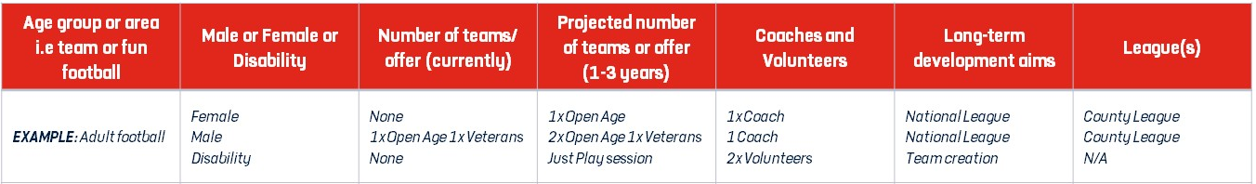
Adult Football | Male | 1 | 3 | 1x coaches | Grassroots | County League
Adult Football | Female | 1 | 3 | 2x coaches | Grassroots | County League
Adult Football | Disability | 1 | 2 | 2x coaches | Grassroots | County League

Slide 16
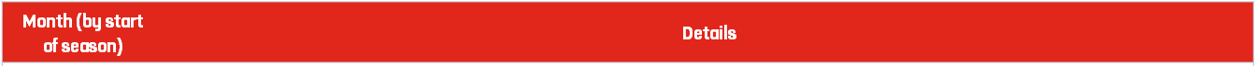
ADD IN SEASON HERE
September | All coaches to join the Hampshire FA Coaches Community
October | Complete all Safeguarding for Children Course
November | -
December | Winter break
January | -
February | Book CPD courses through Coach Development Programme of events on Hampshire FA website
March | Coach CPD event
April | -
May | Seasonal planning

Slide 18
Total Projected Income | £11,000
Total Projected Expenditure | £10,000
Annual Balance | £1,000

Slide 19
Annual Accounts Sheet | Cost (£)
Club | Hampshire FA FC
Year | 2021-2022
Income |  | Expenditure
Sponsorship | £2000 | Affiliation | £500
Subs | £2000 | Pitch Hire | £2500
Donations | £2000 | Training Hire | £2000
Grants | £2000 | Referee Fees | £2000
Trips | £2000 | Washing | £1000
 |  | Fines | £1000
Total Income | £10,000 | Total Expenditure | £9000
Opening Balance | £10,000
+ Surplus / Deficit | £1000
Total / Closing Balance | £1000

Slide 20
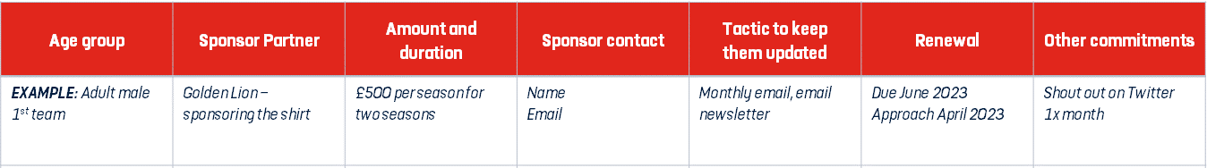
Adult Female 1st team | Starbucks – sponsoring shirt | £10000 per season for 5 seasons | John Doe John.doe@starbu cks.com | Monthly meeting | Due August 2027 | Photos on social media each week
Adult Male 1st team | Boots– sponsoring shirt | £5000 per season for 5 seasons | John Doe John.doe@Boots. com | Monthly meeting | Due August 2027 | Photos on social media each week
Adult Disability 1st team | Tk Maxx– sponsoring shirt | £10000 per season for 5 seasons | John Doe John.doe@TKMA XX.com | Monthly meeting | Due August 2027 | Photos on social media each week

Slide 22
Club contact details
Club Name | Hampshire FA FC
Club Address | Winklebury Way, Basingstoke, Hampshire, | Postcode | RG23 8BF
Telephone | 01256 853000
Access routes
For Ambulance | Main entrance
From Pitch to Ambulance | Emergency access gate
First Aider / Helper Information
Name | Max Humphreys | Mobile number | 07500 600700
For queries about this EAP | Email Max.Humphreys@hampshirefa.com
See relevant coach for First Aider on day of match | Max Humphreys
Other Information
Nearest A&E / Trauma Hospital | Basingstoke & North Hampshire Hospital Aldermaston Rd, Basingstoke, RG24 9NA
Fastest Route to A&E / Trauma Hospital | Via Ambulance
Distance and Journey time | 2.2 miles – 7 minutes
Nearest Walk-in Centre | Acorn Health Partnership, CGH Partnership –St Andrews Centre, Western Way, Basingstoke, Hampshire, RG22
Alternative Trauma Hospital | Frimley Park Hospital Portsmouth Rd, Frimley, GU16 7UJ
First Aid Equipment and Facilities
Item | Location
Defibrillator | Main reception and cafe
Stretcher | Main office
First Aid Room | Stand – near the changing rooms

Slide 23
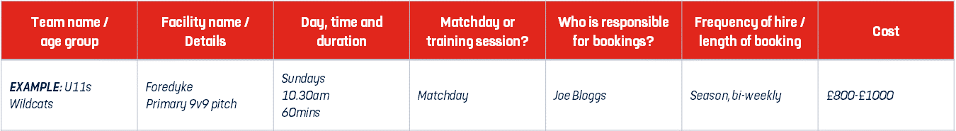
Adult Female 1st team | Winklebury football complex 11v11 pitch | Mondays 11am | Matchday | The club committee | Season | £1000
Adult Male 1st team | Winklebury football complex 11v11 pitch | Mondays 1pm | Matchday | The club committee | Season | £1000
Adult Disability 1st team | Winklebury football complex 11v11 pitch | Mondays 3pm | Matchday | The club committee | Season | £1000

Slide 27
England Football Resources
England Football – Leagues & Clubs
England Football Accreditation
Club Learning Opportunities
YouTube - The League and Club Hub
England Football Learning
Club Resources
Club Structures Guide
Contact details for County FAs
Other Grassroots Support
Football Foundation
Football Foundation – Local Plans
Sport England
Sport England – Funding

