Slide 1
Disability Football Ambassador | Hampshire FA
EMPLOYMENT APPLICATION PACK:
Disability Football Ambassador

Slide 2
Disability Football Ambassador | Hampshire FA
WHAT IS IN THIS PACK?
1 Job Advert & Description
2 Application Process
3 Full Role Profile & Person Specification
4 Supporting Information
Hampshire FA Vision, Mission & Values
If you would like to discuss the role further or have any questions on the content of this pack, please contact Glenn Brailey using the details below:
E: Glenn.Brailey@HampshireFA.com
T: 01256 853023

Slide 3
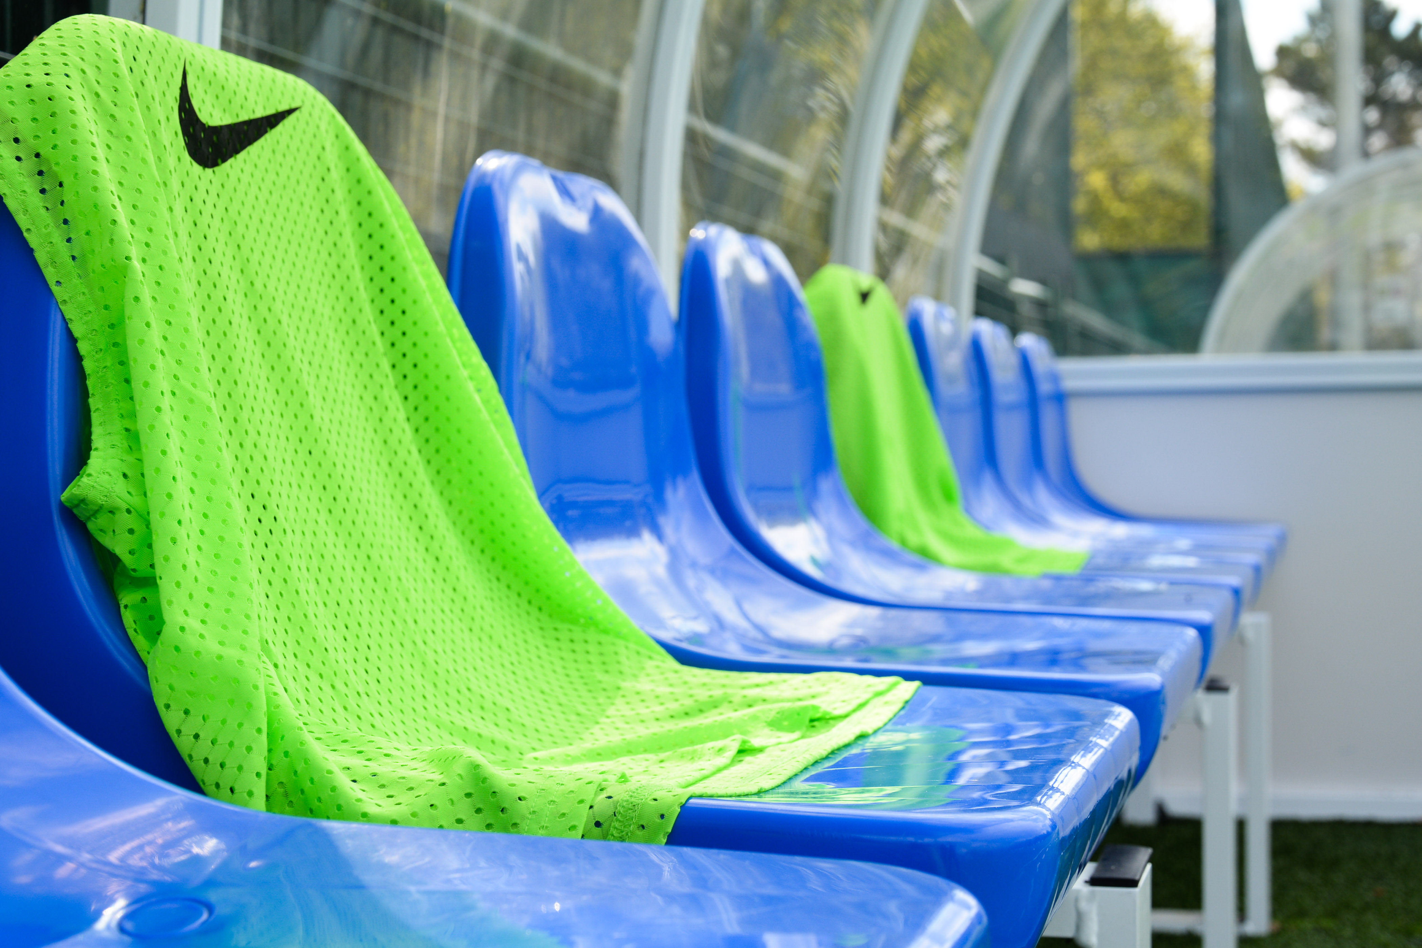
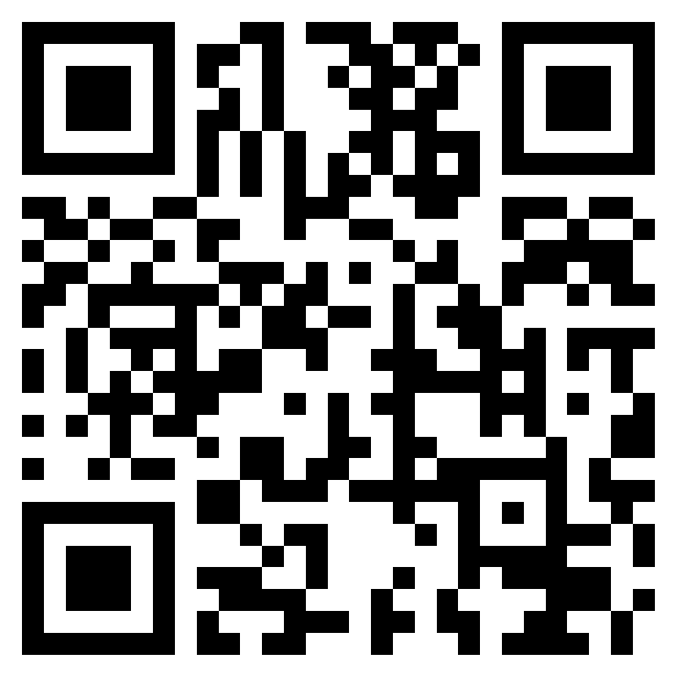
Disability Football Ambassador | Hampshire FA
Disability Football Ambassador
Salary: £25 ph Contract: Casual Contract. 50 hours per contract.
What is the role?
Hampshire FA are looking for an enthusiastic and experienced individual(s) with a passion for grassroots football to join the team as a DISABILITY FOOTBALL AMBASSADORS.
The successful candidates will be responsible for supporting grassroots football clubs in applying their learnings from the Disability Football Training to create and implement their own Disability Football game plan, creating more opportunities for people with disabilities.
What will you do?
Drive engagement at every level of clubs to maximise and sustain these opportunities for disabled people.
Signpost and help clubs access relevant support.
Support clubs to build and sustain relationships with relevant local partners.
Collaborate with County FA staff, national FA staff, and other grassroots football stakeholders.
Maintain records of the support being provided to grassroots club.
What do you need?
The ability to build and maintain working relationships
The ability to work independently and as part of a team
The ability to work around challenges by developing new solutions
The determination to fail better - try > fail > learn > repeat
Applications by Friday 18th August 2023:
To apply, complete the online application form. Interviews will take place on Thursday 24th August.
Access the form by scanning this QR code with a smartphone:
Or via : Disability Ambassador Application Form

Slide 4
Disability Football Ambassador | Hampshire FA
APPLICATION PROCESS
Please see the accompanying advert & job description, full role profile & person specification and supporting information. These should be used as a guide when completing the application form. The application form can be made available in alternative formats and should this be required please contact us to advise of your requirements.
Please complete the application form by clicking here.
If shortlisted, you will be invited to interview for the role. The exact format of the interview will be confirmed with notice of the interview and reasonable adjustments can be made to accommodate any needs you may have.
Hampshire FA have an understanding and commitment to equality, diversity and inclusion and would be grateful if you could complete an optional, anonymous equality monitoring form as part of your application. By completing this questionnaire, you are helping us to plan for the future and ensure we recruit from a diverse pool of applicants that are appropriate and relevant to the community we serve.
Please complete the equality monitoring form by clicking here.
Hampshire FA are committed to safeguarding children and adults at risk. Due to the nature of this role, the successful candidate will be required to undertake a Disclosure and Barring Service (DBS) check through the FA DBS process. The possession of a criminal record will not necessarily prevent an applicant from obtaining this post, as all cases are judged individually according to the nature of the role and information provided.
Key Dates:
Application Closing date – Friday 18th August 2023
Interview date –Thursday 24th August 2023 (in person @ Winklebury Football Complex, RG23 8BF)

Slide 5
Disability Football Ambassador | Hampshire FA
FULL ROLE PROFILE & PERSON SPECIFICATION
Hampshire FA are an equal opportunities employer and actively encourage people from diverse backgrounds to apply for all roles.
Job title​ | Disability Football Ambassador
Reports to​ | Male Recreational Football Development Officer and Disability Lead
Job purpose(s)​ | Support 2 and 3-star England Accredited Clubs to apply the key learnings from the Disability Club Training to create their own Disability Football Game Plan. Support the club to implement this Game Plan to provide more club-based opportunities for disabled people to play, coach and/or volunteer.
Direct reports​ | N/A
Location​ | Winklebury Football Complex, Basingstoke, RG23 8BF ​ (mix of office/remote working – Including travel to Hampshire based clubs)
Working hours​ | 50 hours per contract. Hours of work will vary and may include evenings and weekends
Contract type ​ | Casual Worker
Salary​ | £25ph
Roles & Responsibilities:​
Representing Hampshire FA​ | Actively deliver against Company Values and Behaviours and the Customer Charter​ Actively support the challenging of all forms of discrimination in football​
Support Clubs | Engage with selected 2 and 3-star England Football Accredited clubs following their completion of the Disability Friendly Club Training. Support in the creation of a bespoke disability game plan which will outline new club-based opportunities for disabled people which may include new playing provisions, coaching opportunities, and/or volunteering roles. Drive engagement at every level of clubs to maximise and sustain these opportunities for disabled people. Support clubs to build and sustain relationships with relevant local partners such as charitable organisations, disability support groups, educational establishments, alongside other key partners to promote the new opportunities. Help clubs access relevant support including funding and coach development opportunities with support from the County FA. To collaborate with County FA staff, national FA staff, disability football coach mentors, external partners, and wider members of the grassroots delivery team workforce. Maintain records of the support being provided to grassroots clubs with the aim of providing clarity on work programmes, development opportunities and sharing of good practice.
Safeguarding ​ | Support maintenance of FA safeguarding 365 operating standards and ensure that the safeguarding of young and vulnerable people is prioritised at all times​ Carry out appropriate Safeguarding Risk Assessments for any activities delivered​ Ensure that all participants and their families are aware of how/encouraged to report any safeguarding concerns they might have​ Listen to and consult with under-18s on their experiences of grassroots football as part of the Hampshire FA youth engagement strategy ​

Slide 6
Disability Football Ambassador | Hampshire FA
SUPPORTING INFORMATION
Hampshire FA Vision, Mission & Values
Vision
Using the power of football to build a better future for all communities in Hampshire.
Mission
Set strong foundations for all of Hampshire football to Recover stronger by enabling & supporting a bespoke Hampshire FA workforce.
Deliver an expanding network of Hub Sites, connected with & fully engaging their local communities.
Put Youth Engagement at the centre of all delivery & ensure young people are heard, safeguarded & empowered to influence the future.
Re-invigorate Equality, Diversity & Inclusion through new IAG/local engagement structure & governance standards.
Undertake a full business Culture review to embed inclusivity, safeguarding & quality community service throughout all we do.
Values
Progressive - Respect - Inclusion - Determined - Excellence

