Slide 1
Lancashire FA Activity Pack
Create your own football team!
And lots of fun, football related activities inside!

Slide 2
What will you call your team?
And what stadium will they play at?
HOME STADIUM:

Slide 3
Use one of our templates, or use the box in the middle to draw your own!

Slide 4
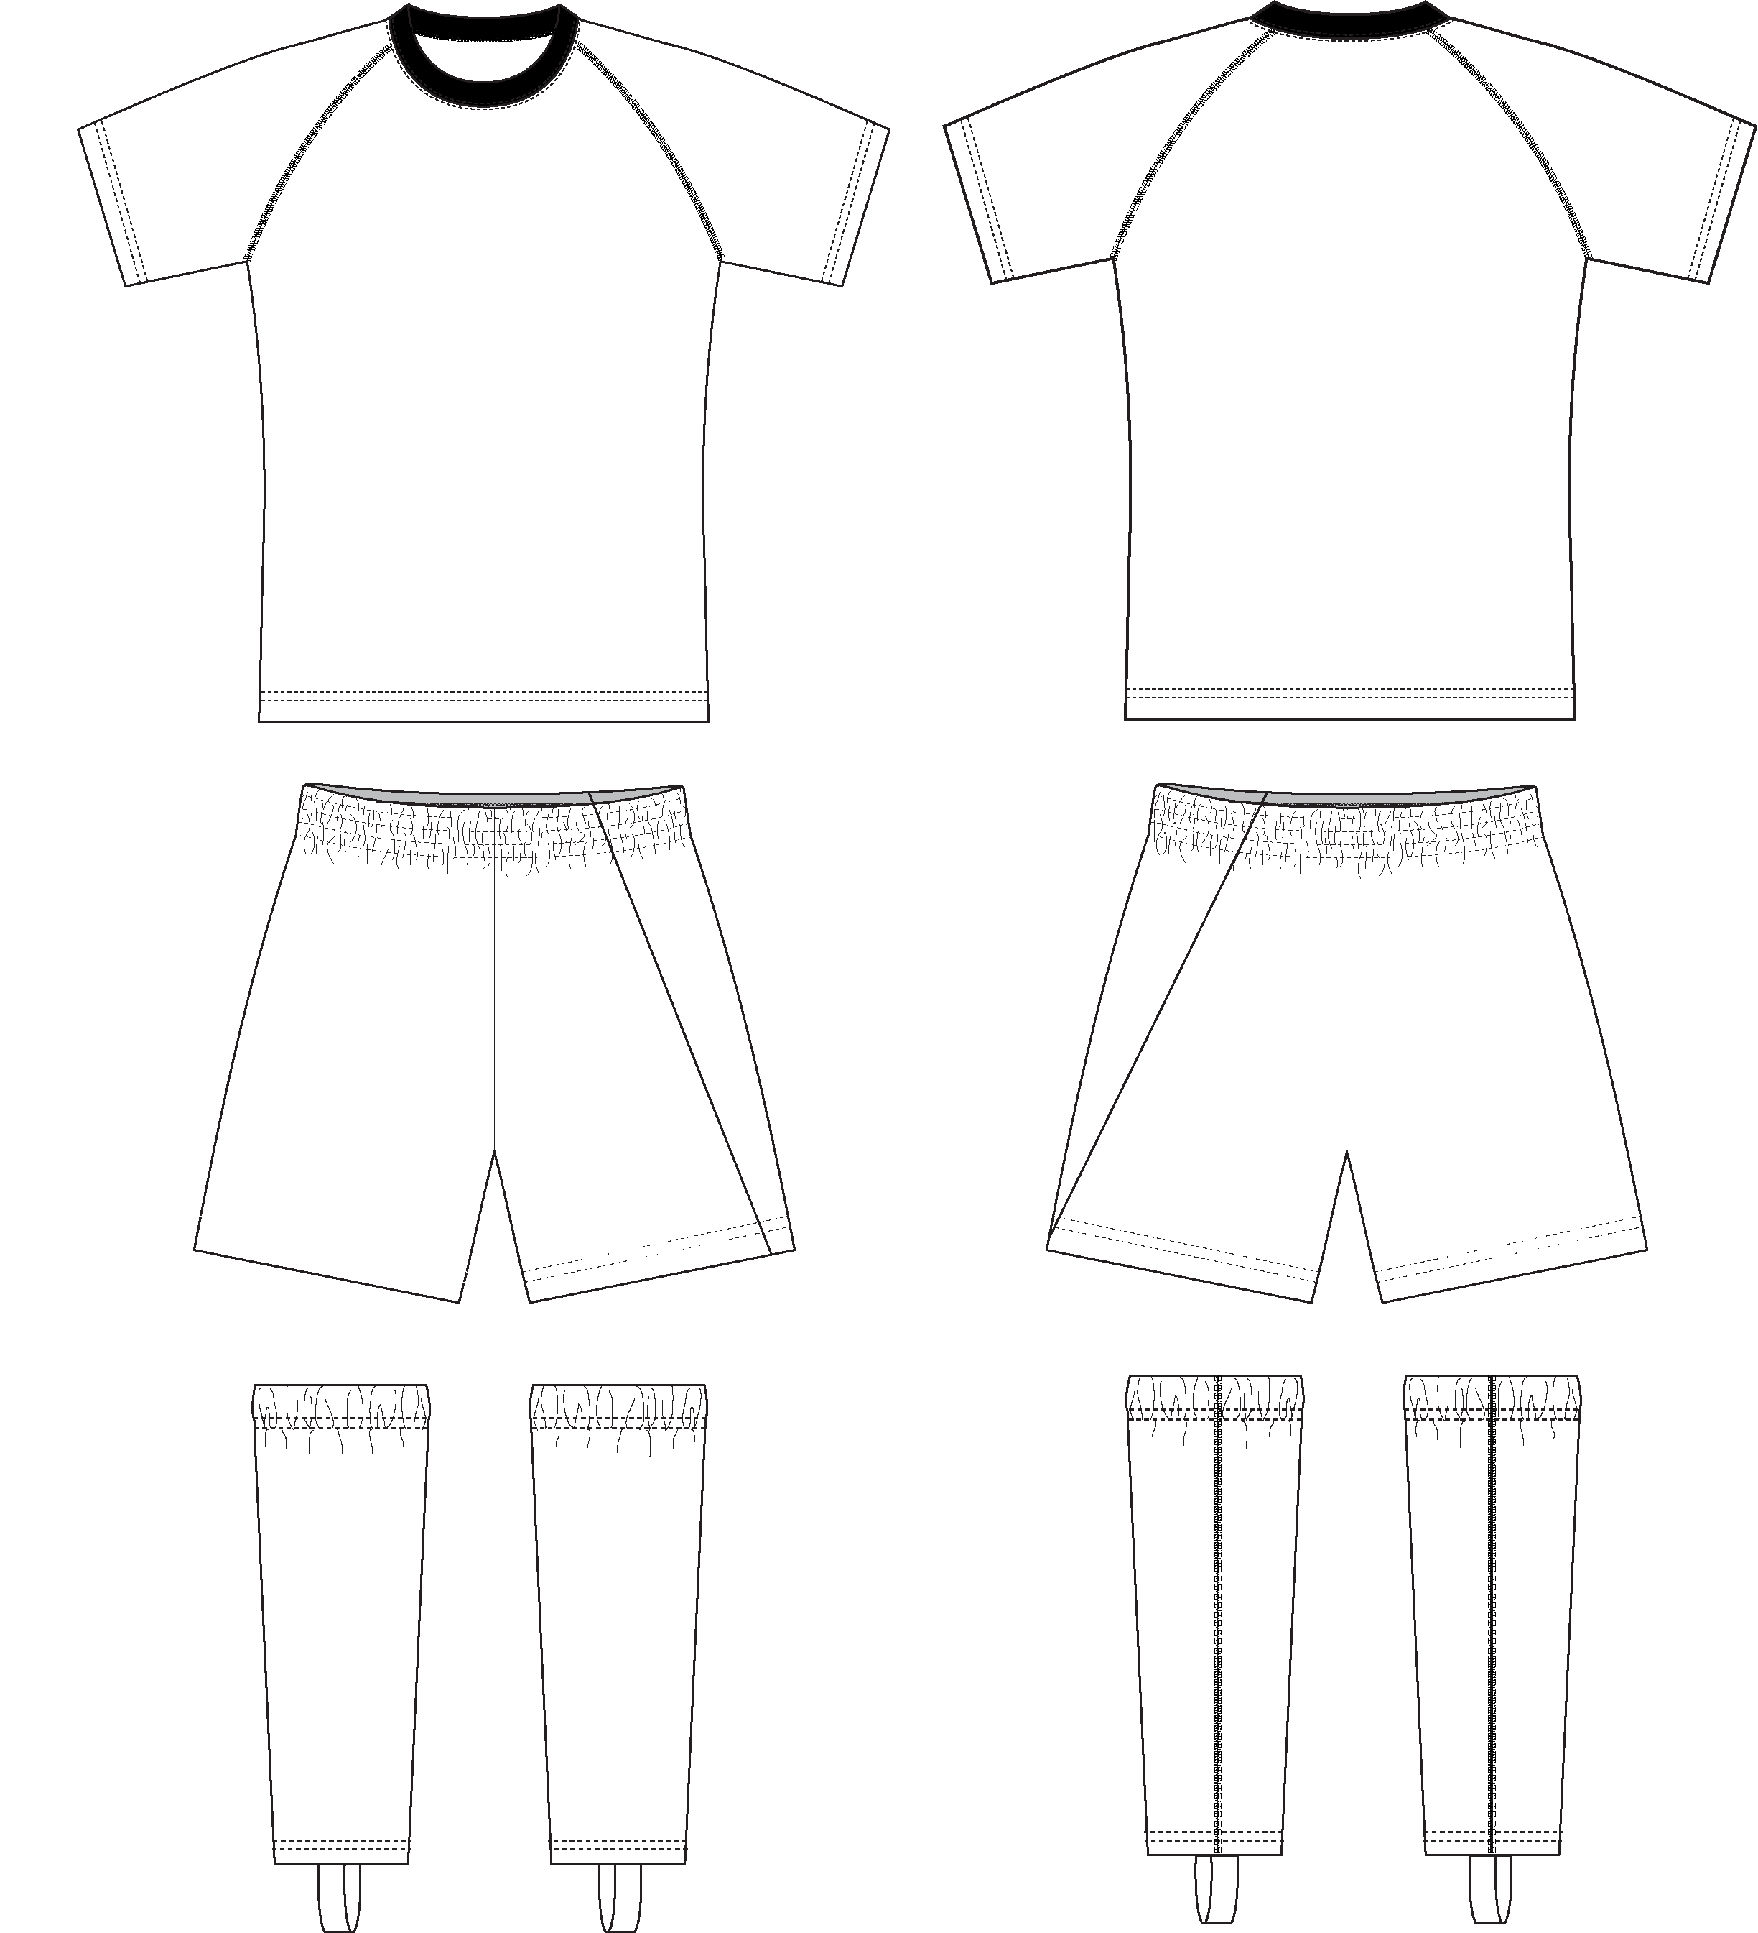
Colour in your home kit, and don’t forget to add your badge!

Slide 5
Colour in your away kit! Try using colours from your badge, or go completely wild!

Slide 6
What colours will you choose?

Slide 7
Choose whatever colours you like to make it stand out!

Slide 8
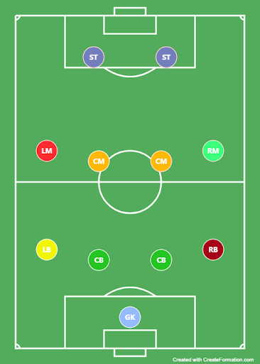
Use players from your favourite teams, or make a team using your friends! And don’t forget to fill in your substitutes below!
Write their surnames below their positions

Slide 9
See if you can answer these questions correctly! (The answers will be at the back of this pack)
3. At the professional level, how many players are on the pitch from each team?
5. The referee usually wears what colour shirt?
1. Where did the game of football begin?
9
12
13
11
10
Blue and Gold
Orange and White
Black and White
Red and Green
Purple and Black
America
Italy
England
Brazil
Japan
4. Who is the only player who can use their hands during the game?
6. If you receive a red card, what happens?
2. What is another name for football?
Ping Pong
Bocce
Soccer
Jai-Alai
Red Rover
A warning
Asked to leave the pitch
A free kick
A throw-in
Nothing
Goalkeeper
Defender
Striker
Midfielder
Linesman
Ping Pong
Bocce
Soccer
Jai-Alai
Red Rover

Slide 10
SCORED A GOAL | CAME ON AS A SUB | BEEN A GOAL KEEPER | TAKEN A CORNER
MADE A CHALLENGE | HEADER | TAKEN A PENALTY | BEEN CARDED
TAKEN A FREE KICK | BEEN A LINESMAN | COMPLETED A PASS | PLAYED A FULL MATCH
DEFENCEWALL | DRIBBLED THE BALL | MESSI BODY FEINT | THROW IN
Cross off what you have done while playing football!
See if you can get Bingo!

Slide 11
Football
Substitute
Boots
Stadium
Referee
Card
Flag
Bench
Player
Striker
Defender
Goal
Penalty
Corner
Kick
Manager
Coach
Midfield
Offside
Trophy
Words can be backwards and diagonal too!

Slide 12
Can you guess which team these football badges belong to? (Answers will be at the back of this pack!)
4.
5.
1.
2.
3.
8.
10.
6.
7.
9.

Slide 13
Quiz Answers:
C
C
D
A
C
B
Guess the Team Answers:
Aston Villa
Chelsea
Manchester United
Birmingham City
Arsenal
West Bromwich Albion
Coventry City
Wolverhampton Wanderers
Walsall FC
Burton Albion

