Slide 1


Lincolnshire FA Club & League Forum
Behaviour within Grassroots Football

Slide 2


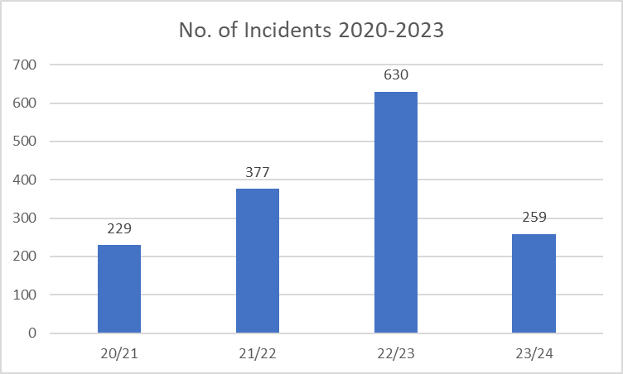
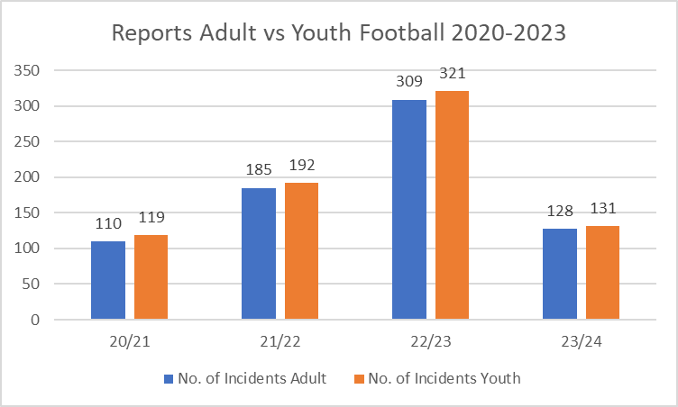
Behaviour in Lincolnshire
247
113
157
Red bars indicate the number of incidents reported by 30th November in each season
Behaviours in Grassroots Football

Slide 3
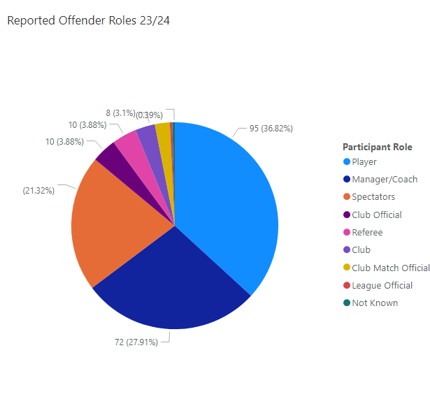
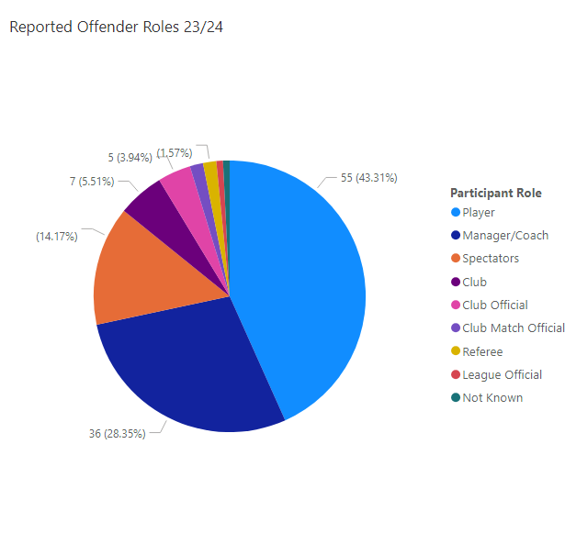
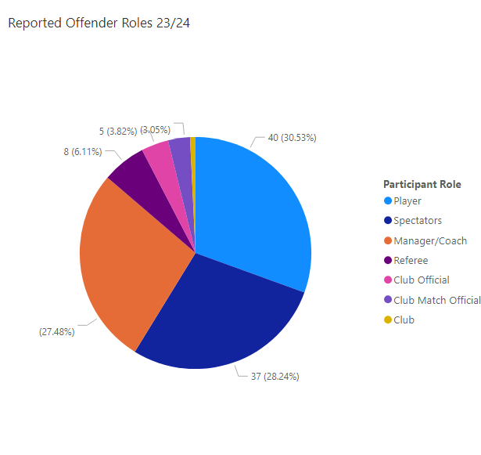
Areas of Focus
Offender Roles in Football 23/24
Offender Roles in Adult Football 23/24
Offender Roles in Youth Football 23/24
Behaviours in Grassroots Football
Notes:
Left to right offender roles across football, Offender roles in Adult Football, Offender Roles in Youth Football

Slide 4
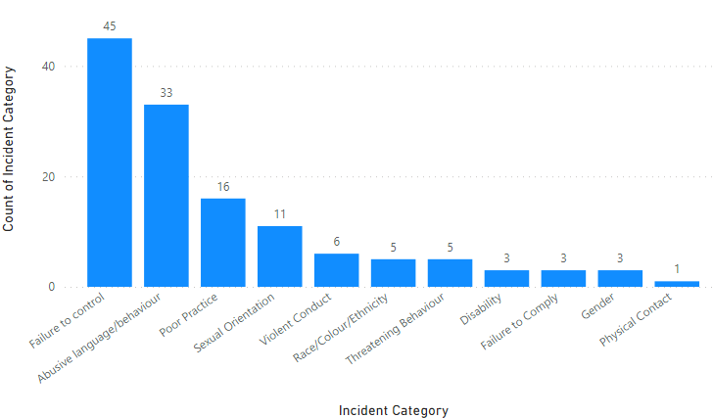
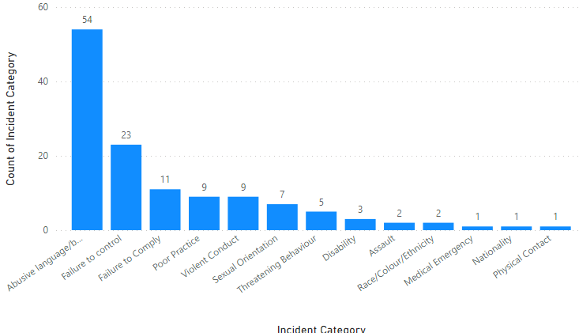
Areas of Focus
Youth Football Incidents 23/24 Season
Adult Football Incidents 23/24 Season
Behaviours In Grassroots Football
Notes:
Biggest challenge in youth football – Failure to control linked to spectator behaviour followed by conduct towards referees

Slide 5
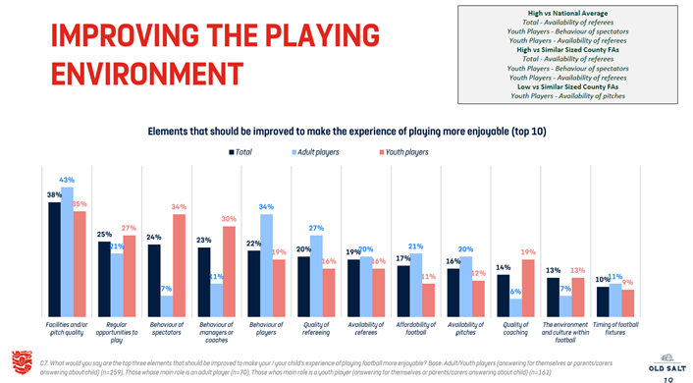
Your Feedback
Behaviours In Grassroots Football
Notes:
Left to right offender roles across football, Offender roles in Adult Football, Offender Roles in Youth Football

Slide 6
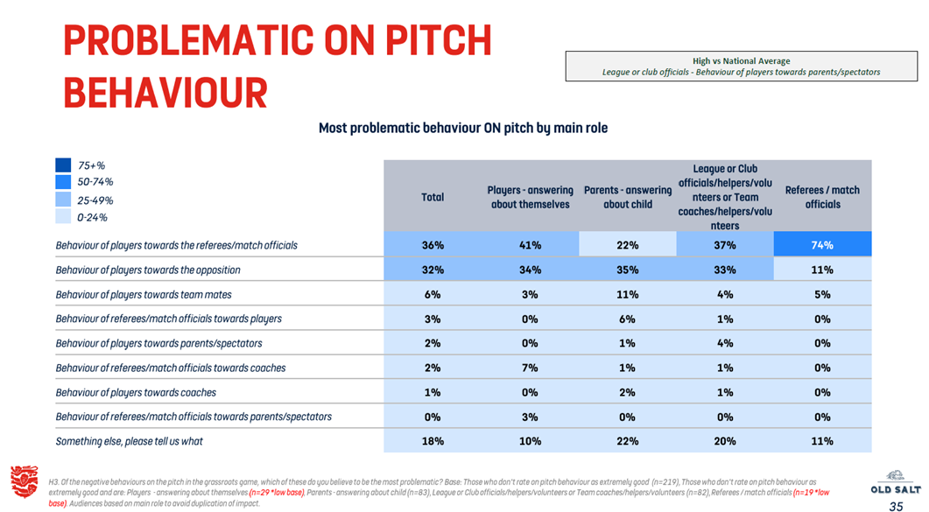
Your Feedback
Behaviours In Grassroots Football
Notes:
Left to right offender roles across football, Offender roles in Adult Football, Offender Roles in Youth Football

Slide 7
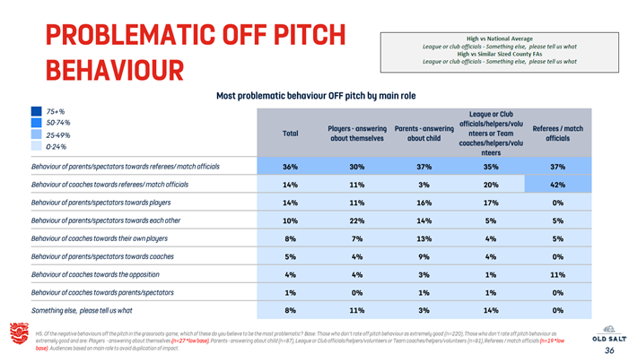
Your Feedback
Behaviours in Grassroots Football
Notes:
Left to right offender roles across football, Offender roles in Adult Football, Offender Roles in Youth Football

Slide 8

Questions & Feedback
TITLE OF PRESENTATION

Slide 9

Question 1
Points to consider:
If we asked all the clubs in the county, where they have had behaviour/conduct issues – how many would say your club?
Statistically, mid-teen age groups at grassroots, are where we see the highest proportion of coach & spectator issues
Statistically, player conduct towards a match official in open age football is the most frequent behaviour/conduct issue
When considering behaviour and conduct across grassroots and open age football in Lincolnshire…..
Who or what do you think is the problem?
Answers on Slido please
Behaviours in Grassroots Football

Slide 10


“The ref is the problem”
“If we’d had a stronger ref, this wouldn’t have happened”
The need to compartmentalise
(Question 2) In football terms, what do you consider to be abuse?
There must be a consideration of where the line of emotional control is
Is a parent/spectator shouting (abuse or otherwise) at a match official past that line?
Is a coach shouting (abuse or otherwise) at a match official past the line?
Is a player shouting (abuse or otherwise) at a match official past the line?
The standard of officiating
There needs to be an acceptance that a proportion of grassroots games are officiated by junior referees
They will be going through a development phase themselves
It is the job of the CFA RDO, referee support leads and leagues to support that referee to develop, grow and improve
Behaviours in Grassroots Football
Notes:
Club Marks for Refs:
Lincoln Sunday League – 81
Lincolnshire League – 85
Boston Saturday League – 79
Scunthorpe Saturday League - 72

Slide 11
Question 3
Club Discipline Transparency
Are clubs honest and transparent enough around their own discipline?
If they are not, does this influence Club Culture?
Points to consider:
Do clubs just ‘go through the process’ of corresponding to discipline, without considering the deeper roots or frequency of issues within their own club?
If a club feels like there is a matter serious enough to constitute a counter allegation, why was this not reported to the FA in the first place?
Are counter allegations used as a deflection or defence, to the actual issue?
Behaviours in Grassroots Football

Slide 12
Solutions already Implemented
Respect & Behaviours workshops for coaches.
6 Delivered to clubs Season 23/24 with 106 coaches attending
Outlines expectations of coaches on a match day and the role they play in creating a positive football environment
Safeguarding Validation Visits
Matchday & Training visits to clubs across Lincolnshire where concerns are highlighted around conduct at youth football
FA Regulations amendments
Points Deductions
Ground Closure at Step 5 &6
Education for offenders involved in Serious Cases
Behaviours in Grassroots Football

Slide 13
Solutions to consider
Monthly Respect Award
Option 1:
Clubs & officials nominate (via MS forms) examples of positive behaviour & conduct beyond the expected
Clubs cannot nominate themselves
Monthly winners receive financial rewards (up to the sum of) for Coach Education
Option 2:
Refs Suite app, has a function where officials can provide scores on conduct & behaviour
Highest scores become monthly winners and receive financial rewards like above
Video Content
Short but powerful video clips created by the Lincolnshire FA to highlight contextual issues
Selection of clips targeted at parents & spectators (specific to common issues)
Selection of clips targeted at youth players (specific to common issues)
Clubs can then use the clips as and when they wish, and feel is relevant to do so
Club Culture
Club community commitments to stronger cultures, mindsets and expectations around behaviour
CFA support via resourcing, support visits and culture reviews
CFA collaboration with club policy to ensure strength within supporting documentation
Club ‘Respect’ days and events which compliment the FA ‘Play Safe’ and similar campaigns
Behaviours in Grassroots Football

Slide 14
Thank You
TITLE OF PRESENTATION

Slide 15

CONTACT US
T 01522 596580
Lincolnshire Football Association Ltd
Deepdale Enterprise Park
Deepdale Lane
Nettleham
Lincoln
LN2 2LL
TITLE OF PRESENTATION

