Slide 1
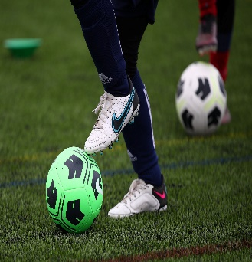
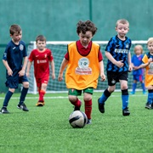
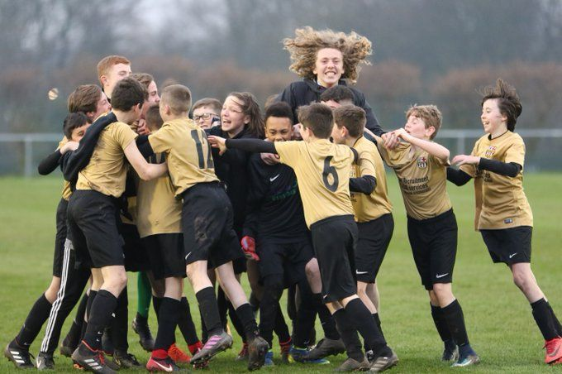
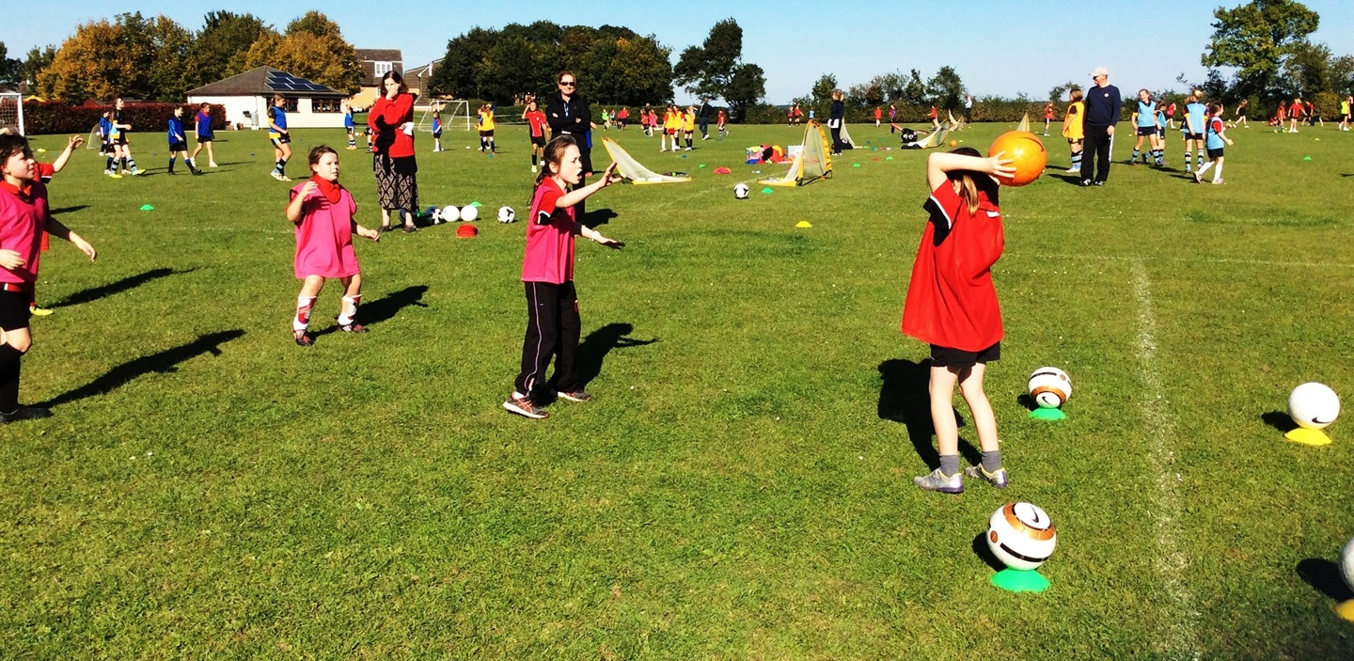
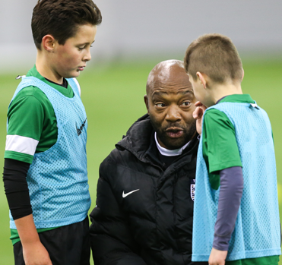
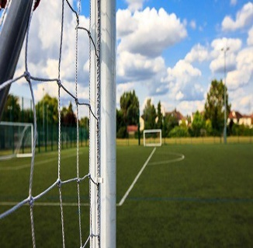
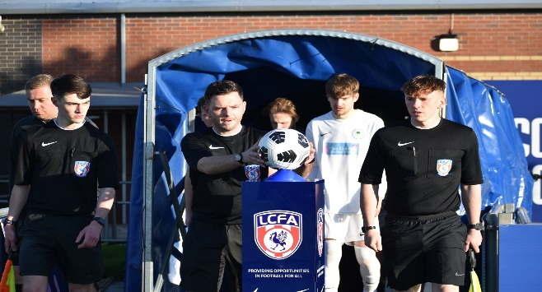
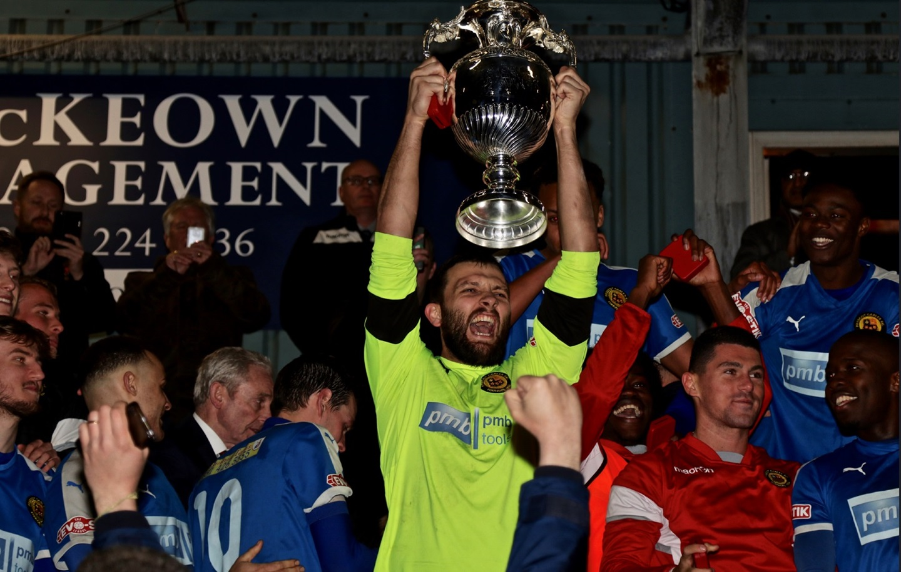
Insert Club Badge Here
Youth Club Season Planner
20xx-20xx

Slide 2
Season Planner Youth Clubs
Club Administration
Task: | Description: | Timescale: | Person Responsible: | Cost: | Task Complete:
General: All Teams affiliated with LCFA by 1st July every year and entered into the appropriate Leagues. Secretary to submit paper work to CFA. | Affiliation forms to be fully completed and returned to Liverpool FA ensuring details for all Teams are provided. | Window opens April each Season | Secretary | £ (Insert Amount)
All Teams registered with ??? League by ??? every year and entered into the appropriate Leagues. Secretary to submit paper work to CFA. | To: (Insert League Name) | Due (Insert Date set by League) | Secretary | £ (Insert Amount)
Enter appropriate Teams in to LCFA Cup Competition | To: (Insert Competition Name & Team details) | Window opens April each Season | Secretary | £ (Insert Amount)
Enter Teams in to League Cup Competitions | To: (Insert Competition Name & Team details) | Due (Insert Date set by League) | Secretary | £ (Insert Amount)
Enter Teams in to Festivals/Tournaments | To: (Insert Organisers Name & Team details) | Due (Insert Date set by League) | Secretary | £ (Insert Amount)
Book/Confirm Facility/Pitches for each Team | To: (Insert Facility Providers Name & details regarding each Team) | (Insert Date & Frequency) | Secretary | £ (Insert Amount)
Sanction Friendly Fixtures | To: Liverpool FA. | 72 hours prior to fixture | Secretary | £ (Insert Amount)
Complete Player Registration for all Teams | Via FA Club Portal. | Due (Insert Date set by League) | Team Managers Club Secretary | £ (Insert Amount)
Complete & Submit League Match Details | Results & Paperwork/Online Reporting sent to League.. | Due (Insert Date i.e. weekly - 6pm Monday Evening) | Team Managers | N/A

Slide 3
Season Planner Youth Clubs
Season Planner Youth Clubs
Club Administration
Task: | Description: | Timescale: | Person Responsible: | Cost: | Task Complete:
To provide all new Managers/Coaches with guidance and support when joining the Club in terms of Coaching and admin. | Induction to be held with new Volunteers to clearly outline role and expectations. | (Insert Date & Detail) | Secretary Club Welfare Officer | £ (Insert Amount)
Complete England Football Validation (Formerly known as FA Charter Standard Annual Health Check) | Ensure all criteria and qualifications are in place and up to date on Club Portal | November each season | Secretary | N/A
Organise Club Summer Festival/Tournament | (Insert Detail) | (Insert Date & Detail) | Insert role/person responsible | £ (Insert Amount)
Hold Induction for all new Volunteers. | Induction to be carried out in order to outline expectations. And requirements for role before officially being appointed. | (Insert Date & Detail) | Secretary Club Welfare Officer | £ (Insert Amount)
Hold Pre-Season Parent/Guardian Inductions | Each age group to hold Induction for the Parents/Guardians in order to outline expectations. | (Insert Date & Detail) | Club Welfare Officer Team Manager Team Coach | £ (Insert Amount)
Add any additional tasks if necessary.
Club Administration

Slide 4
Season Planner Youth Clubs
Club Administration
Club Administration
Task: | Description: | Timescale: | Person Responsible: | Cost: | Task Complete:
Meetings: League Meetings League Annual General Meeting (AGM) Club Committee Meetings | Attend each League meeting on behalf of Club. Attend League meeting on behalf of Club. Hold meetings for all Club Committee Members and other relevant Club Members | (Insert Date & Frequency) (Insert Date) (Insert Date & Frequency) | Club Secretary Club Secretary Club Secretary | N/A N/A N/A
Communication: Parents (Match Details) Match Officials (Match Details) Send Opposition Medical Emergency Action Plan (MEAP) | Time and meeting point sent via WhatsApp/Text Message Time and meeting point sent via WhatsApp/Text Message MEAP to be sent via emailed/WhatsApp to each opposition prior to each Home Game | (Insert Day & Frequency) (Insert Day & Frequency) (Insert Day & Frequency) | Team Managers Team Managers Team Managers | N/A N/A N/A

Slide 5
Season Planner Youth Clubs
Safeguarding
Task: | Description: | Timescale: | Person Responsible: | Cost: | Task Complete:
Ensure all coaches and assistant coaches have in date FA DBS Check in place. | FA DBS check carried out by the Club through The FA. Must be showing on their FAN Number as in date and accepted in order to undertake any role with Children | (Insert Date & Detail) | Club Welfare Officer | £ (Insert Amount)
Ensure all coaches and assistant coaches have in date FA Safeguarding Children course. | Course available through England Football Learning website |  | Club Welfare Officer | N/A
Ensure all new coaches, assistant coaches and Team helps have in date FA DBS Check in place. | Any Volunteer wishing to join the Club (To work with children) must be interviewed by the CWO and have an FA DBS check carried out by the FA and can not carry out any activity with the Team until this has returned from the FA as accepted. | (Insert Date & Detail) | Club Welfare Officer | £ (Insert Amount)
Ensure each Team has up to date qualified Coaches in place. | Coaches hold minimum of FA Level 1 or Introduction to Coaching Football Qualification, FA DBS Check, FA First Aid & FA Safeguarding which are all in date and showing on their FAN numbers. | (Insert Date & Detail) | Secretary Club Welfare Officer | £ (Insert Amount)
Safeguarding to be key agenda item for each Committee Meeting. | CWO to provide update to Committee at each meeting regarding any cases and/or updates from Durham County FA Designated Safeguarding Officer (DSO) | (Insert Date & Detail) | Club Welfare Officer | £ (Insert Amount)
Replenish Medical Equipment. | (Insert Detail & Supplier) | (Insert Frequency) | Team Manager/Coach | £ (Insert Amount)
Add any additional tasks if necessary.

Slide 6
Season Planner Youth Clubs
Other
Task: | Description: | Timescale: | Person Responsible: | Cost: | Task Complete:
Social Events: Fund Raising Night End of Season Presentation End of Season Trip Away/Tournaments | (Insert Type of Event i.e. Race Night, Sportsman's Dinner etc) (Insert) (Insert Type of Event i.e. Trip Away, Day at the Races etc) | (Insert Date & Frequency) Due (Insert Date) Due (Insert Date) | Club Secretary Club Secretary Club Secretary | £ (Insert Amount) £ (Insert Amount) £ (Insert Amount)

