Slide 1
Let’s Talk MONEY MULES…

Slide 2
SYMBOL GUIDE
If you see the symbol, the slide will have lots of useful information
If you see the symbol, the slide will have a fact or definition
If you see the symbol, look out for the warning!

Slide 3
Today’s SESSION
LEARNING OBJECTIVE:
In this session, we are exploring MONEY MULES
LEARNING OUTCOMES:​
By the end of the session, you will be able to:
define the term MONEY MULE
understand how becoming a MONEY MULE can impact you
protect yourself and others to prevent criminals from taking advantage!

Slide 4
What is a money mule?
A MONEY MULE is:
“…someone who allows criminals or fraudsters to ‘launder’ or transfer money through their bank account in return for cash”

Slide 5
Did you know…
MONEY MULES under 21 have tripled between 2016 and 2019
6 out of 10 teenagers admitted to being tempted to become a MONEY MULE
1 in 20 students said that due to COVID-19, they are more likely to consider making easy money, even if it looks suspicious

Slide 6
Criminals may ask you to receive money into your bank account and transfer it into another account, keeping some of the cash for yourself. If you let this happen, you’re a MONEY MULE. You’re involved in money laundering, which is a crime!
You might be approached by criminals online or in person. They might post what looks like a genuine job ad, then ask for your bank details.

Slide 7
Once you become a money mule, it can be hard to stop. You could be attacked or threatened with violence if you don’t continue to let your account be used.
Don’t Be Fooled by offers of quick cash.
Criminals need MONEY MULES to launder the profits of their crimes. MULES will usually be unaware of where the money comes from – fraud, scams and other serious crime – or where it goes!

Slide 8
Where does the money go?​
The money that is being used by criminals will go towards:
Drugs
Guns
Child Criminal Exploitation
Cyber Crime
Terrorism

Slide 9
You may have your own personal bank account but this does NOT mean other people can use it! You will be breaching your contract with your bank!
ANYONE at any age is AT RISK of becoming a MONEY MULE
If you have a bank account, YOU are responsible for what transactions are carried out - nobody else! Age is not a factor if the law is broken!

Slide 10
Do these images look familiar?

Slide 11
These images are a variety of adverts to recruit MONEY MULES
Look at the language used:
"wanna make money..."
"...interested in making money"
"Who wanna make big money ASAP??"

Slide 12
Let's look at a conversation between a
MONEY MULE recruiter and a Year 8
student named Brad...

Slide 13
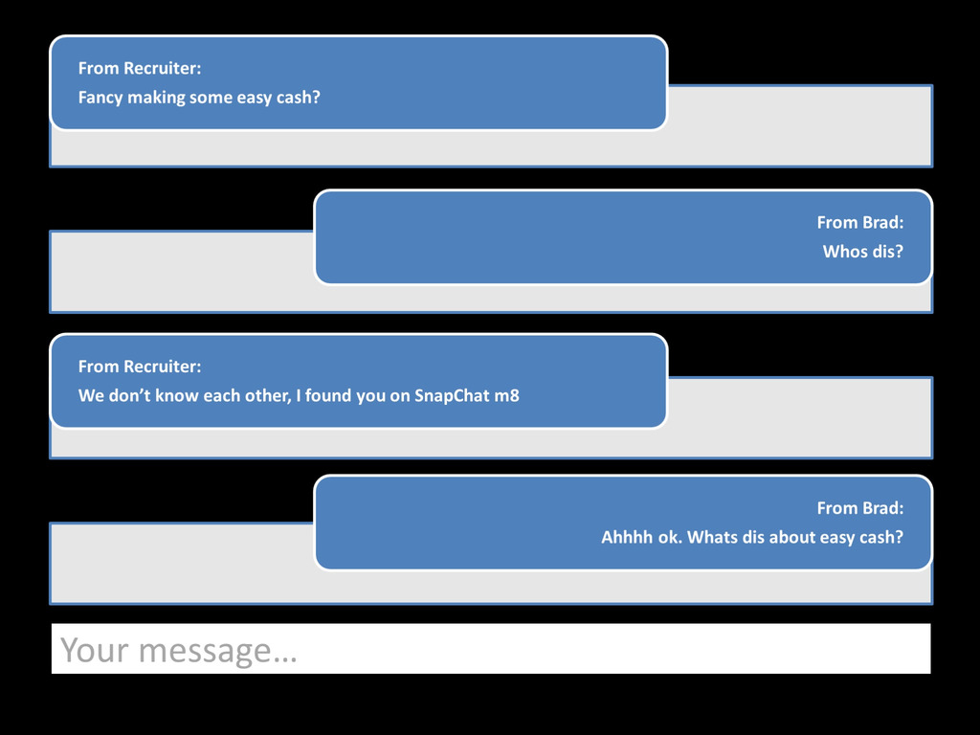

Slide 14
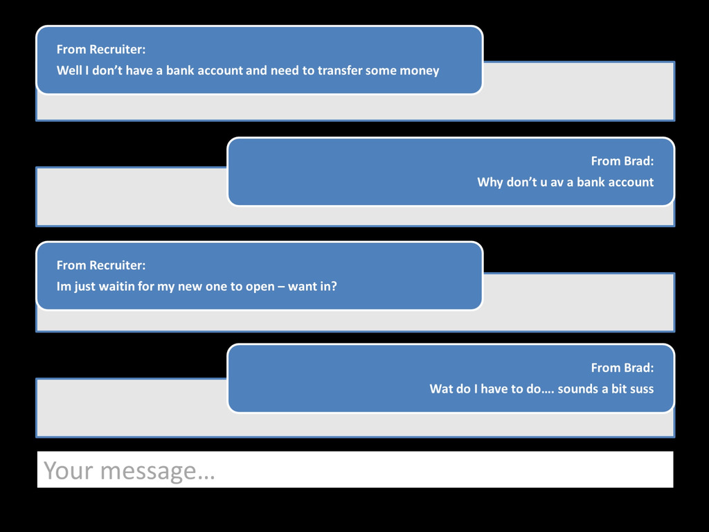

Slide 15
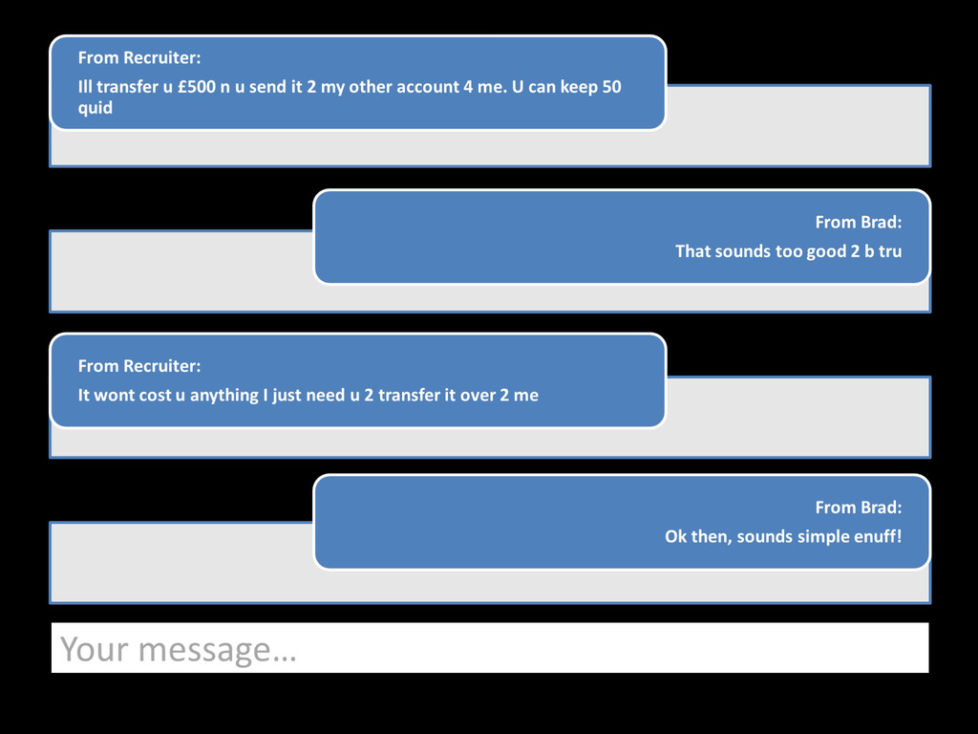

Slide 16
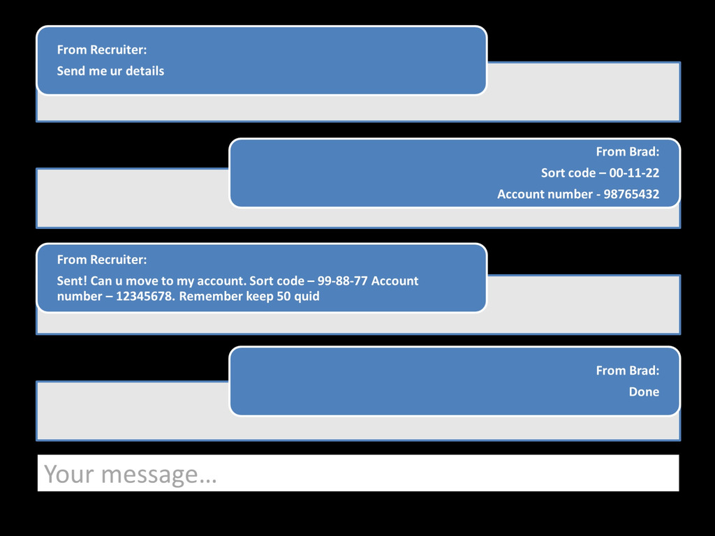

Slide 17
What MONEY MULES are “guaranteed”
Same day cash
Small amount of work
Large amounts of money

Slide 18
What criminals may ask MONEY MULES to do...
Sell or allow your bank account to be controlled by a criminal
Receive funds into your bank account before transferring it to another account
Asking you to open an account using fake details or your own identity
Ask you to accept deliveries for items that were purchased using stolen bank details
Collect stolen funds via ATM cash outs​
Convert cash to virtual funds - Bitcoin/Cryptocurrency

Slide 19
Now let’s look at a conversation
Between Brad and his friend Jamie…

Slide 20
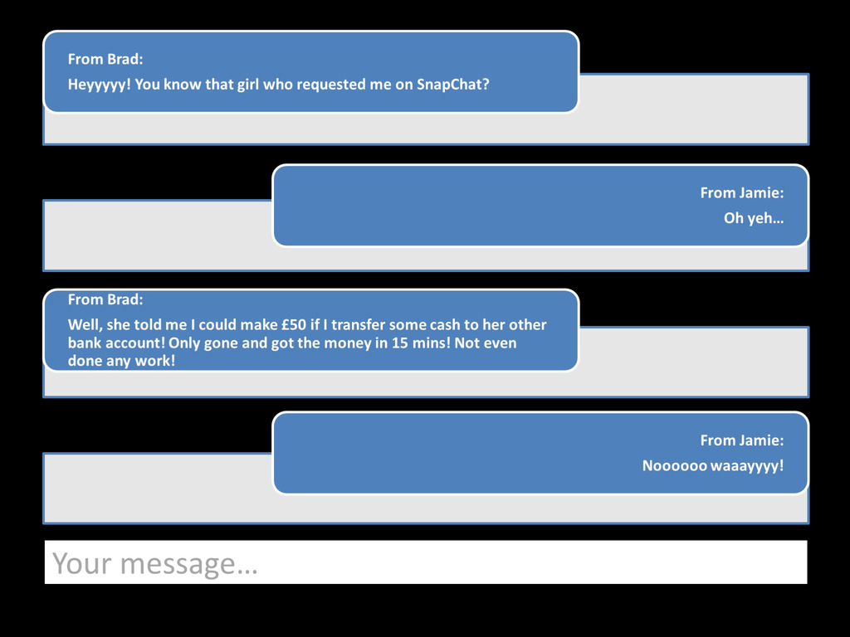

Slide 21
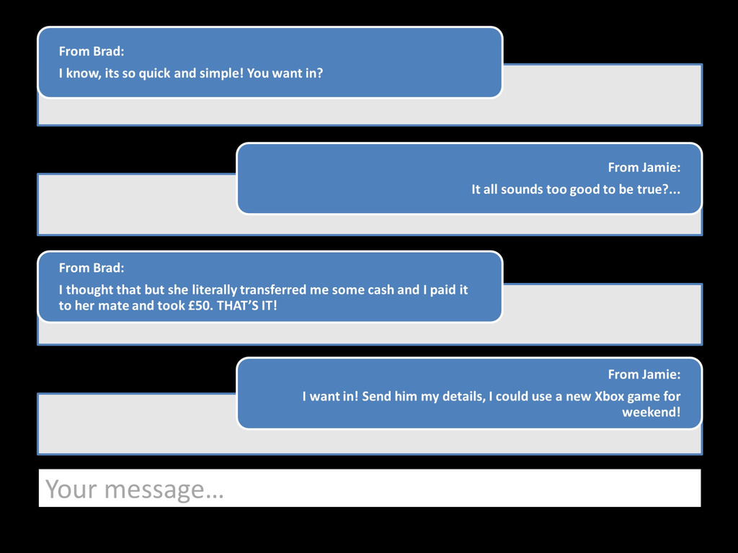

Slide 22
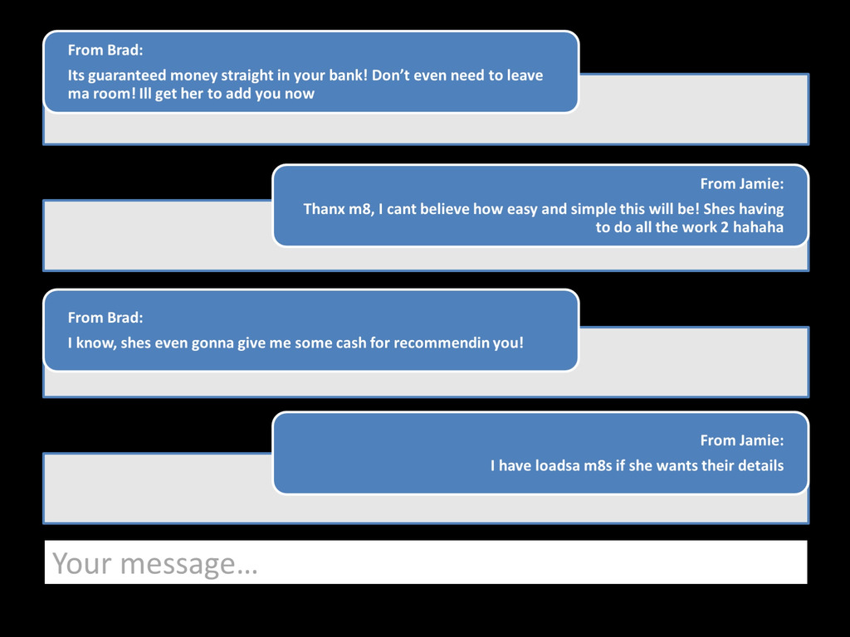

Slide 23
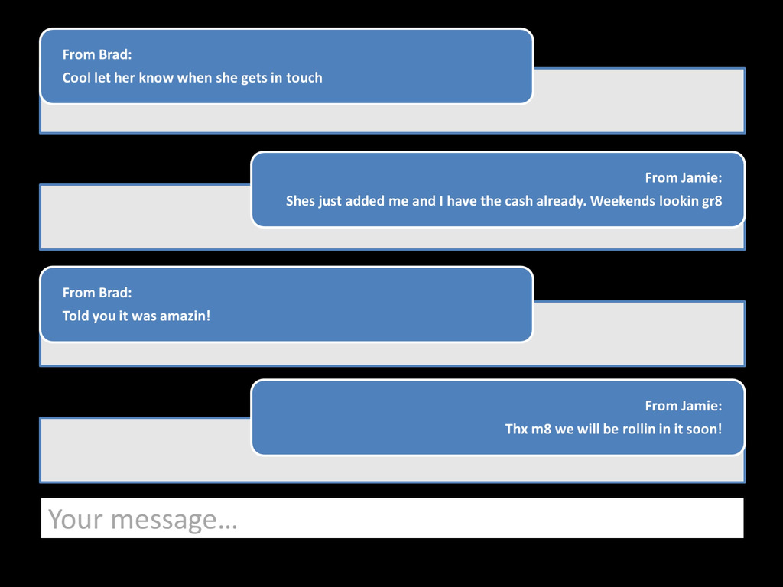

Slide 24
What criminals may ask MONEY MULES to do...
Whilst it is important to recognise that criminals may contact you to help them - your friends may do this too!
If a friend has recently become a MONEY MULE, they may ask you for your details.
Just because someone you know is doing it, does not make it right

Slide 25
​What MONEY MULES actually get in return...
Bank account closed - NO access to cash!
Fraud Marker against their name - Untrustworthy to ALL
Risk having their bank accounts emptied by the criminal - NO money
Problems applying for ANY credit - NO gaming account, NO mobile phone
Criminal record that STOPS any chance of a dream job!
Loans taken out in your name that you will struggle to prove was NOT you!
and in some cases...
A PRISON SENTENCE FOR UP TO 14 YEARS

Slide 26
If you are worried that you have been targeted as part of this crime, you should speak to an adult that you trust. You should also contact your bank as soon as possible, they have specialist teams who will be able to help you.
You can also contact the Police or other organisations who can provide assistance:
In a non-emergency contact the police on 101.
If a crime is in progress or there is a danger to life call 999.
You can speak to Greater Manchester Police online via Live Chat
If you would rather not contact the police you can call -
Crimestoppers – 0800 555 111 - you can speak to Crimestoppers anonymously
Childline – 0800 111
NSPCC – 0808 800 5000

Slide 27
Where to find support
It is important to ensure that everyone knows where they can seek help and further advice, both now and in the future.
Anyone wishing to seek further guidance on the issue of fraud and cybercrime can visit:
www.cyberaware.gov.uk
www.actionfraud.police.uk
www.victimsupport.org.uk
www.barclayslifeskills.com
www.moneymules.co.uk
www.takefive-stopfraud.org.uk

