Slide 1
Matchday
The meeting will start at 7pm
Please remain muted when not speaking
Donna Crowthers – North Riding FA
Claire Davidson – Technology Adoption (The FA)

Slide 2
Using MS Teams for Online Calls
Please ensure you’re muted when not speaking to reduce background noise
If you have a question, please use the chat function or wait for the designated question slots
Struggling to see the screen? Use full screen mode by clicking the 3 dots in the hover over bar
This is new to many people, so we thank you for your patience

Slide 3
This evening we’ll go through
My Account
Matchday and how it works
Support

Slide 4
The FA’s Grassroots Technology Ecosystem
Three online tools to make Grassroots football easier and more rewarding for you.
Seasons
Divisions
Team Administrators
Cups
Players
Managers
Coaches
Team Administrators
Players
Fixture details
Match returns
League tables

Slide 5
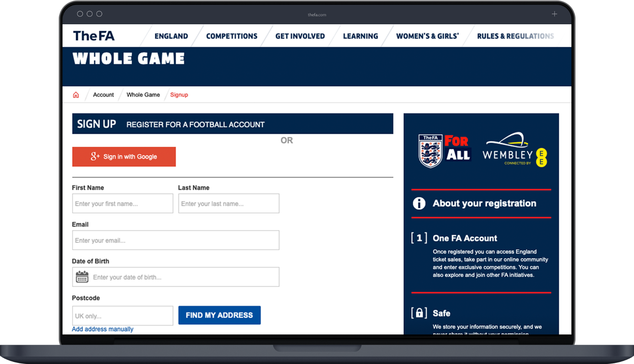
System updates

Slide 6
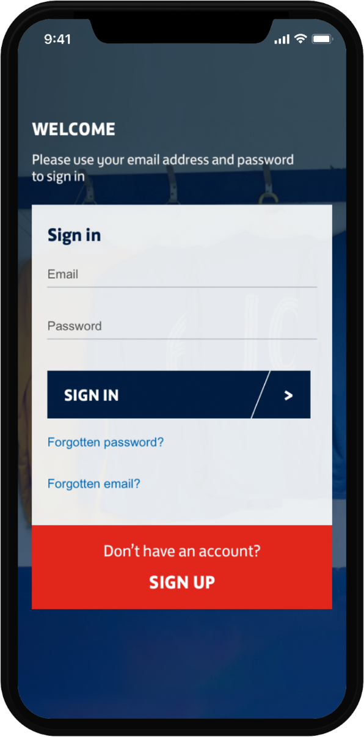
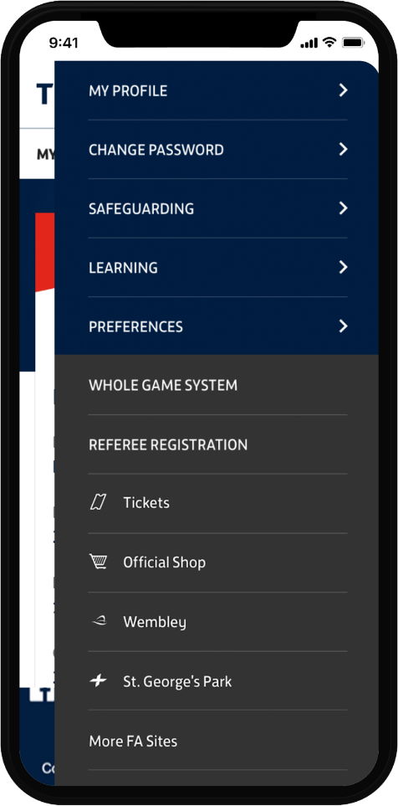
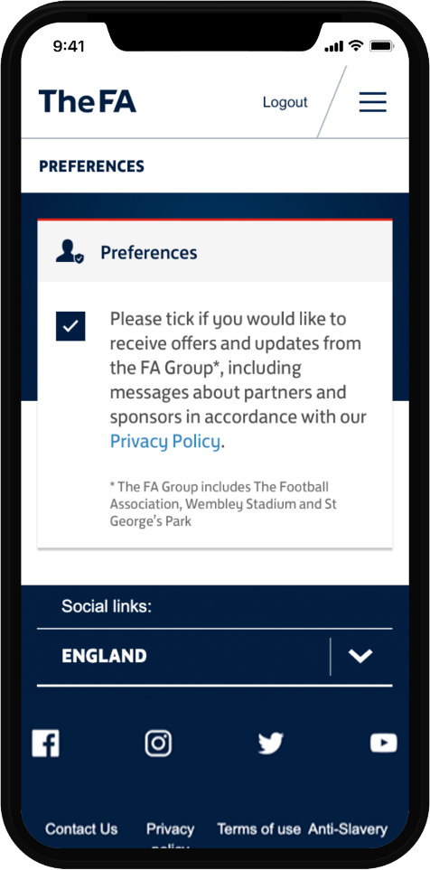
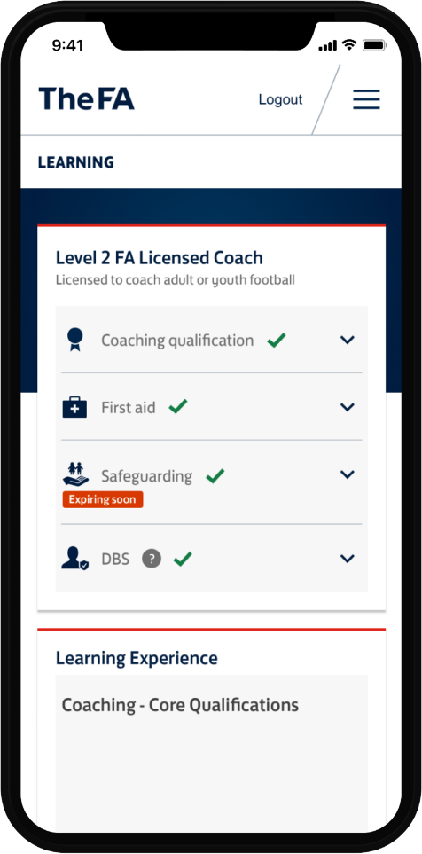
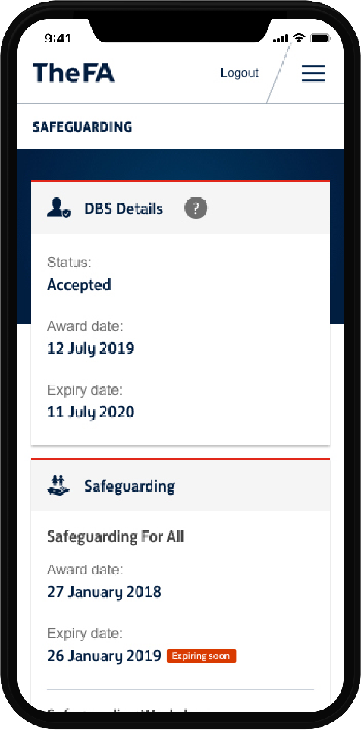
My Account…

Slide 7
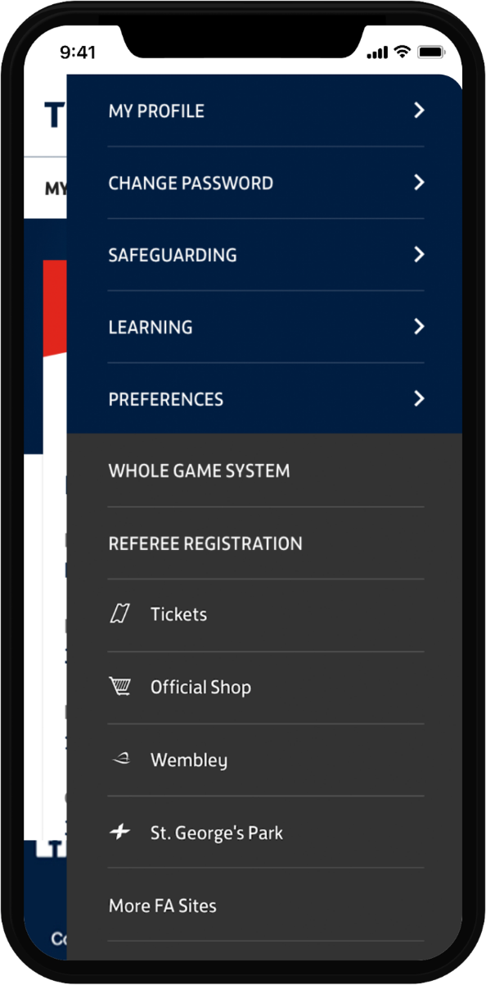
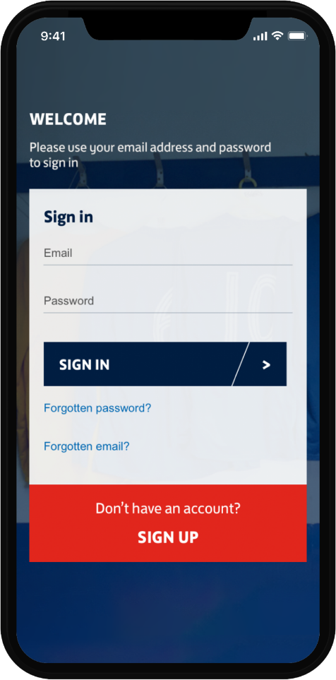
My Account...

Slide 8
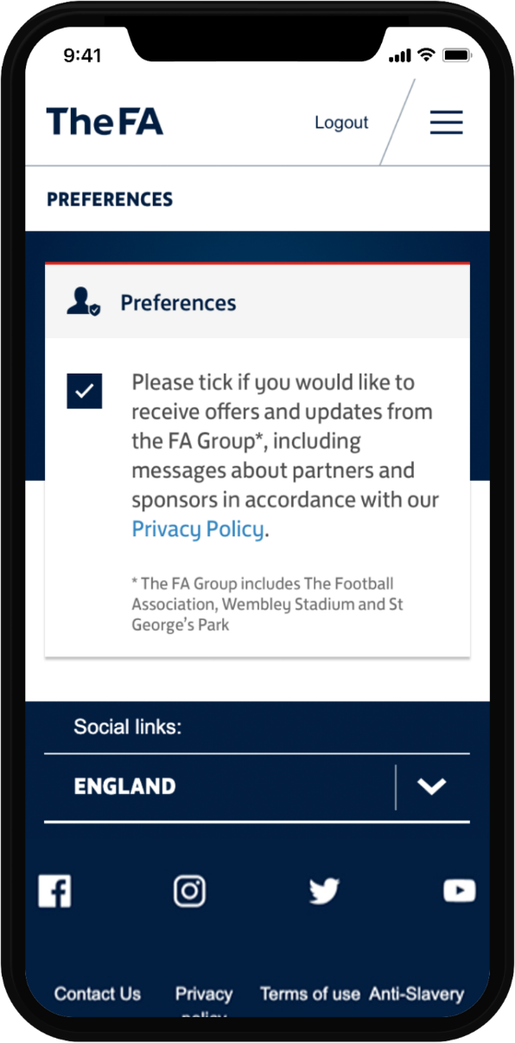
My Account…

Slide 9
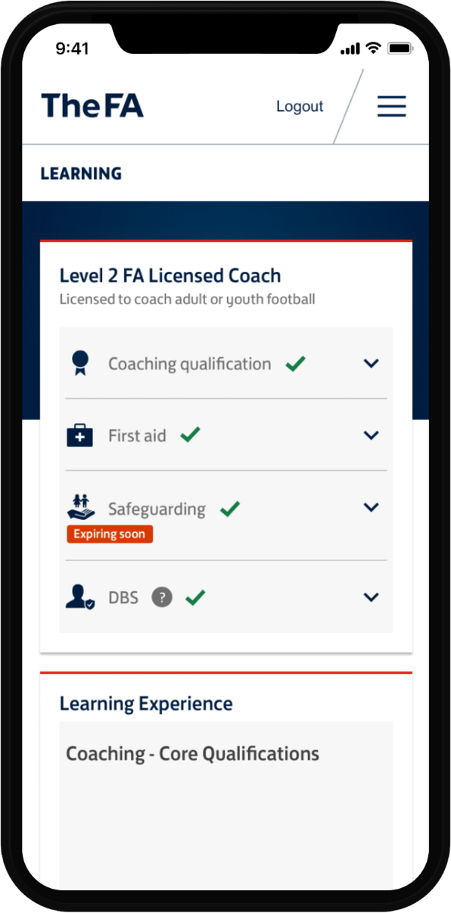
My Account…

Slide 10
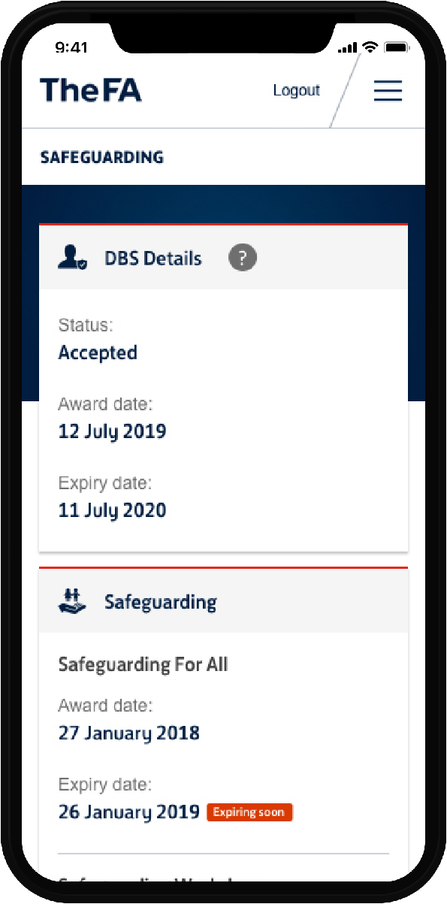
My Account…

Slide 11
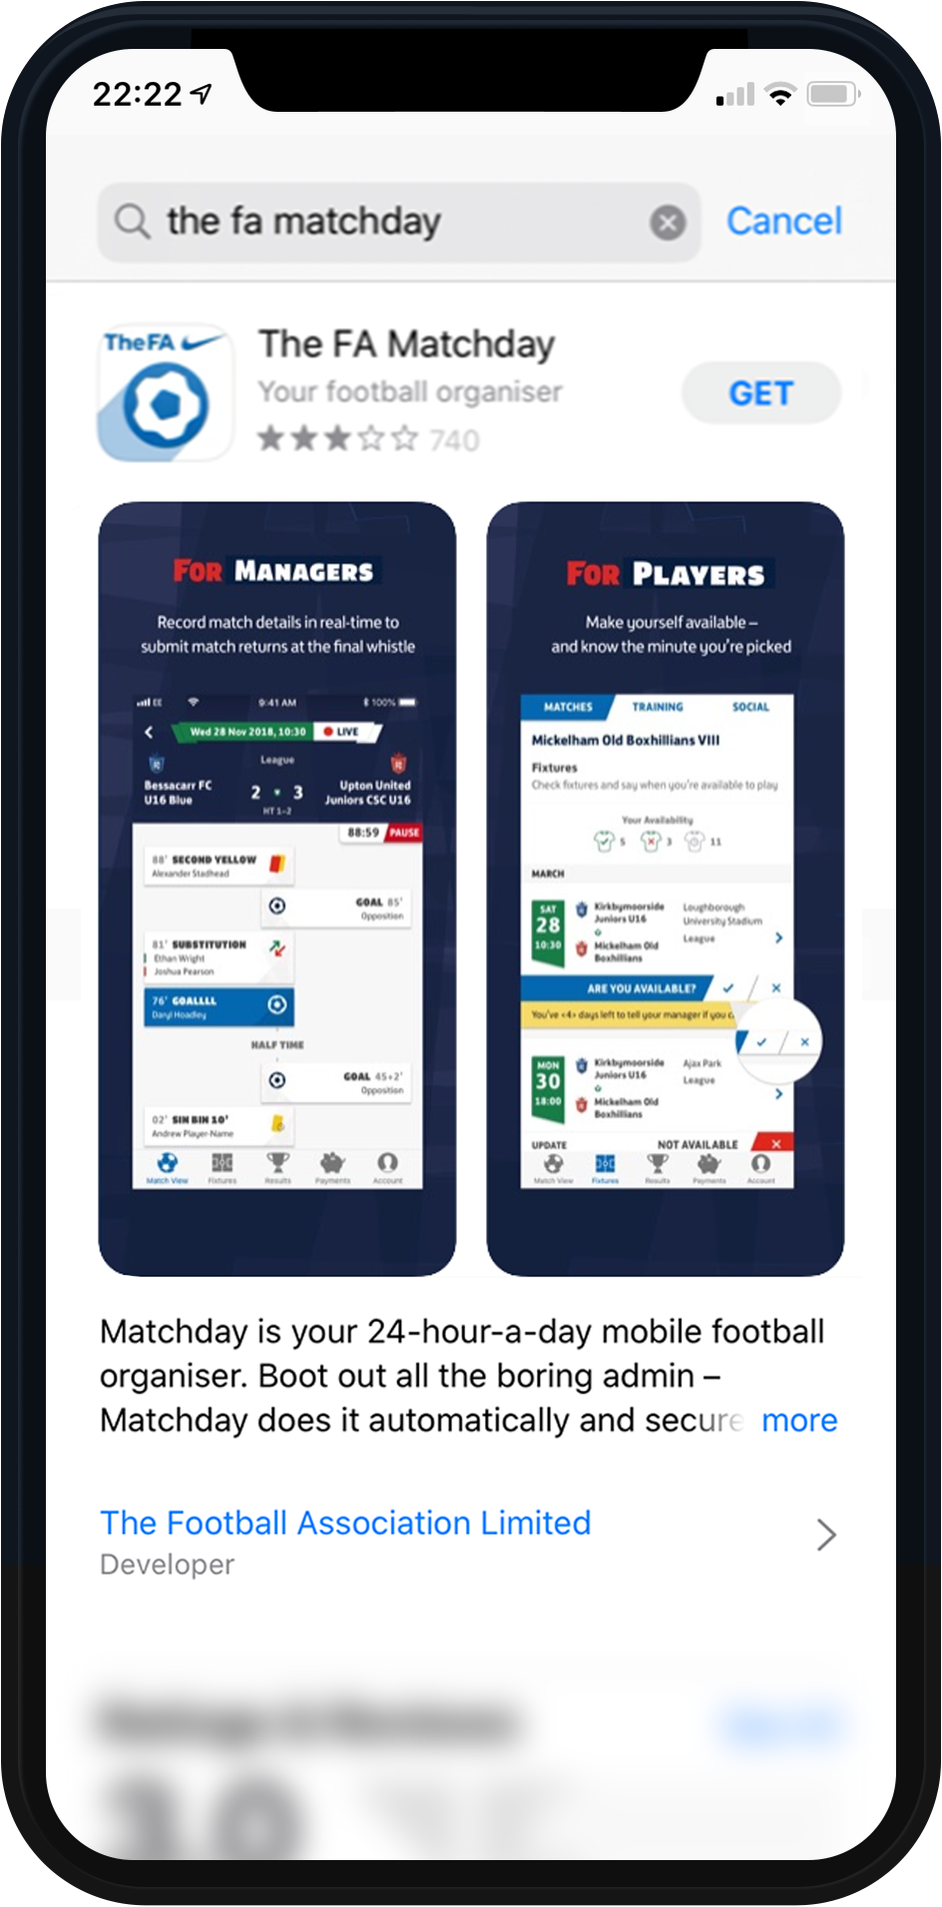
Matchday with Lucy

Slide 12
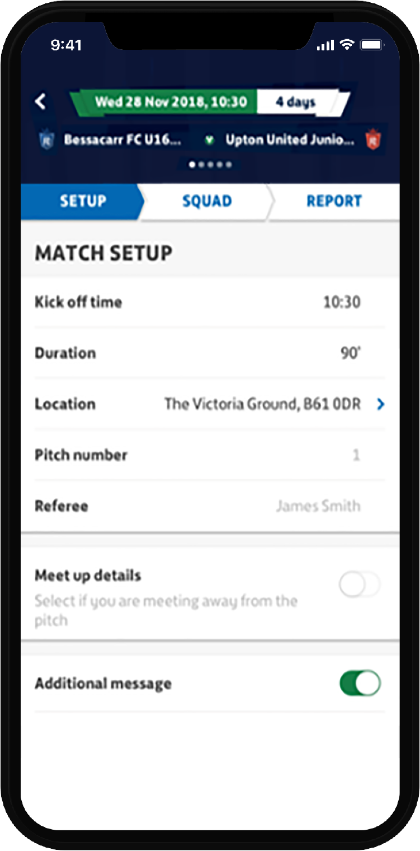
Administration tasks

Slide 13
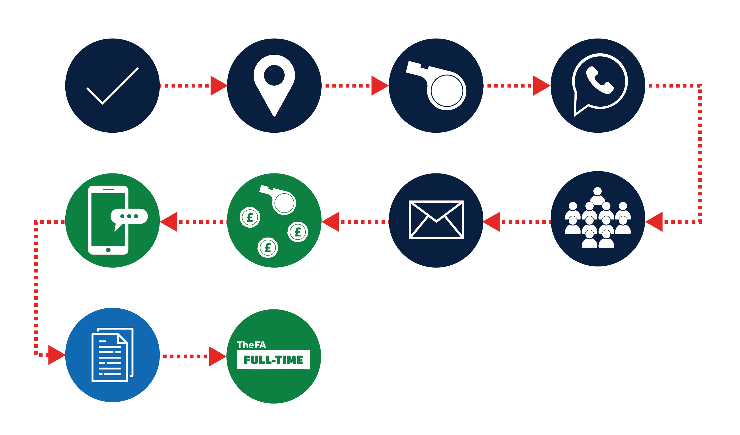
Your admin tasks all in one place…
Fixture Confirmation
Confirm venue
Confirm match officials
Squad availability
and selection
Match day post
kick off
Match pre
kick off
Postponed fixtures
Confirm opponents and details
Post Match day admin
Notes:
We’d like to make this into a small animation to move into the following slide

Slide 14
=
Notes:
This could be the outcome of the animation to show how using the Matchday App helps to keep everything in one place

Slide 15
Extra time for the game you love
Less admin
On average 30+ admin tasks per week
organising a team
Less paper
Offline processes are often duplicated online (i.e. team sheets)
Instant results
Submit results of the game at the side of the pitch
More money
40% of affiliated football match fees go unpaid each season

Slide 16
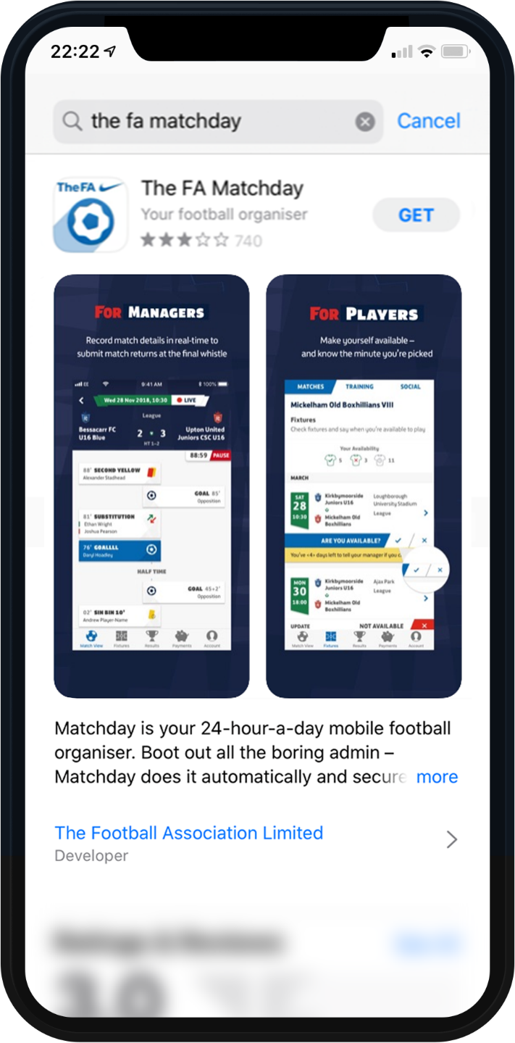
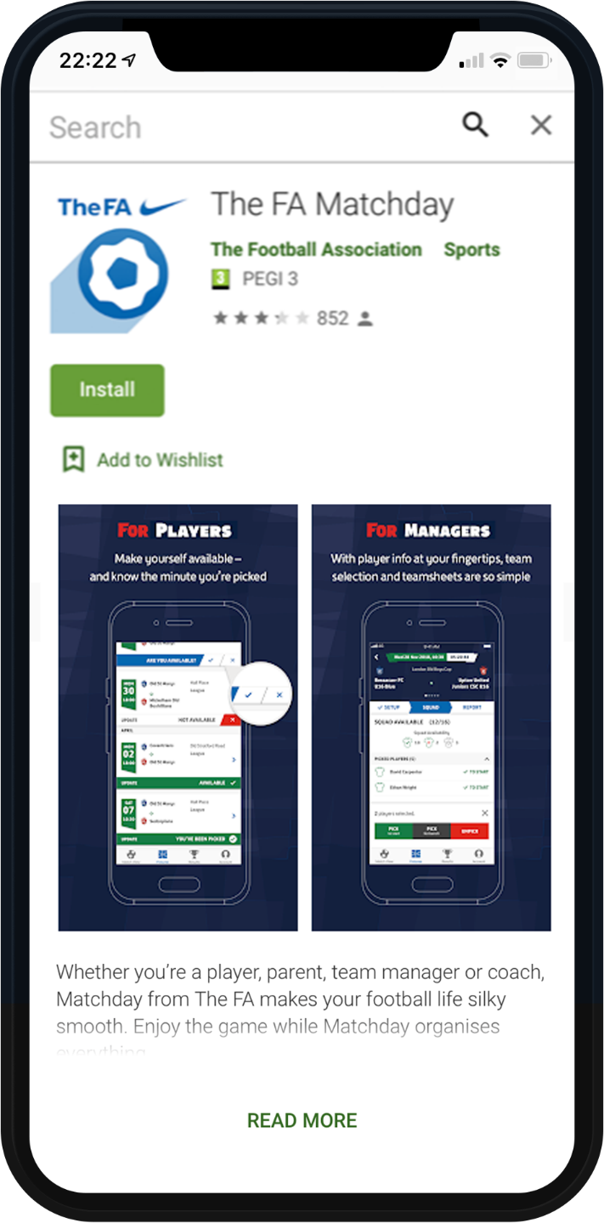
Search ‘FA Matchday App’

Slide 17
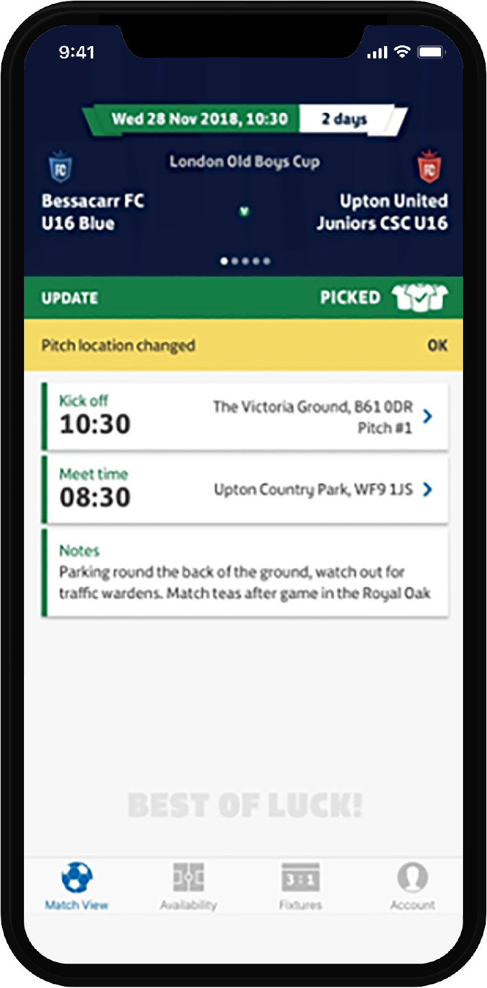
Manage match details

Slide 18
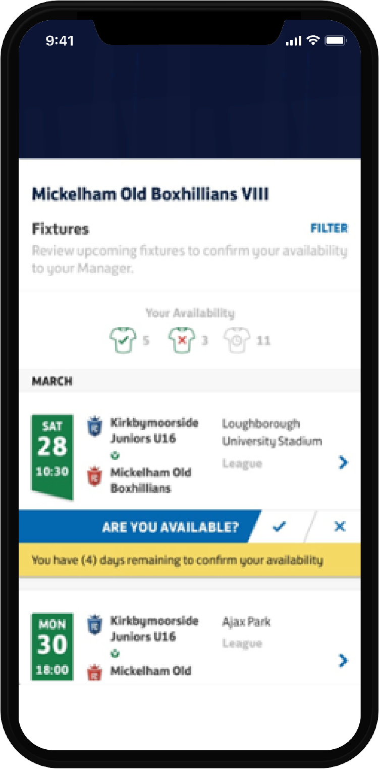
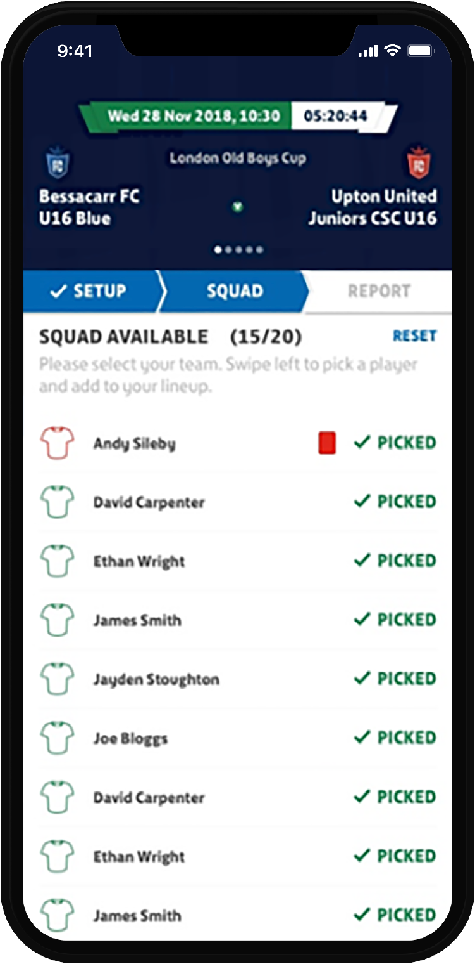
Player availability

Slide 19
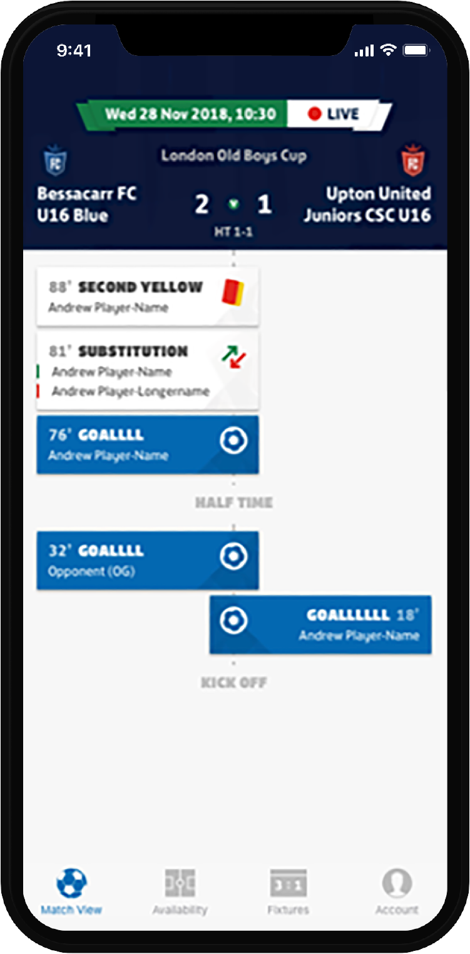
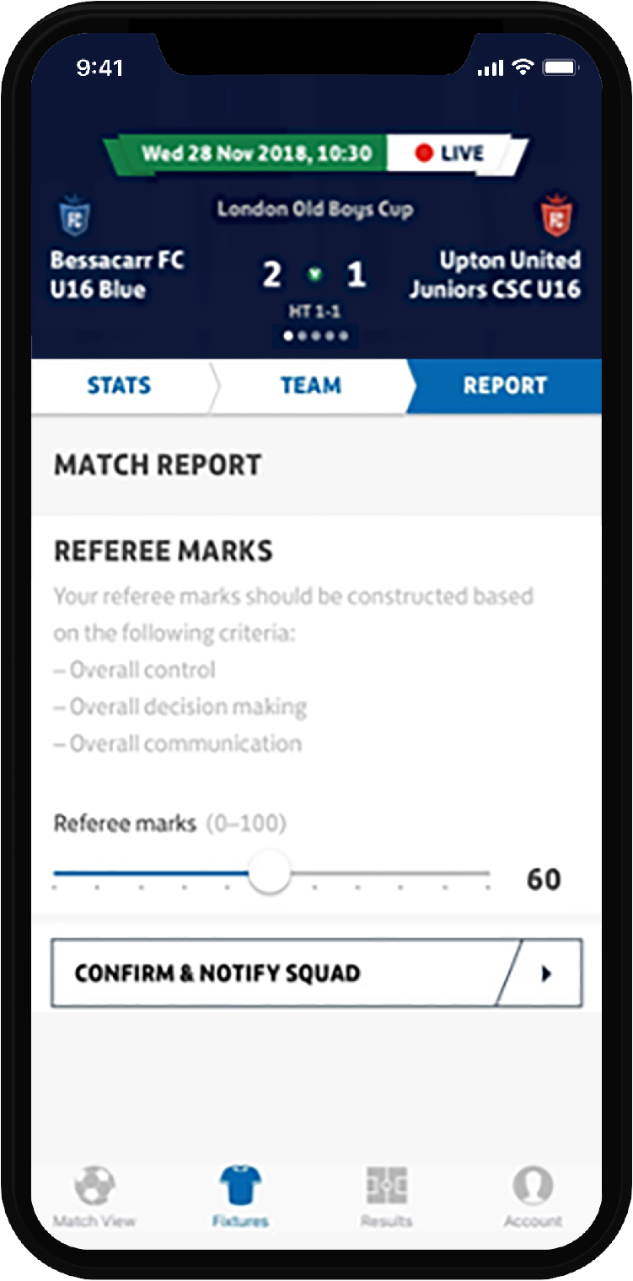
Live events and match reports

Slide 20
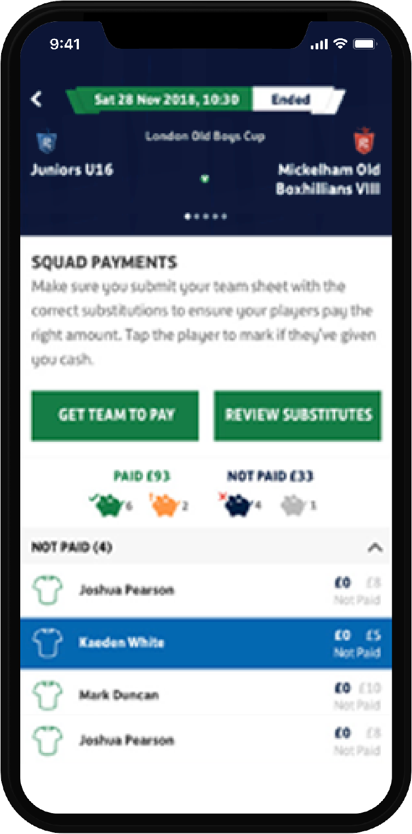
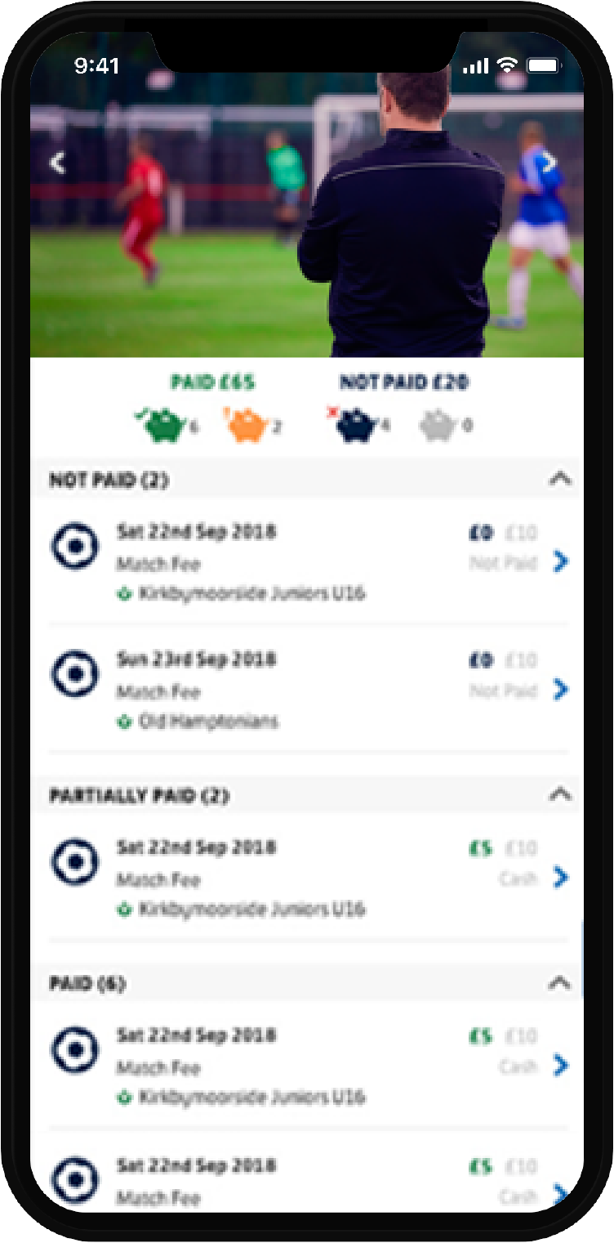
Match fees and payments

Slide 21
Get the best Matchday experience
www.login.TheFA.com
Notes:
We’ve added a URL as well as a QR code to make sure desktop and mobile/tablet users can assess the page

Slide 22
PayPal incentives

Slide 23
VAR review

Slide 24
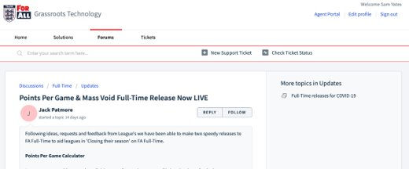
Want to be in the know?
https://grassrootstechnology.Freshdesk.com

Slide 25
Remember…
We are modernising our technology to greater serve the game
GrassrootsTechnology@TheFA.com

Slide 26
FA GRASSROOTS FOOTBALL AWARDS
CATEGORIES
Grassroots Coach of the Year for Youth
Grassroots Coach of the Year for Adults
Grassroots Club of the Year
Grassroots League of the Year
Grassroots Volunteer of the Year
Rising Star of the Year
Grassroots Grounds Team of the Year
Grassroots Project of the Year
‘We Only Do Positive’ - Parents Respect Award
Grassroots Match Official of the Year

Slide 27
Thank you & stay safe.

