Slide 1
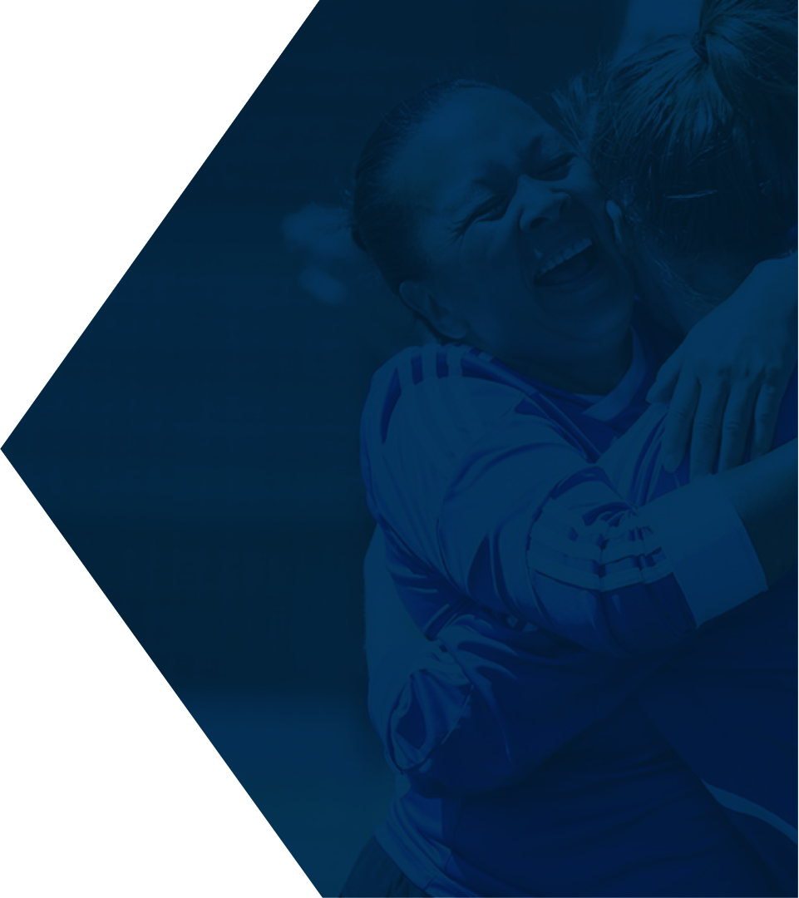
Bystander Bitesize Training
Notes:
For cases when imagery isn’t available

Slide 2
Bystander Training
Football bystander, could refer to an individual who is subjected to discriminatory language or behaviour based on their race, ethnicity, gender, or other characteristics. In this context, the term "bystander" would denote someone who is inadvertently caught up in or affected by discriminatory actions or remarks happening around them, even if they are not directly involved in the game or the incident. It's important to address and challenge discriminatory behaviour wherever it occurs, including in sports settings.
The following will give you an understanding of what our 45-minute bitesize workshop will provide to help you understand more about becoming an active bystander:
Understand what we mean by a Bystander
What is the Bystander Effect
Gain a better insight into why we may not act in certain situations
Look at strategies and be equipped with the skills to be an Active Bystander
Impact: We all feel confident and empowered to use these skills to make your environments and culture inclusive for all

Slide 3
Bystander 4Ds Model
The 4Ds bystander model — direct, distract, delegate, and delay. Is another variation or interpretation of a framework for bystander intervention. This model provides specific strategies that bystanders can employ when they witness a problematic situation. Here's a breakdown of each D:
Direct: This involves directly intervening in the situation. It could mean stepping in to stop inappropriate behaviour, speaking up, or taking action to prevent harm.
Distract: Instead of confronting the situation directly, a bystander can use distraction techniques to redirect attention or diffuse the situation. This could involve starting a conversation with the individuals involved or creating a diversion to shift focus away from the problematic behaviour.
Delegate: Bystanders can delegate intervention to someone else who may be better equipped to handle the situation, such as alerting authorities, contacting a supervisor, or asking for assistance from others nearby.
Delay: If immediate intervention is not feasible or safe, a bystander can choose to delay their response by monitoring the situation and intervening later when it's more appropriate or effective.
Direct
Distract
Delegate
Delay
These four strategies offer different approaches for bystanders to consider depending on the specific circumstances and their comfort level. The goal is to provide bystanders with practical options to intervene in a way that aligns with their capabilities and the context of the situation. This model encourages bystanders to take proactive steps to address problematic behaviours and promote a safer environment.

