Slide 1
Managing a player’s uniqueness
Richard Allen
4th December, 2015

Slide 2
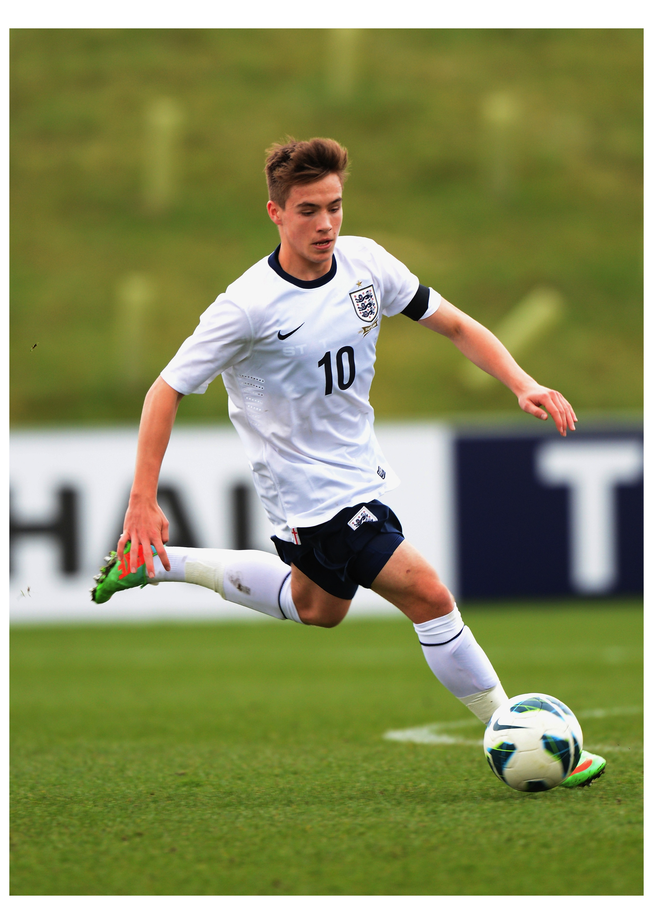
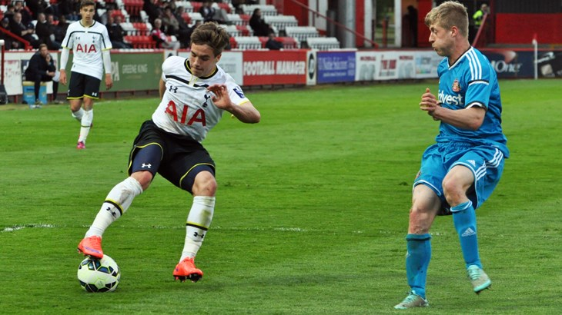

Slide 3
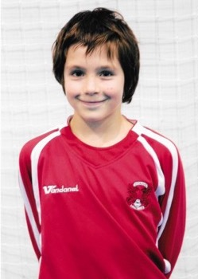

Slide 4
Managing Will Millers uniqueness

Slide 5
‘My first year at the Academy I would describe as ‘uncertain’…I was playing down a year and not doing well…I felt unsure and slightly out of place…my confidence was low…When I started playing with my own age group I felt things started to change, more confidence and less out of place…Towards the end of the year they offered me a contract and I felt like I could exhale……’
Will Miller

Slide 6
U9’s to First Team – 0.5% (PL)
42 players in their 95/96 year group to produce 8 pros – 2 of their original U9’s group became pros at the club (THFC)

Slide 7
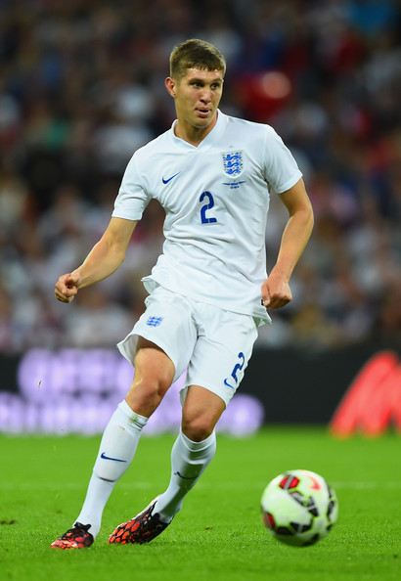
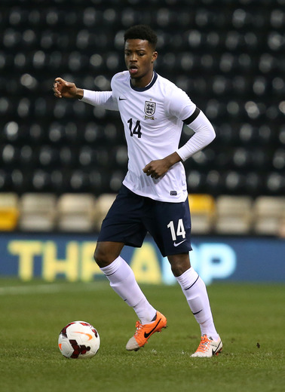
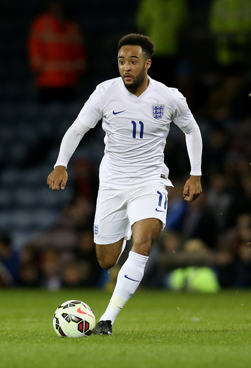
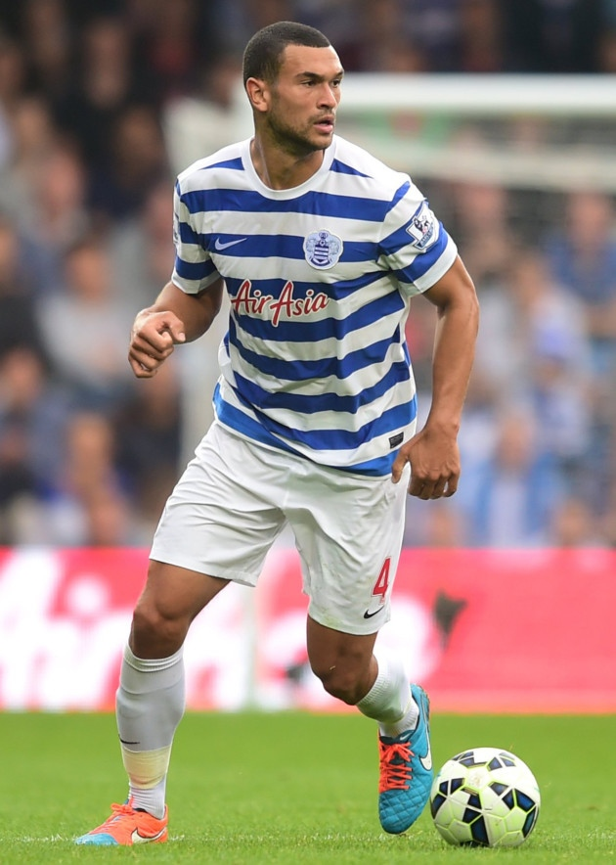
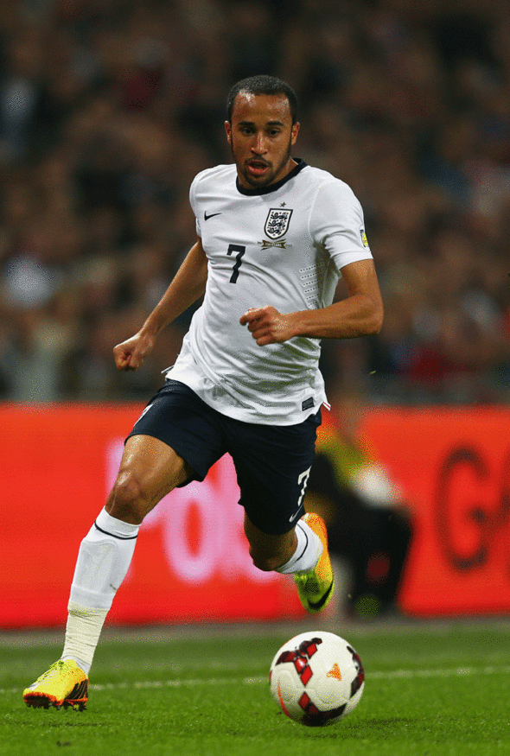
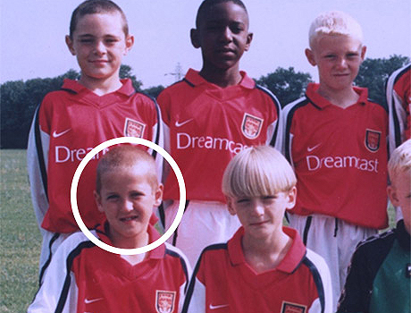
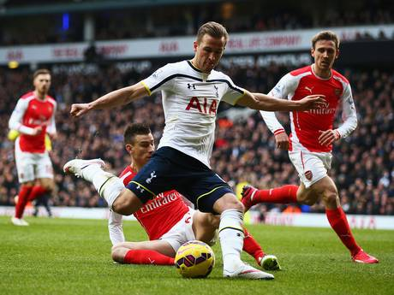
What do they all have in common?
Different journeys

Slide 8
THANK YOU FOR YOUR TIME.

