Slide 1
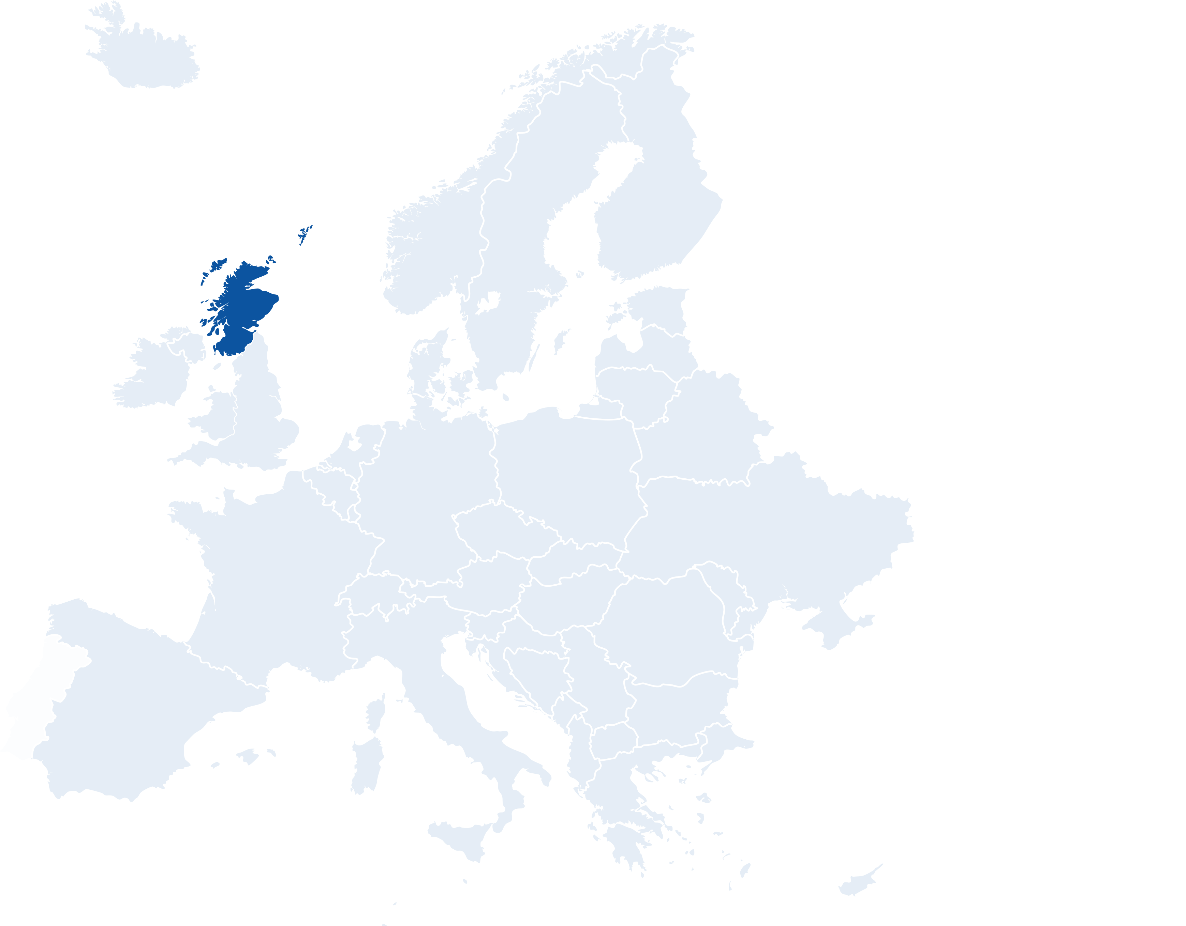
Welcome to..
glasgow
Continent: Europe
Country: Scotland
Capital: Edinburgh
The People's Palace
What country is Scotland next to?
What is the official language of Scotland?
Hampden Park
Notes:
Teacher Notes
Starter activity: Get students thinking about what country they are visiting.

Slide 2
Welcome to Glasgow
You’ve made your railway journey to the largest city in Scotland. It’s famous for its architecture, culture and arts. It is one of the Group D hosts in UEFA EURO 2020.
What teams will be playing in this group?
Use the flags below to find out…
Glasgow
ENGLAND
CROATIA
GROUP d
SCOTLAND
CZECH REPUBLIC
Notes:
Teacher Notes
Language spoken: Majority language is English. Minority language is Gaelic
Brief introduction to Glasgow as a city.
Locate Scotland and then Glasgow on the map.
Use the Glasgow Host City Guide to discuss the country in more detail (optional).
The majority language is English, but Scottish Gaelic is also spoken.

Slide 3
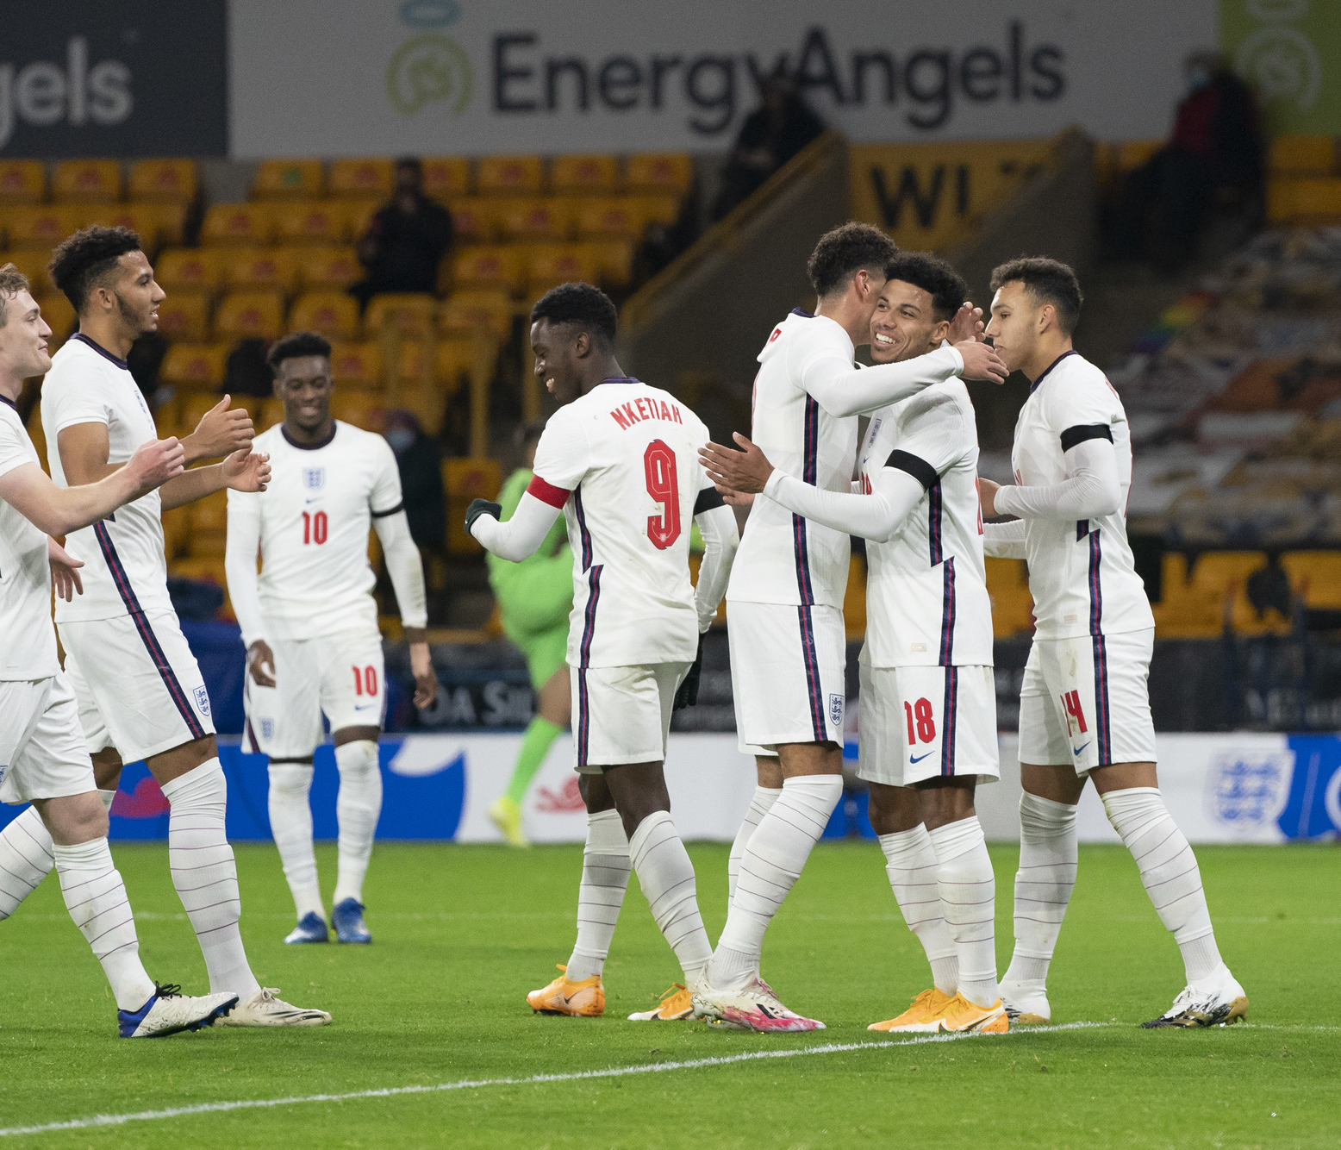
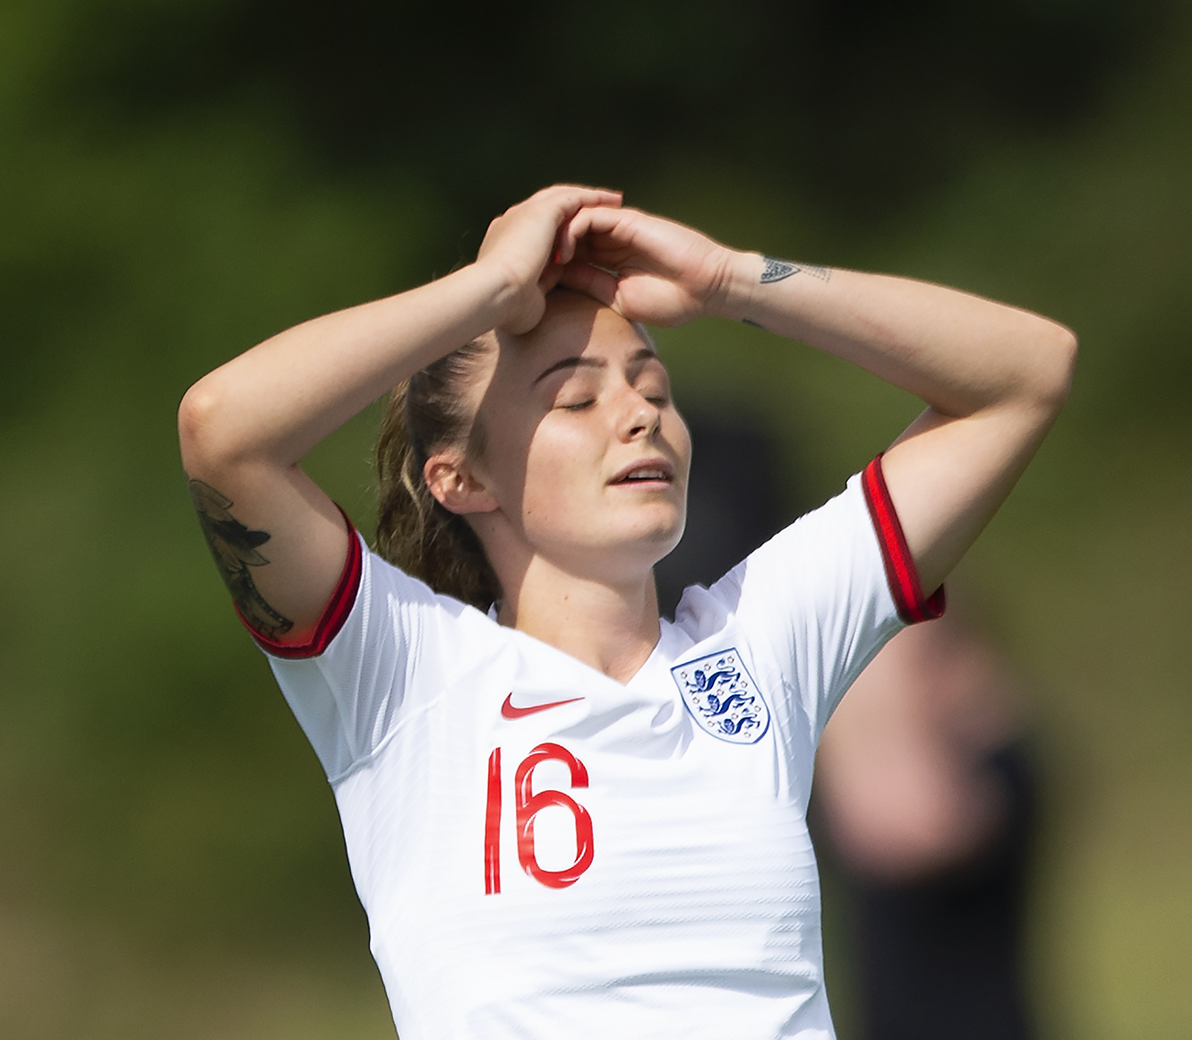
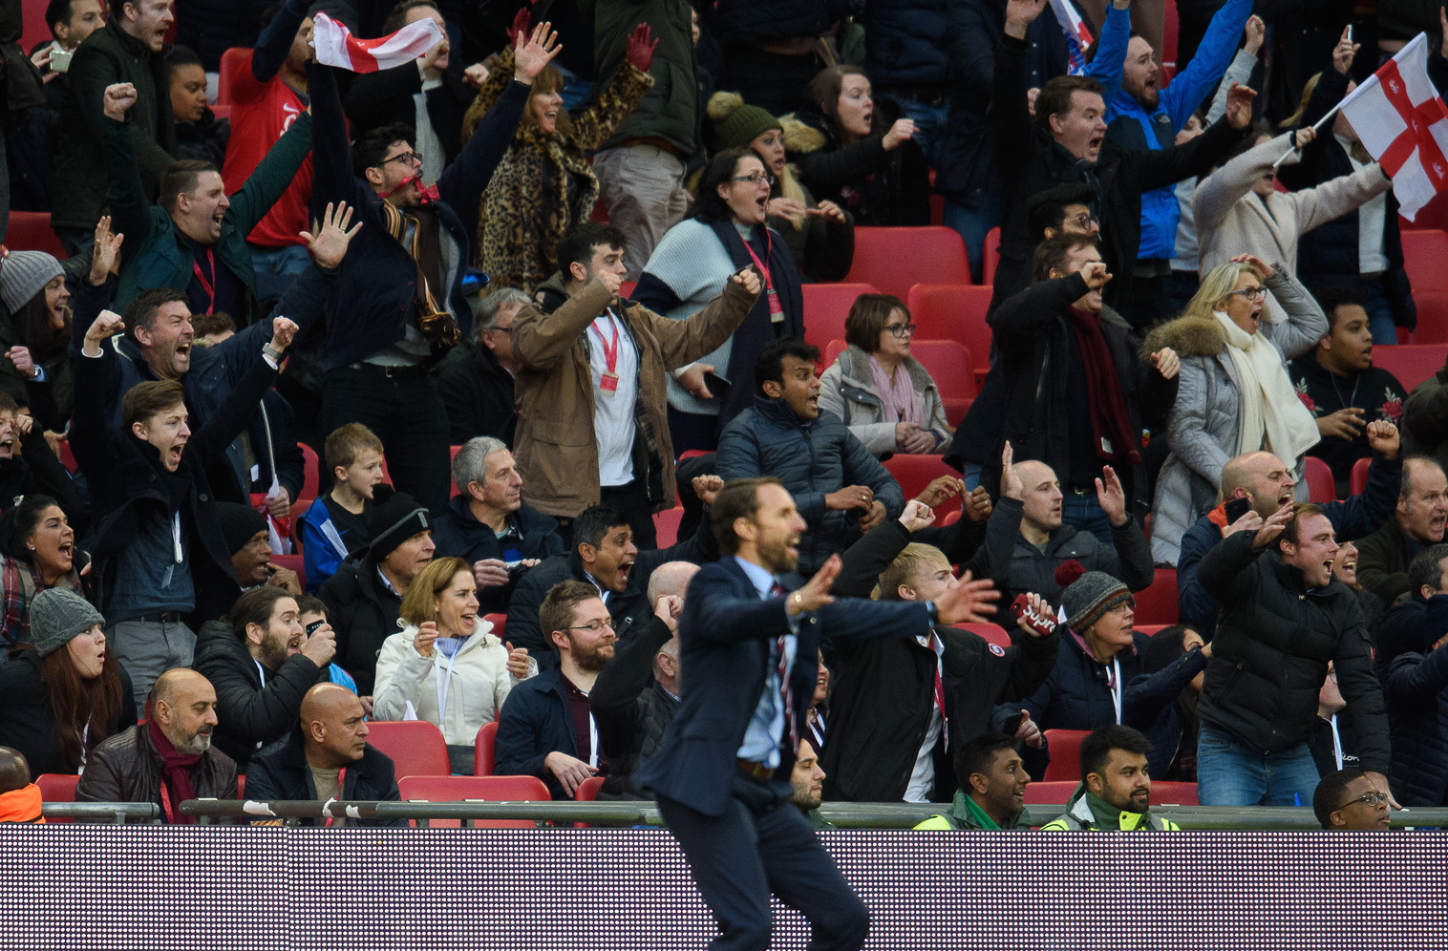
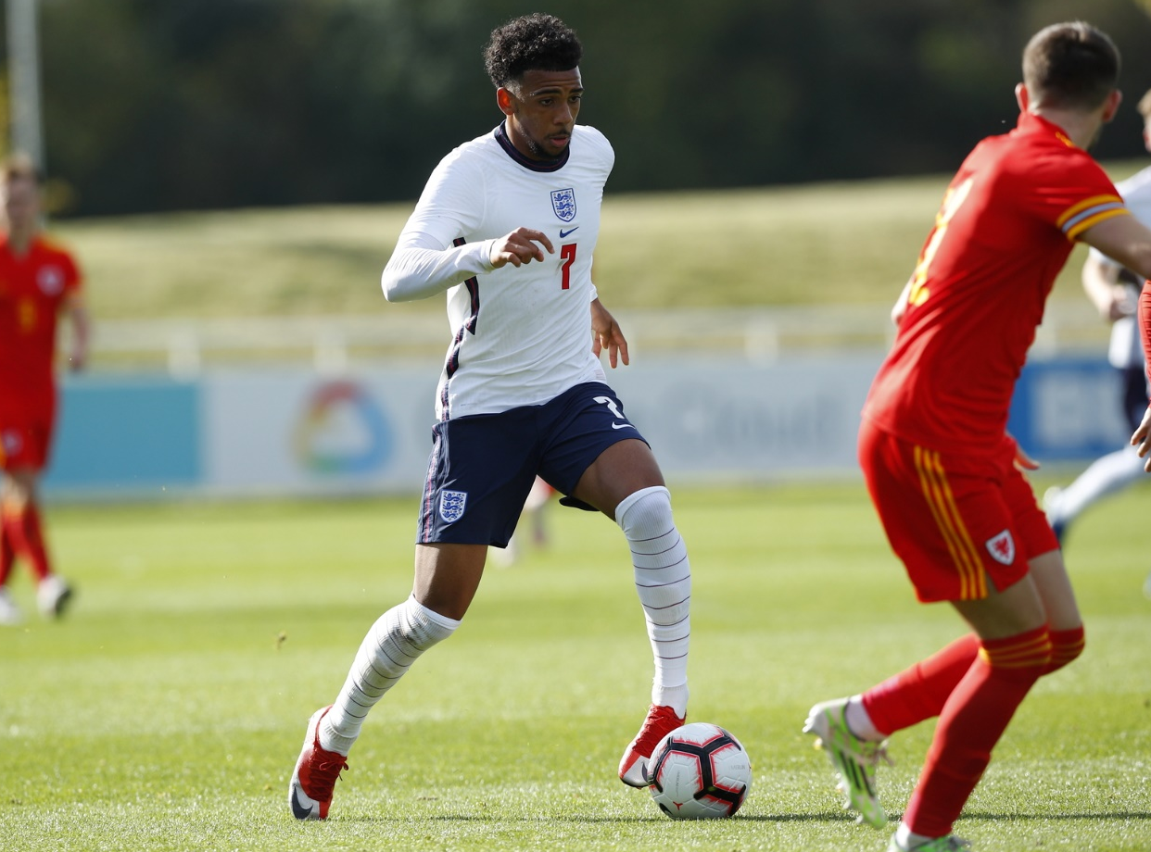
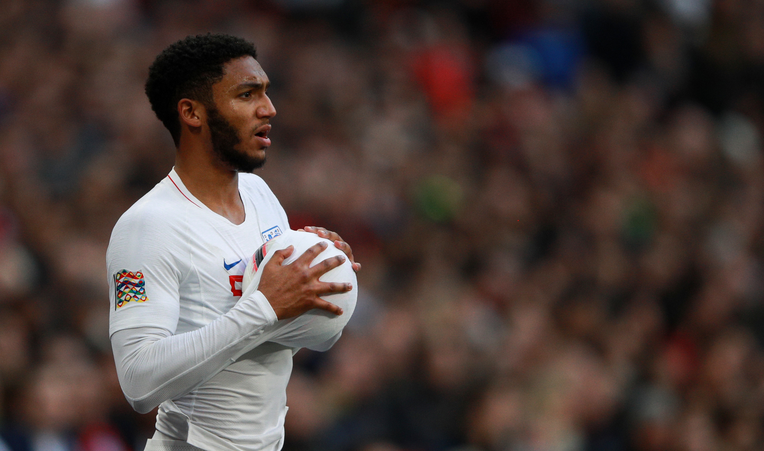
Starter: what emotion/theme is linking all these pictures?
Notes:
Teacher Notes
Discuss the different emotions shown in these images, and what links them.

Slide 4
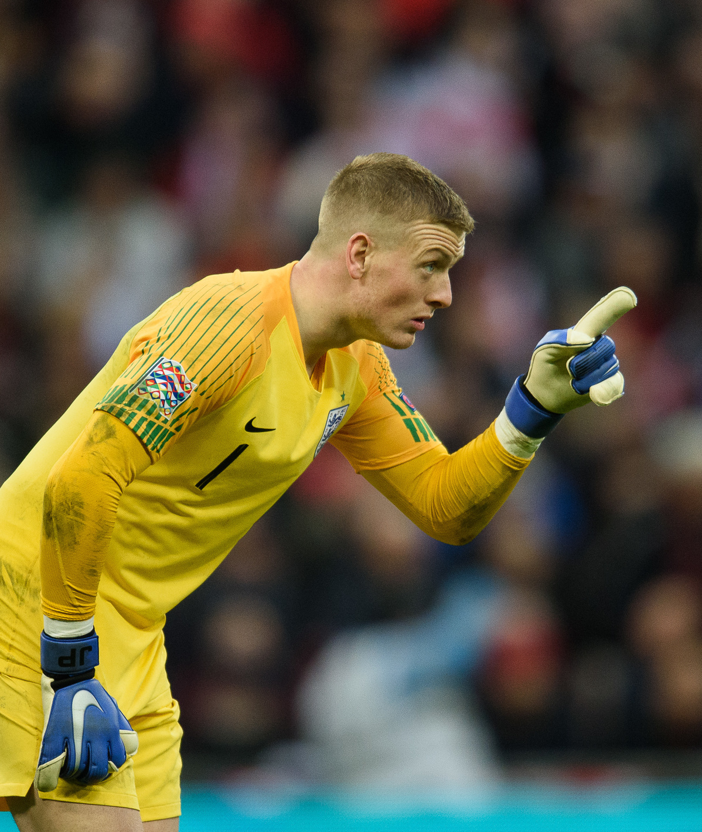
YOUR BIG QUESTION TO ANSWER IN Glasgow IS:
Stress – friend or foe?
Learning objectives:
To understand what stress is and recognise how it can affect our wellbeing.
To discuss how stress can be both positive and negative and how footballers manage stress.
To identify ways to deal with stressful situations.
Notes:
Teacher Notes
The big question to answer is a key point of the lesson.

Slide 5
What is stress and what is its impact?
Think, pair, share
Stress is the body's reaction to feeling threatened or under pressure.
Impact:
Can be positive and motivating to help us achieve things in our daily life, and can help us meet the demands of home, work and family life.
Can have a negative effect on wellbeing and make us feel anxious, overwhelmed and uncertain.
Notes:
Teacher Notes
Discuss when pupils have experienced or have seen other people experiencing stressful situations.

Slide 6
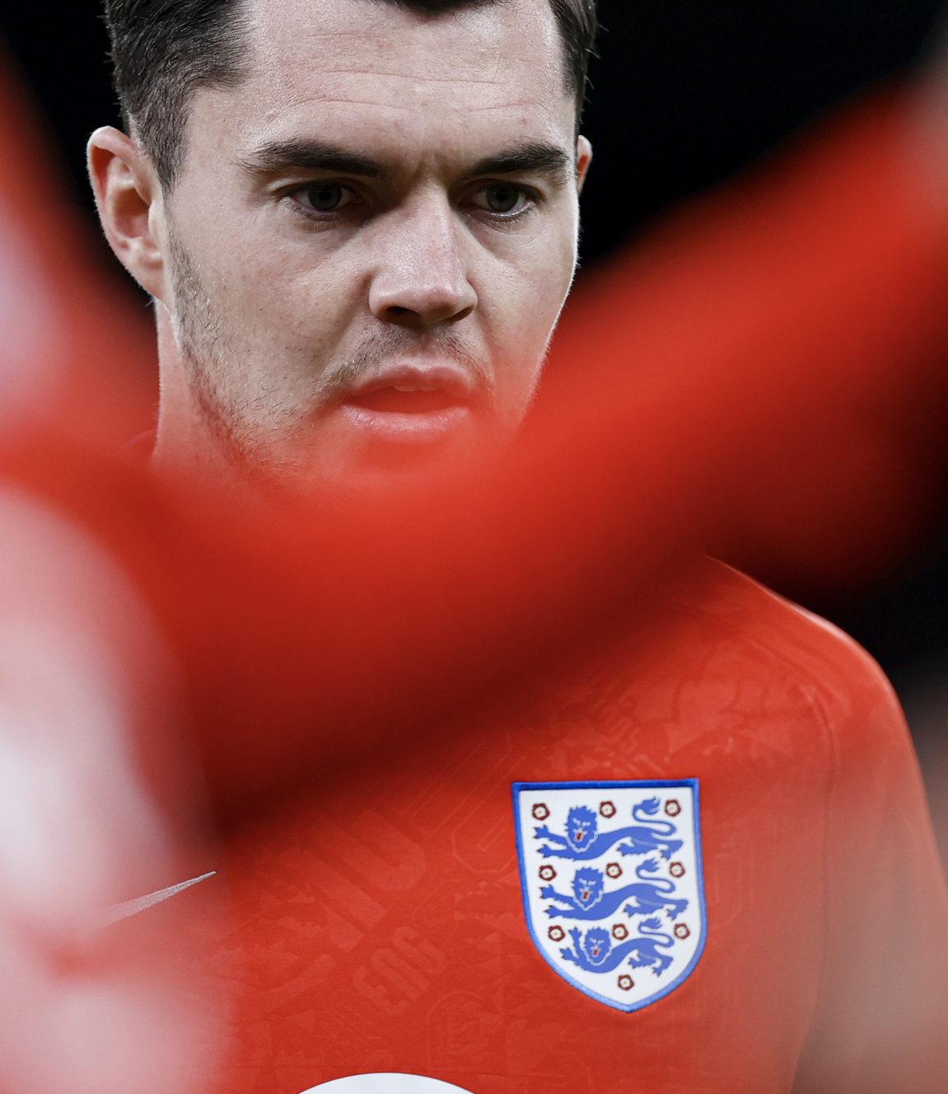
What stress is involved in football?
Think, pair, share
Unwanted media attention in the news and social media.
Pressure to perform and win from friends and family.
Busy schedule.
Players own high expectations – low self esteem, too hard on themselves.
Notes:
Teacher Notes
This could be done as a think, pair, share activity using situations they might have seen in the media as a prompt for ideas
Link to a news article: https://www.theguardian.com/football/2018/may/18/bojan-krkic-interview-anxiety-attacks-football

Slide 7
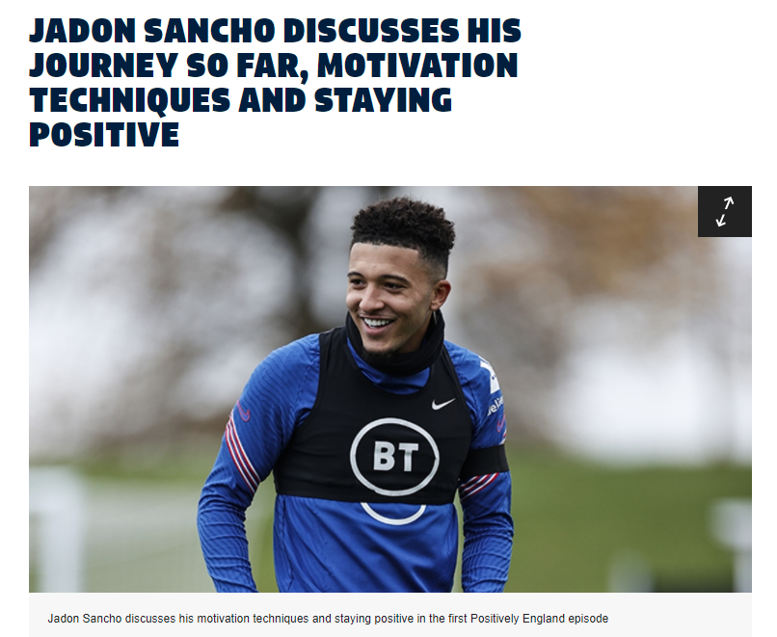
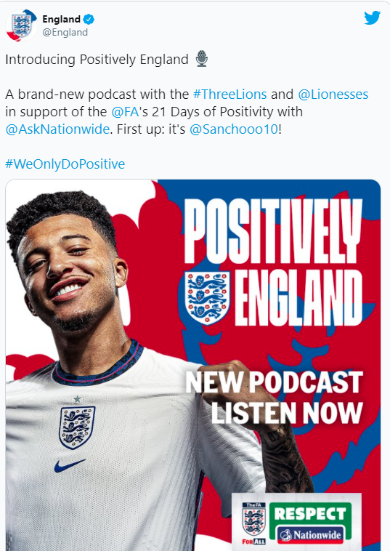
How do players manage stress?
Enjoy playing and have fun!
Have a positive growth mind set.
Think about what they can do next to improve rather than what they didn't do well.
Use teammates and younger players success to motivate their own progress.
Use set backs as a springboard to focus further development.
Notes:
Teacher Notes
Link to the full article: https://www.thefa.com/news/2021/jan/18/jadon-sancho-positively-england-20210118

Slide 8
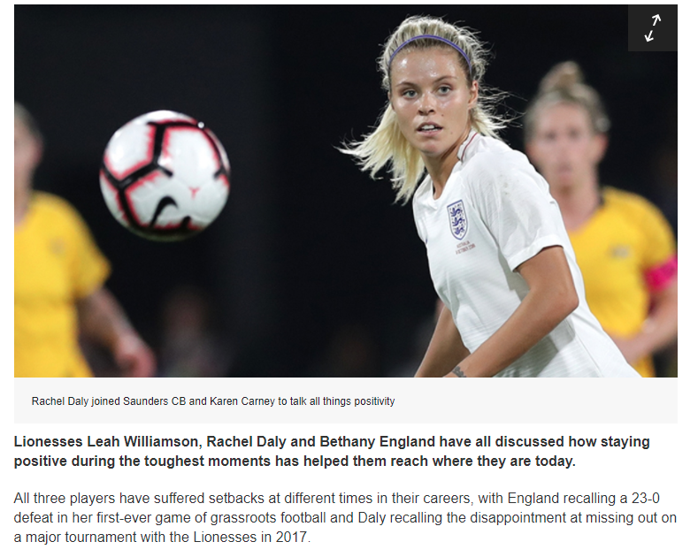
stay positive!
Notes:
Teacher Notes
The Football Association recently launched a podcast which is all about promoting mutual respect on and off the pitch. It features insightful and inspiring interviews with some of the stars from the England Men's and Women's teams, exploring how they maintain a positive attitude on and off the pitch.
Link to full article: https://www.thefa.com/news/2021/jan/22/lionesses-positively-england-podcast-20210122

Slide 9
Activity 1: footy in the middle
Aim: To kick the ball between the two passers with different numbers of interceptors and see how we feel.
Round 1: Two players (blue) stand opposite each other about 10m apart and pass the ball between them. Four passes back and forth. The players cannot move in front of their cone but can move in line with it side to side.
Round 2: A third player (red) stands in the middle of the two passers. Make a zone in the middle that the interceptor has to stay inside using cones. The passers continue to kick the ball to each other and the interceptor has to try and block the pass between the two players. If the interceptor blocks the pass they become a passer and swap places with the person who kicked the ball. Do this for approximately four passes.
Round 3: A fourth player stands in the middle (there are now two interceptors and two passers) and repeat the above.
Round 4: A fifth player stands in the middle (so there are now three interceptors and two passers) and repeat the above.
Round 1: 10m distance between passers
Round 2: Interceptor zone
Round 3: Interceptor zone
Round 4: Interceptor zone
Notes:
Teacher Notes
Split the class into groups of five (this can be more if needed). Each group will have two passers and the rest are interceptors. Teacher can choose passers and interceptors randomly giving each player in the group a letter (P or I).
Limit the number of passes per round (suggested four) so that the rounds pass quickly, and all members get involved by round four.
Gather groups up and then discuss questions based on each round. You may choose to stop groups after each round and ask the relevant questions then, or to complete all rounds and do the questions together at the end.
This activity is designed to increase in difficulty for the passers to successfully pass the ball.
Class management options: The class could be split into groups of five and do this at the same time, or it could be done by one group with others watching if limited space/time.
After each round stop and ask questions to find out how the pupils are feeling and about how easy was it to achieve the aim of kicking the ball from one passer to the other.

Slide 10
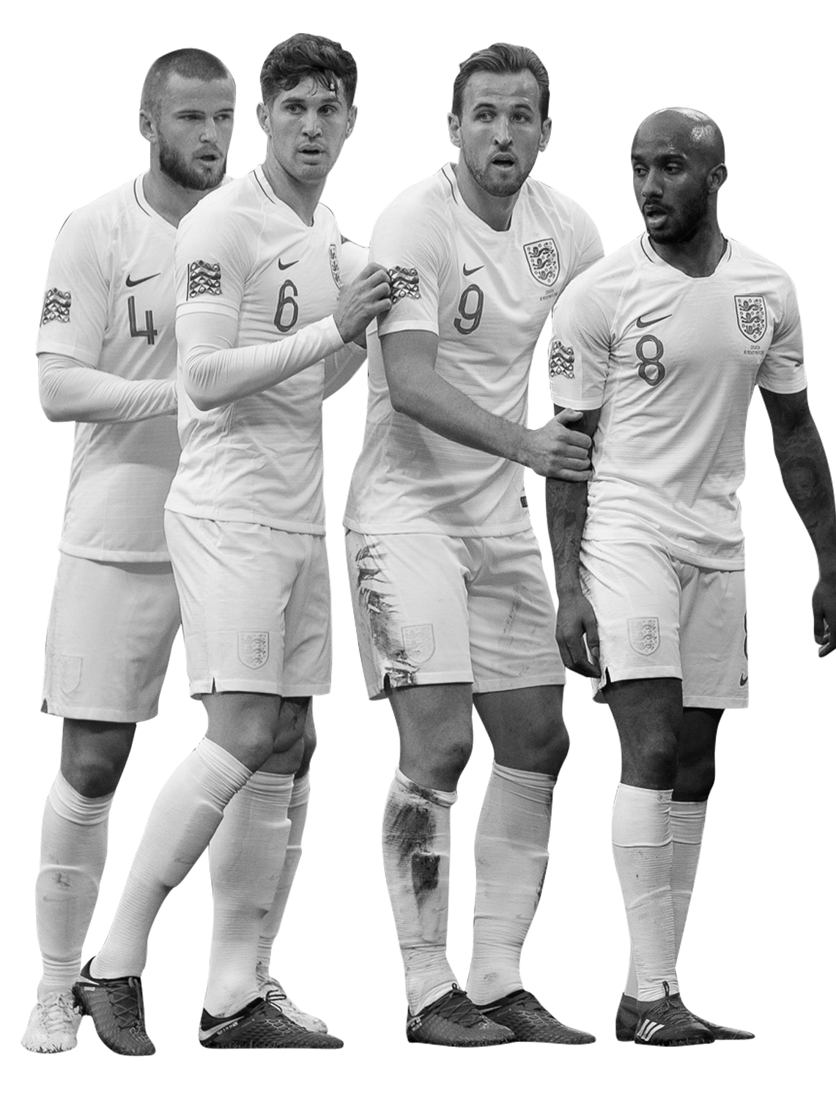
Discuss – think and share
Round 1 questions:
How successful were the passers at kicking the ball between themselves?
How did this task make you feel?
Was it easy/hard. Did it make you feel happy/stressed/annoyed?
Round 2 questions:
How successful were the passers at kicking the ball between themselves?
How did the passers feel about this round?
How did the interceptors feel in this round?
What did you do to manage any stress you felt in this game?
Round 3-5 questions:
How successful were the passers at kicking the ball between themselves?
How did the passers feel about this round?
How did the interceptors feel in this round?
What did you do to manage any stress you felt in this game?
See “feelings word bank” to help you.
Notes:
Teacher Notes
The questions are designed to get pupils to discuss their success and their emotions whilst playing.
The game is designed to increase the level of difficulty and therefore for some pupils this may in turn increase the level of stress they feel.
Some may feel it unfair as more interceptors are added in, others may enjoy the increased challenge. This may lead to a mix of answers to the questions about how they feel.
Responses my include frustration, anger and annoyance, or pupils may say they found it fun, challenging and exciting etc.
You could share the feelings word bank on the next slide to help pupils identify their emotions as some may find this hard to express.

Slide 11
Feelings
word bank
Happy
Sad
Unsure
Mad
Pleased
Proud
Confident
Calm
Friendly
Loved
Understood
Excited
Sympathetic
Fortunate
Hopeful
Content
Appreciated
Optimistic
Blue
Guilty
Ashamed
Embarrassed
Disappointed
Hopeless
Depressed
Miserable
Lonely
Remorseful
Left out
Unhappy
Discouraged
Sorrowful
Nervous
Worried
Scared
Shy
Insecure
Surprised
Shocked
Mixed up
Confused
Anxious
Stressed
Afraid
Uneasy
Annoyed
Disapproving
Fed up
Jealous
Determined
Disgusted
Frustrated
Angry
Furious
Impatient
Outraged
Offended
Aggravated
Notes:
N/A

Slide 12
What can we do to deal with stressful situations?
Notes:
Teacher Notes
Create a mind map in groups or as a class.
Pupils could write responses on sticky notes to add to a printed copy of the mind map, or they could create their own version of this slide to add ideas to.

Slide 13
AVOID
ALTER
Stressful situations E.g. allow more time to get to school! Avoid people who bother you. Say no – don’t take on too much.
Respectfully ask others to alter their behaviour. Communicate feelings – ‘I feel unhappy about what you said to me. Please can you…’
ADAPT
What can we do to deal with stressful situations – The four A’s
ACCEPT
Look at bigger picture – will this matter in a day, week or year's time? Stop gloomy thoughts – think positive - use a stress reliever/ball/toy to help you.
Talk to someone
Forgive
Be positive
Learn from mistakes
Notes:
Teacher Notes
Some suggestions here – click the boxes to reveal examples of each “A” underneath.
There are many different suggestions apart from the 4 A’s. This is just an example you may want to show the class.
https://www.mayoclinic.org/healthy-lifestyle/stress-management/in-depth/stress-relief/art-20044476

Slide 14
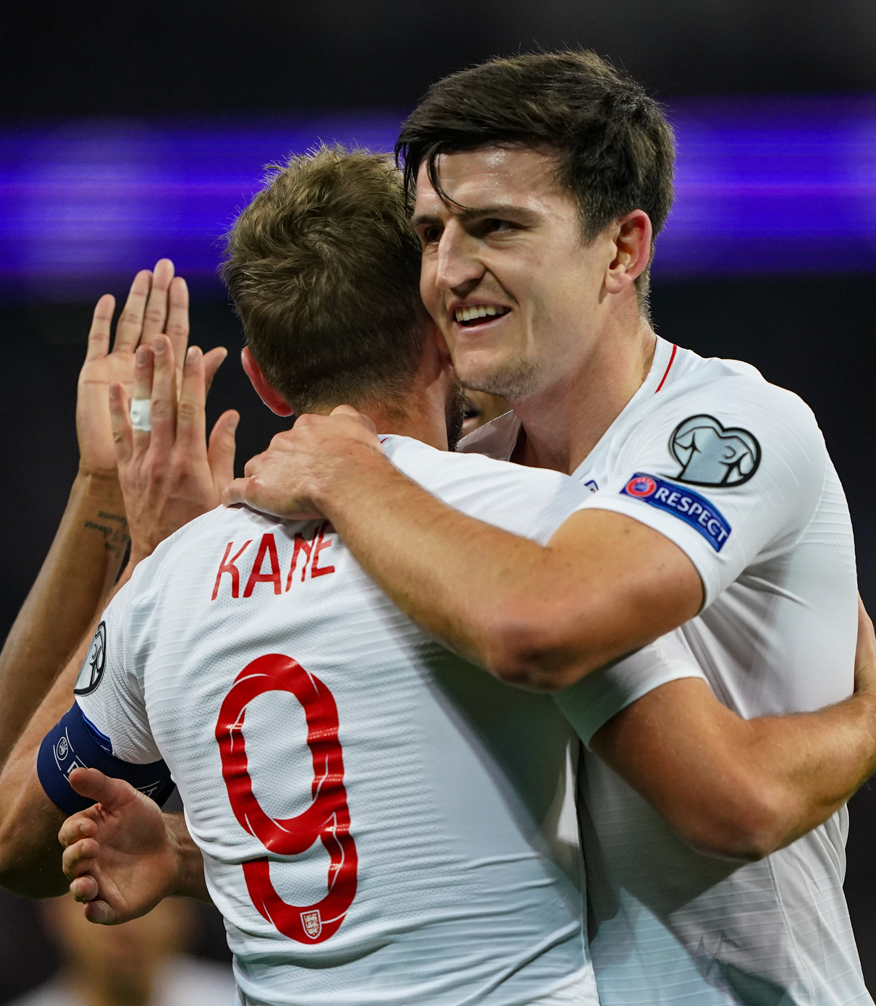
Activity 2: make a de-stressing football!
Decorate your balloon with a football theme.
Fill your balloon with corn starch and water using a funnel or cut the top off a disposable plastic drinks bottle.
Tie the balloon securely and squeeze gently.
Take care not to over squeeze your balloon or dig your nails into it as you could puncture your stress ball.
Watch this clip for tips on making your own stress ball
Notes:
Teacher Notes
There are many clips/methods to make a stress ball. Here are two clips, one using a balloon and one without.
The balloon method is very simple and easy to follow but take care to use a good quality balloon that is not old or the rubber may break and the contents leak - https://www.youtube.com/watch?v=ndp2gq6wveM or https://www.youtube.com/watch?v=gHOp22_Sjqg.
Balloon free method: https://www.youtube.com/watch?v=k38wlQjzJD8.
Remember to risk assess any practical work you do with your group and read any advice on bottles of substances used. Wear goggles if necessary. Wash hands. Ask pupils to bring in a plastic pot to store their stress ball in (empty hummus pots and lids are great for this).

Slide 15
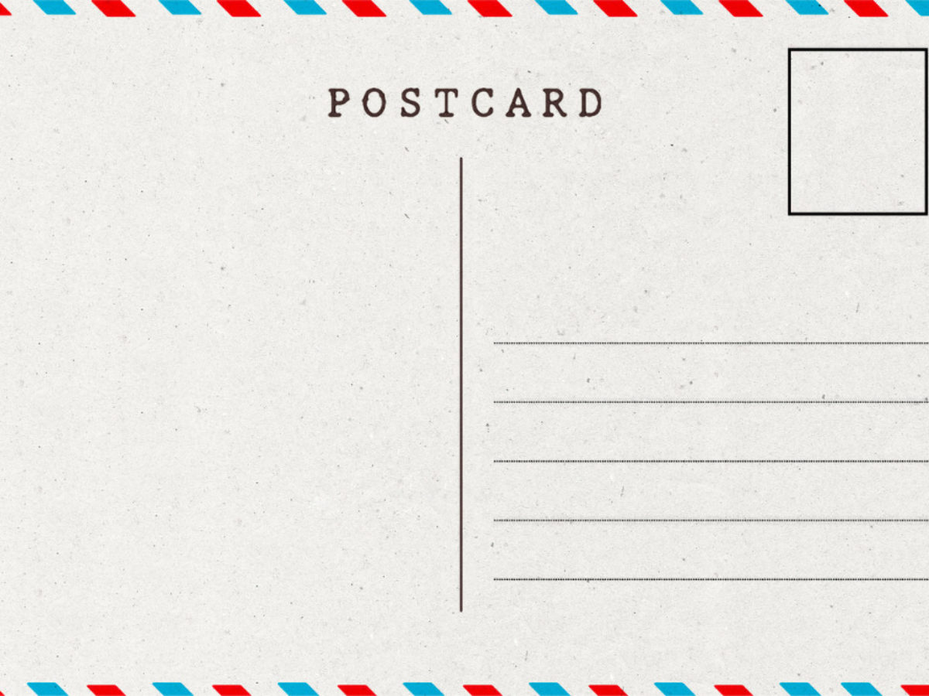
Let’s write home
Write a postcard home saying what you have learnt about stress.
Can you include:
What stress is and how it can affect us.
A description of how footballers manage stress.
Suggestions for ways to deal with stressful situations.
Where are we going next?…..
Notes:
Teacher Notes
Students to consolidate their learning within this section.
Linking back to the big question.

